Slide 1
A Handful of Best Practices for When you are Asked to Teach a Community Group…
“Teaching 101”
Ryan A. Gise MD, Elizabeth Seashore MD

Slide 2
“Do Now”
Think about some experiences you’ve had teaching, prior to and during your residency career…
What are 2 “Do’s” and 2 “Don’ts”
of teaching?

Slide 3
OK, Let’s Get Going…
Our Rules
Why are We Here Today?
Objectives of the Day
Assessing the Audience

Slide 4
Always Start with RULES!
If your ASCOM rings…
Respect each other’s inputs
Learn from each other
Have some fun with us ☺
Notes:
As we will get to later… any group discussion should start with rules…
Here are ours for today.
1. ASCOM rings… this is not your fault, just please leave quietly to answer it.

Slide 5
What is this Teaching 101??? Why are we here today???
So you went to MEDICAL School…
…But all you really do is TEACH…
BUT nobody really taught you HOW to teach, RIGHT?
Notes:
This is my thought process behind this project…

Slide 6
Teacher = Doctor
The origin of the word Doctor comes from the Latin word “Doceo” (Pronounced Do.ke.o)
“Doceo” = I teach, instruct; tell, inform; show, demonstrate.
Notes:
And that is too bad that nobody taught you how to teach because its in your job title that we all are so proud to have!
You may note as well that nowhere in this definition does it state –I prescribe medications or I heal others, etc…

Slide 7
Aren’t The Best Doctors You Know Also the Best Teachers???
Just think of the ones you know…
We won’t name names, nor do we play favorites…

Slide 8
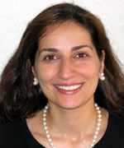
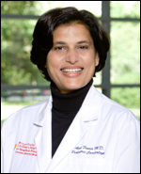
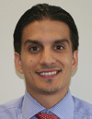
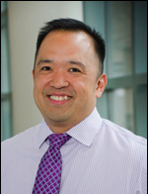
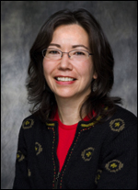
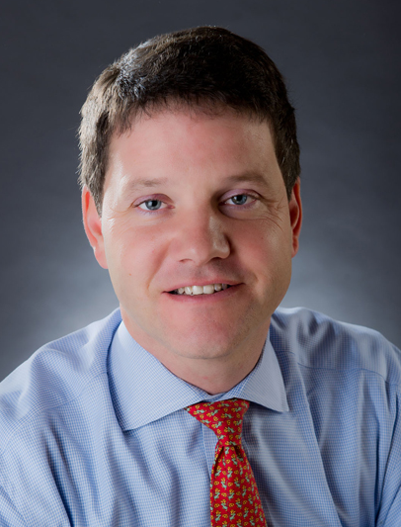
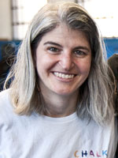
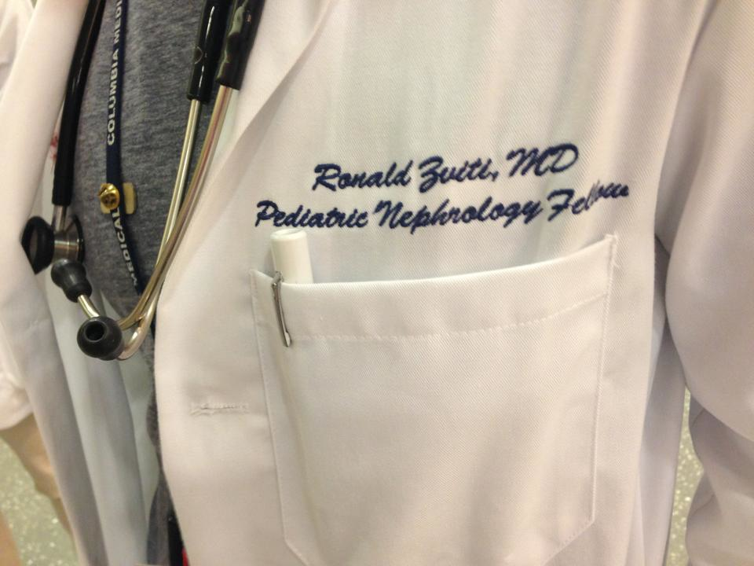
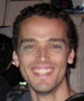
YOU!
Notes:
…And The List Goes ON here at CHONY…

Slide 9
The Way We Think About It…
Resident = Teacher
#1 – Trainees & Colleagues
#2 – Patients & Families
#3 - Community at Large
Notes:
So here is the way I think about this…

Slide 10
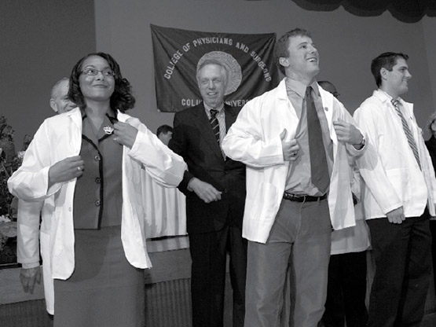
#1 – Trainees & Colleagues
Notes:
Classically – the resident teaching a med student or a resident teaching an intern.
But also think about a resident explaining a treatment plan to an RN or a cardiology attending explaining the risks of myocarditis given an abnormal ECG finding in your patient. We are always teaching each other.
Other examples – Sign Out, Chief of Service, Grand Rounds, Noon Conferences, etc…

Slide 11
#1 - Drs. Mutnick & Paik
Thankfully, we have Andrew and Steve
They model finding time to teach on the busy wards, meeting students where they are at, finding that teachable moment and…
Our favorite topic… The Feedback Sandwich!!!

Slide 12
The Way We Think About It…
Resident = Teacher
#1 – Trainees & Colleagues
#2 – Patients & Families
#3 - Community at Large

Slide 13
#2 – Patients and Families
OUR DAY JOB!
Ex: Asthma Action Plan, Weight Loss Strategies, Carb Correcting, What is a Milk Protein Allergy, etc...
Non-compliance & Non-adherence…
We need to own this better
Simple Language
Better Teaching = Less Morbidity
Notes:
Patients are non-compliant, or non-adherent…
I challenge us to think more along the lines of……… How about we didn’t teach them well enough!!!
Its easier to blame, harder to self reflect on the fact that teaching asthma to low health literacy population is really challenging! We need more skills here. A topic for another day perhaps…
This is the resident goal of Bedside rounds – to bring residents to a level of excellence with their roles as teacher of their patients and patient’s families.

Slide 14
The Way We Think About It…
Resident = Teacher
#1 – Trainees & Colleagues
#2 – Patients & Families
#3 - Community at Large

Slide 15
#3 – The Community
Why we are here today!!!
You have required and voluntary community teaching opportunities
We think these opportunities are a great way to refine your overall teaching skills!
Notes:
Lang, NY Foundling, Healthy Schools/Healthy Families
Arash’s/Daniel’s Mentorship Program, with new second years

Slide 16
Today’s Objectives
C – CHONY
R – Residents
W – Will
B – Be
A – Able
T - To
Notes:
LANG Format
Thus… today’s Objectives…
By the end of today…

Slide 17
CRWBAT…
1. Learn about the current opportunities you will have to teach in our community during your time at CHONY. (8 mins)
Focus on Lang / Doctors in Training
2. Understand our desire to standardize lesson plan formats despite changing resident teachers. (5 mins)
3. Approach their community teaching experience with little anxiety to ensure a successful session for you and your learners. (2 mins)
Notes:
Call attention to time allotment

Slide 18
CRWBAT…
4. Appreciate some of the many hands-on strategies we use to teach and assess student understanding. (15 mins)
5. Apply understanding of above by reviewing an Actual DIT lesson. (5 mins)
6. Use this lesson as a foundation AND a reference tool to make your community teaching session and future teaching opportunities more successful. (2 mins)
Notes:
Objective #4 – AKA “Best Practices”
Objective #6 - This will be posted on the CP website.

Slide 19
www.communityped.org
username: community
password: pediatrics

Slide 20
Objective #1 – Community Teaching
Lang
NY Foundling
Healthy Schools / Healthy Families
Notes:
NY Foundling – Hospital for foster children
HSHF – Large comm peds initiative to help guide schools towards healthy living – asthma, vaccines, nutrition, etc

Slide 21
Lang “Doctors in Training”
Notes:
The Lang Doctor’s In Training Program

Slide 22
What is the Lang Program?
Background –
6 years (7-12th graders)
Local Community scholars
Educational support (SAT prep, mock interviews…)
Extracurricular activities (DIT, College visits…)
Mentorship (NYP Staff, Med Students, Peers…)
All with the goal towards fostering a career in health sciences and / or community leadership.
DIT Audience –
12-14 HIGHLY MOTIVATED, Bright, 7th graders

Slide 23
Lang “Doctors in Training”
Program started 4 years ago as CP Project
Continued effort to enhance the curriculum to help students improve critical thinking, gain health literacy and learn “doctoring skills”
Notes:
Key Aspect of Program - While each lesson has a heath issue theme, the real goal of the Doctors In Training Program is to teach our Lang Scholars a hands on “doctoring skill” (e.g. How to read a basic x-ray, how to teach a family an AAP, how to carb count and order the correct amount of insulin, etc...).
This year’s topics are organized in threads and are based on feedback from the last 3 years.

Slide 24
Lang in the Literature!
Michael Goldman’s abstract entitled
“Cultivating the Resident-as-Teacher Through Community Partnership Yields Dual Benefits”
has been accepted to the Pediatric Educational Excellence Across the Continuum (PEEAC) 2013 Meeting this October!

Slide 25
What is Your Role???
All PGY2’s will have opportunity to participate, some are “required”
Our Expectations–
Review the material
Communicate w/ RG or SB
Practice your teaching skills
Increase comfort level with teenagers
…and HAVE FUN!***
Notes:
Your role - You will be provided with a Lesson plan and all necessary supplies. You are expected to review the lessons in advance of your session and contact Michael, Ryan or Sandhya with any questions. While these lessons are written in advance, you are expected to review the activities, practice your questioning technique and practice organizing the actual activity prior to the lesson so that it all goes smoothly.
Our Hope for Your experience with Lang DIT-
*** Have fun! Enjoy being out of the hospital and working with an incredible group.
***Best advice I got from my principal when I was struggling as a new teacher… work with the kids in a different setting! This inhibits burnout!

Slide 26
Objective #2 – Standardizing our Lessons
Discipline
Using Objectives
Timers
Notes:
The things I am TRYING to model here today…
One of the goals of this talk is to make sure WE are all on the same page with the format of how we hope to deliver our lessons each month.
In sum, the experience for the kids should really be the same regardless of who is delivering the lesson!!!!

Slide 27
It All Starts With Discipline
Respect
Confidentiality / Trust
Raise your Hands
Listen and Learn from Each other = Teamwork!
Notes:
There was a reason why I started with “RULES” – WE start all of our lessons reviewing our Lang Rules.
Discipline / Set Expectations for HOW your session is to be run.
-As the guest teacher, the group is going to be happy you are there, interested in what you have to say and well behaved! THANK GOODNESS!!!
-While this is a fortunate starting off point, you still need to take control of the classroom!
-Therefore ALL lessons must start with how you want your students to act! -Always re-emphasize the current rules/regs of the class and post them. If none are posted, use these! Ask the kids to give you the Lang Rules!!!
i. Respect - Stress to your class that we learn from asking the “dumb question” and often that question is in someone else’s mind, too.
ii. Confidentiality / Trust - this is often topic dependent how much this must be stressed, but in general is good to address.
E.g. If someone in the group decides to share an anecdote about their grandpa’s struggle with diabetes, that person should feel confident to know their story is safe in the group. This mentality should encourage more audience participation!
iii. Raise Your Hand - raising your hand to talk sounds quite elementary but it addresses the fact that it is a courtesy to wait for the prior person’s question to be addressed before asking your own.
iv. Listen and Learn from each other - This emphasizes your expectation of audience participation – your peers are a wealth of information and your best teachers.
-Keep this discussion short and easy to follow - don’t use more than 5 minutes on this, but DO spend 2-3 minutes on this!

Slide 28
Always Post Your Objectives
Serves Two Major Purposes.
Tells the audience what you are going to tell them.
A roadmap with a timer!
Helps build from factual knowledge → application of knowledge = promoting higher order thinking.
Build excitement for where your map ends.
Notes:
MODELING... REFER AGAIN TO HOW WE ARE ADVANCING THROUGH OUR SESSION’S OBJECTIVES and HOW WE STARTED TODAY REVIEWING OBJECTIVES!!!
Tell ‘em what you’re gonna tell ‘em AND tell them what they will be able to do when you’re done.
-This is why we write them as “SWBAT” format.
-This not only keeps you organized as the teacher (especially when using a timer) but it keeps your audience’s eye on the prize.
-They also realize that they have to master the first objective to be able to move onto the second and so on... (higher order thinking)

Slide 29
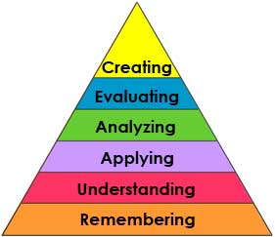
Bloom’s Taxonomy
Notes:
A teaching theory describing how learning at the higher levels is dependent on having attained prerequisite knowledge and skills at lower levels

Slide 30
An Example From a Lang Lecture… “Healthy Eating”
LSWBAT #1– Lang Scholar Will be Able to – explain energy needs and energy consumption (Energy in = Energy out) – (5 mins)
LSWBAT #2 - Identify healthy diet and exercise choices in daily life (10 min)
LSWBAT #3 – Analyze their own healthy choices - (15 mins)
LSWBAT #4 – Create an advertisement about a healthy lifestyle concept – (25 mins)
Notes:
Note how objectives serve as a guide for what is coming and the time allocation sheds light on the amount of emphasis on each objective.
2. Note also how Objective #4 = Most time allocated 20 mins – the objective that elicits higher order thinking.
-This is the part of the lesson the class will remember and be excited about.
-Contrast that with Objectives #2 and 3 – 7 mins each – which is the potentially boring, but necessary factual part of the lesson that you can cover quickly and must be addressed before attempting to master the final objective / DIT task
***In sum, YOU can TALK through Objective #1 in 2 minutes. You will want to allow for more time to teach and practice the DIT task.

Slide 31
The Time will Fly!
Notes:
MODELING... Refer to the timer we’ve been using all session!
The Time Will Fly!
Use a timer!
Our brains are terrible timekeepers when we are even the slightest bit stressed!
And we don’t want to waste too much time on the early stuff causing us to rush through the higher order / fun stuff.

Slide 32
Objective #3 – Reduce Resident Anxiety
Be Prepared…
Notes:
PLEASE!!!!!
We realize you are incredibly busy people. The last thing we want to do is add stress!
But preparation is 75% of the work in teaching!
Don’t let anyone ever tell you teachers have great hours!
Lazy teachers have great hours!!!

Slide 33
Preparedness…
Notes:
This is NOT an easy job!!!
Anxiety is a symptom of being underprepared or scared of the unknown!
A lot of the survey questions you answered this week were about being prepared….
-This is another reason we are here today, we’d like to PREPARE YOU… to set you up to succeed!

Slide 34
Our goal for your experience!

Slide 35
The Antidote to Teaching Anxiety
Review your lesson ahead of time
Collect supplies from Ryan or Liz (one of us will be present at most lessons)
Practice your questions and activities (make notes)
Reference this PowerPoint!
Notes:
-PLEASE, PLEASE look at your lesson ahead of time. They will be on the CP website.
-Contact your curriculum developers (Michael or Sandhya) with any questions and to get supplies!
-Practice your questioning style and your activities so you are the expert in the room and to troubleshoot.
(E.g. If you are teaching carb correcting, go on the website and do the practice problems before you ask your class to do it). -Review this PowerPoint prior to your lesson! Also will be on CP website.

Slide 36
Objectives #4 – Some Best Practices ☺
Notes:
We have covered some of these already and have been trying to model them throughout the session.
e.g. Rules, Assessing your Audience, Objectives, Timers, Being Prepared
So We will now use the rest of the session to model some general best practices that way when you see them on your lesson plans you can know what they are or reference this PowerPoint to re-familiarize.

Slide 37
Best Practices…
Rules, Assessing your Audience, Objectives, Timers, Prepare!
Starting a Lesson with “Do Now”
Questioning Techniques
Demonstrating Understanding with Fun Activities
Infusing Cultural Competency
Bringing it All to a Close

Slide 38
How to Start a Lesson? Do Now!!!
Two goals:
Catch the audience’s attention
Assess your audience’s prior knowledge
Some examples we often use:
What I know… What I think I know… What I want to know
Sharing Anecdotes
Case Based!
Notes:
MODELING... We did this in the beginning of our session today! We know many of you have great experiences teaching that this lesson can only hope to build upon.
Know your audience - e.g. teaching diabetes to 8th graders is different that teaching it to a bunch of med students which is different from a room full of teachers.

Slide 39
Open with a Case!!!
Works for us, right?
Here is way to phrase a case scenario when teaching a community group.
You are walking in the park with your friend who you know has asthma. Suddenly she looks as if she is having trouble breathing…
What do think you should do first?
Notes:
Keep a list of responses, refer back to them at the end of the lesson.
THEN at end of the lesson, state the case again… would anyone change their answer????
Note how case language is different from how we do cases, but it still works!

Slide 40
Questioning Techniques “Less is More”
Avoid being Charlie Brown’s teacher!
Question Ping Pong does not mean YOU always have to hit the ball back
Ask the audience to answer the question
Dr. Mutnick has skills in this! →
“What do you think of what she said?”
Notes:
Use these strategies when you are communicating the factual information. Make it interactive!
Encourage the kids to summarize what you are teaching frequently - ping pong
Encourage kids to respond to each other’s questions
Your audience is a fantastic resource… use them!
This technique is how we urge you all to march through the early, lower order thinking objectives.
Hearing Crickets??? Its OK. Either rephrase (assume you asked it wrong) or just give it time (easier said than done).

Slide 41
“Less is More” Examples of Ping-Pong Questioning Technique
1. The question you’ve already answered…
2. The thought provoking question…
Notes:
Ex. At some point during your Lang asthma lesson you are defining airway inflammation and bronchospasm. Someone in the audience asks the question, “can you explain the difference between the two again? I think I’m missing something…”
-Instead of just regurgitating what you have already said, maybe a classmate has a better way to explain it to their peers?
2. Ex. A question comes from the audience during your asthma lesson… “so you tell me these medicines work so well, right? But why do so many kids miss school for asthma???
-You may have your theories here, but perhaps more interesting is what the community thinks…
-Redirect this question to the audience to spark some debate / dialogue / audience participation.
-What is pretty cool is when your theories surface without you saying them
e.g. I bet they don’t think its cool to carry around those big pumps…

Slide 42
Learning Should be FUN!
…And TEACHING Should be FUN Too!
In our lessons we encourage ways to demonstrate understanding of our lessons via fun, hands-on activities.
Assessment does NOT equal test!
But assessment IS always necessary to see what needs reinforcement before moving on to the next objective
Notes:
These activities are Fun for you as the teacher because
– You are off stage
– You get to walk around and work with the kids individually
– You can step back and see where you started and where you have been able to take your group in less than an hour!
– Not to mention, people hate tests… so we don’t give tests… THEREFORE… they like us!

Slide 43
Demonstrating Knowledge Through Having FUN
Two examples for RESIDENTS today…
Think… Pair… Share…
Response Cards
Notes:
The next two examples are NOT taken from the Lang lessons, rather they are meant for you guys to have some fun – MODELING...

Slide 44
Think… Pair… Share…
Helps stimulate both independent thought and allows students to work together.
Set a time limit for each step!
Assign one student to be the scribe to record the “shared” ideas.
Notes:
-This is helpful when you want to stimulate both independent thought and have some time for students to work together.
-Important to have a set time period for each part of “think, pair, and share”. It is often helpful to have a stopwatch!
-Think about the physical setup of the room before starting this exercise, often times it is helpful to have students sitting in pairs prior to this exercise.
-You can assign one student to be the scribe at the front of the classroom to record the “shared” ideas. This way you are not facilitating the lesson and trying to write everything down at the same time.

Slide 45
Think...Pair…Share An example for Residents
Case Presentation:
You are working in the ED and your first patient is a 6-month-old girl, no PMH, who presents with one week of increased work of breathing, poor feeding, and seems fussy to the mother.
Think: What differential diagnosis are you creating in your head as you walk to the exam room?

Slide 46
Think…Pair…Share
Think: 1 minute
Write down your differential, be complete!
Pair: 1 minute
Turn to your neighbor and discuss your DDx.
Share: 2 minutes
Call on a few groups to share.
Notes:
DDx = Differential Diagnosis

Slide 47
Response Cards
Everyone gets two colored cards
The cards have opposite meanings (Y/N, T/F)
Ask pre-thought out Q’s with one word A’s
This assessment activity is GOOD for:
Getting shy learners involved!
Discussing *sensitive* subjects
Encouraging discourse
Utilizing audience’s competitive side
Notes:
-Good exercise if you need the group to stay quiet.
-Can be a good tool to get shy learners involved!
-Can be a good tool when dealing with sensitive subjects.
-Can also be used to encourage discourse in the classroom about divergent opinions or thoughts.
-Can make competitive or into a group exercise – teens love competition!

Slide 48
Question 1:
The best treatment for a human bite, where skin is broken, is amoxicillin.
True (green) or False (red)
Question 2:
The best rotation of intern year at CHONY is Cardiology.
True (green) or False (red)
Notes:
Then ask the group to debate, or have one individual clarify the right answer
Again, a good one to ensue debate
Also really great to see if majority are getting your material you have covered!!!

Slide 49
Other Assessment Tools We Use…
Jeopardy & Scattergories
Role playing – we have the Lang kids practice managing the acute asthmatic in teams.
Journal entries – Writing prompts
Optional E-mail Homework / Discussions

Slide 50
Infuse Cultural Competency
This can be a lesson in itself, but keep this in mind when working with Lang
We always try to weave CC into our lessons:
As you all well know, different cultures have interesting and often differing ideas about the topics we cover…
Healthy diets
Body image
Relationship / Trust with the medical field
Stigma of mental health issues
Higher education
Notes:
In sum, remember that the community’s foundation of knowledge for a topic you are discussing with them may be completely different or very sensitive for them to discuss with a guest teacher. Thus before going into a teaching situation, always know your audience and ASK them to teach you first!

Slide 51
Objectives #5 – Review An Actual Lesson
What you will be provided with,
What you will need to prepare

Slide 52
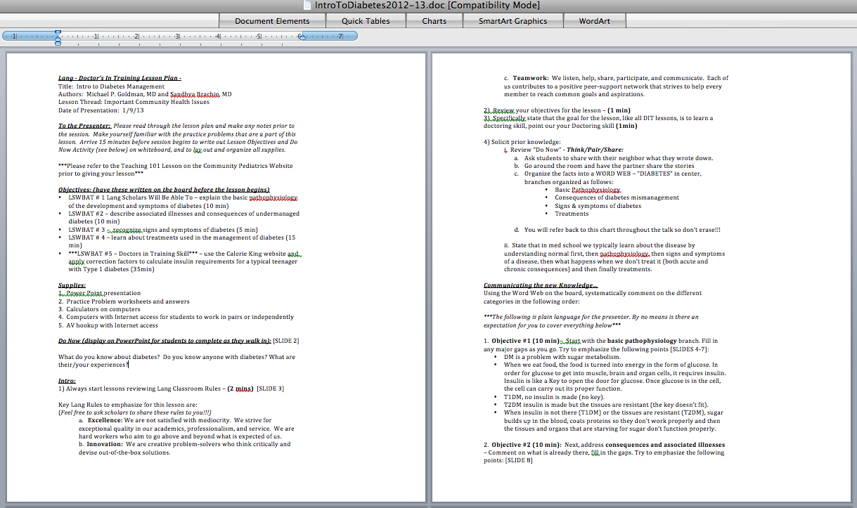

Slide 53
“Intro to Diabetes”
Notes:
Most, if not all are of our lessons will also be accompanied by a ppt document –
THIS is NOT the lesson, nor is it to be used as anything but helping audio/visuals be displayed...
We are not there to give ppt talks. We want them working / contributing / hands-on!

Slide 54
“Intro to Diabetes” Visuals
Notes:
Use this instead of making 15 copies…

Slide 55
Bringing it All to a Close
Review lesson’s objectives
Review your intro activity
Always leave room for questions
Notes:
Shows the group where you went during your lesson

Slide 56
Check Out What we Covered!
1. CRWBAT – Lang / DIT and others
2. CRWBAT – Standardizing our lessons
3. CRWBAT – Decrease resident anxiety
4. CRWBAT – Appreciate some “Best Practices”
5. CRWBAT – Review an actual lesson
6. CRWBAT – Lay a foundation, reference tool
Notes:
MODELING: Always good to end your lesson reviewing the objectives… where you started, where you got to.

Slide 57
Intro Activity: Do’s and Don'ts of Teaching
How did we do?
Notes:
Hopefully we left a list on the board to compare with

Slide 58
Questions?
PLEASE email if you want to help with Lang / DIT!!! doctorsintraining.lang@gmail.com

Slide 59
Sincere Thanks!
Marina Catallozzi, MD, Ms. Monica Hidalgo, Ms. Sharon Kim, Ms. Maria Molina
AS and PF – Our Rockstar Chiefs
Andrew Mutnick, MD and Steve Paik, MD
All of you!!!!!

