Slide 1
Yeti Operations
Introduction and Day 1 Settings

Slide 2
Rob Lane
HPC Support
Research Computing Services
CUIT
hpc-support@columbia.edu

Slide 3
Topics
Yeti Operations Committee
Introduction to Yeti
Rules of Operation

Slide 4
Yeti Operations Committee
Determines cluster policy
In the process of being set up
In the meantime we need a policy for day 1 of operations

Slide 5
2. Introduction to Yeti

Slide 6
Final Node Count
Node Type | Number of Nodes
Standard (64 GB) | 38
Intermediate (128 GB) | 8
High Memory (256 GB) | 35
Infiniband | 16
GPU | 4
Total | 101

Slide 7
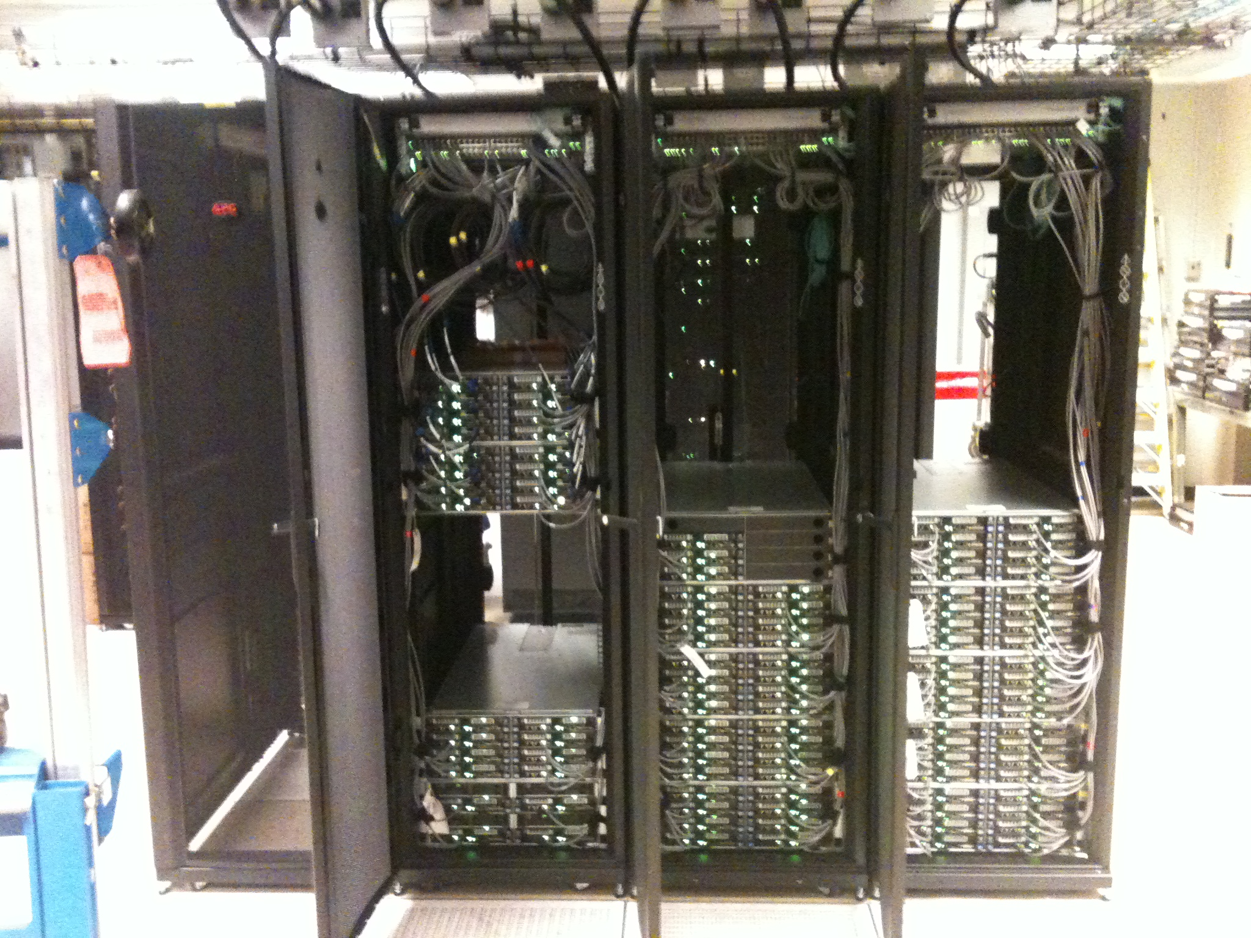

Slide 8
Meet Your New Neighbors
Group |  | Group
afsis |  | ocp
astro |  | psych
ccls |  | sscc
eeeng |  | stats
journ |  | xenon

Slide 9
Group Shares
Group | Share % | Group | Share %
afsis | 2.12 | ocp | 10.60
astro | 6.36 | psych | 2.12
ccls | 19.43 | sscc | 19.08
eeeng | 2.12 | stats | 33.92
journ | 2.12 | xenon | 2.12

Slide 10
Other Groups
Renters
Free Tier
CUIT

Slide 11
Rules of Operation
Job Priority
Job Characteristics
Queues
Guaranteed Access

Slide 12
Job Priority
Every job waiting to run is assigned a priority by the scheduling software
The priority determines the order of jobs waiting in the queue

Slide 13
Job Priority Components
Group’s share vs. recent usage
User’s recent usage
Other factors

Slide 14
Recent Usage
What does “recent” mean?
It’s configurable
Yeti’s setting: 7 Days

Slide 15
Job Characteristics
Nodes and cores
Time
Memory

Slide 16
Job Queues
(subject to change)
Queue | Time Limit | Memory Limit | Max. User Run
Batch 1 | 12 hours | 4 GB | 512
Batch 2 | 12 hours | 16 GB | 128
Batch 3 | 5 days | 16 GB | 64
Batch 4 | 3 days | None | 8
Interactive | 4 hours | None | 4

Slide 17
Guaranteed Access
New mechanism
Subject to review by Yeti Operations Committee
We’re going to try it out in the meantime

Slide 18
Guaranteed Access
Groups have each been assigned systems
Group jobs get priority access to their own systems
“Guaranteed Access” means there will be a known maximum wait time before your job starts running

Slide 19
Guaranteed Access Example
The group astro owns the node Brussels
Only two types of jobs will be allowed on Brussels
Astro jobs
Short jobs

Slide 20
Job Queues
(subject to change)
Queue | Time Limit | Memory Limit | Max. User Run
Batch 1 | 12 hours | 4 GB | 512
Batch 2 | 12 hours | 16 GB | 128
Batch 3 | 5 days | 16 GB | 64
Batch 4 | 3 days | None | 8
Interactive | 4 hours | None | 4

Slide 21
Guaranteed Access Debate
Good because researchers have guaranteed access rights to nodes
Bad because long jobs lose access to many nodes

Slide 22
Thanks!
Comments and Questions?
hpc-support@columbia.edu

