Slide 1
Benefits for 2012
Information Sessions
Fall 2011

Slide 2
Today’s Discussion
Open Enrollment
Health Care Costs
Task Force on Fringe Benefits
What’s New in 2012
Health Care Plans
Salary bands, contributions
Case Study
Communications

Slide 3
Open Enrollment
October 31st – November 18th
Benefit Information Sessions
  CUMC: 10/26 & 11/4
  Morningside: 10/25 & 11/11
  Studebaker: 10/24 & 11/7
  Lamont: 10/19
  Departments/schools: various dates
Benefit Expos & Health Promotion (BP, Chol, glucose)
  CUMC: 11/3 & 11/9
  Morningside: 11/2 & 11/10
  Lamont: 11/1

Slide 4
New Survey Projects Higher Employee Health Premiums
By BRUCE JAPSEN
October 2, 2011
Health Insurers Push Premiums Sharply Higher
By Reed Abelson and nina Bernstein
September 27, 2011

Slide 5
Health care trends
Health care premiums continue to rise nationally
Quoting the New York Times of 10/2/11
  “… 2012 annual employee premiums are expected to jump on average 10.6% …” referring to a recent Aon/Hewitt survey
The Kaiser Family Foundation annual study conducted with the Health Research and Educational Trust (HRET) showed that annual family premiums rose 9% between 2010 and 2011

Slide 6

The gap between increases in earnings and increases in health insurance premiums continues to widen
Source: Kaiser/HRET Survey of Employer-Sponsored Health Benefits, 1999-2011. Bureau of Labor Statistics, Consumer Price Index, U.S. City Average of Annual Inflation (April to April), 1999-2011; Bureau of Labor Statistics, Seasonally Adjusted Data from the Current Employment Statistics Survey, 1999-2011 (April to April).

Slide 7
Task Force Guiding Principles
Provide competitive health care benefits that help recruit and retain top talent
Be responsive to the preferences of the Columbia community
Offer affordable options that help address rising health care costs
Develop a health plan strategy that can weather the economic/regulatory environment over the longer term

Slide 8
Task Force recommendations for benefit programs
Introduce a child care benefit
Add a domestic partner health care credit
Make copay/deductible changes to POS plans
Introduce a High Deductible Health Plan (HDHP) paired with a Health Savings Account (HSA)
Make changes to salary tiers for contributions

Slide 9
Child Care Benefit
Full-time, benefits-eligible Officers
Salary less than $80,000
Child less than age 5, not in kindergarten
Must enroll in Dependent Care Flexible Spending Account (DC FSA)
  Use of funds are subject to IRS DC FSA rules
$1,000 CU contribution to DC FSA, not taxable to Officer
One benefit per family
If receiving $1,000 contribution, Officer can contribute up to $4,000 ($5,000 DC FSA limit)

Slide 10
Domestic Partner Credit
Officer participating in the health care plan with same-sex domestic partner coverage receives $1,000 annual credit
One benefit per family
Help to offset tax burden resulting from after-tax health care contributions and imputed income
$1,000 is taxable income (provided in paycheck)

Slide 11
Health Care Plans for 2012

Slide 12
A health care strategy for the longer term
Phase out high-cost, tax inefficient plans, and the plans with low enrollment
  Phase out POS 100 by 2018
  Eliminate CIGNA Indemnity plan
  Close Aetna HMO to new participants
Establish lower cost health plan options
  A High Deductible Health Plan paired with a Health Savings Account
  A Point-Of-Service (POS) 80 plan
Address affordability through salary-based contributions with additional tiers

Slide 13
Changes to in-network coverage will help manage costs
POS 90 in-network plan limits
  Preventive care at 100%
  Office visit copay of $30
  Deductibles are $200 per person
  Coinsurance of 10% (member)
  Out-of-pocket maximum of $1,500/$3,000 individual/family
    Deductible and coinsurance accumulate to OOP max

Slide 14
Changes to in-network coverage will help manage costs
POS 100 in-network plan limits
  Preventive care at 100%
  Office visit copay of $30
  Hospital admission copay of $500
  Hospital outpatient (including lab & radiology) copay of $150
  No deductible, no OOP max

Slide 15
Changes to out-of-network coverage will help manage costs
Out-of-network services are covered similarly across all POS plans
  Deductible of $600 per person
  Coinsurance of 40% (member)
  Out-of-pocket maximum of $3,500/$7,000 individual/family
  Reimbursement will be limited to 150% of the Medicare Maximum Allowable Charge

Slide 16
New POS 80 health plans offer more choice
POS 80 plan offered by Aetna, CIGNA and UHC with same features and contributions
Has higher out-of-pocket costs than the POS 90, but offset by lower contributions
  Preventive care covered at 100%
  Office visit copay of $30
  Deductible of $400 per person
  Coinsurance of 20% (member)
  Out-of-pocket maximum of $2,000/$4,000 individual/family
    Deductible and coinsurance accumulate to OOP max

Slide 17
Prescription Drug Plan for POS plans remains the same
Prescription Drug Plan | 2012 Copays
Retail: 30-day supply
Generic | $10
Single-source brand | $25
Multi-source brand | $45
Mail order: 90-day supply
Generic | $15
Single-source brand | $50
Multi-source brand | $90
Rx copays (& other copays) do not apply towards the deductible and OOP maximum

Slide 18
High Deductible Health Plan versus POS plans
The HDHP is a significant departure from POS plans
  Highest out-of-pocket costs, offset by lowest contributions
  Plan administered by Aetna
  Prescription drug benefits are integrated
  Paired with a Health Savings Account (HSA) to help you – as a health care consumer – make decisions

Slide 19
HDHP: In-Network Medical Plan
Preventive care at 100%
Services (e.g., office visit, ER) subject to the deductible
In-network deductible of $1,250/$2,500 individual/family
  Aggregated family deductible
Coinsurance of 10% (member)
In-network out-of-pocket maximum of $2,750/$5,500 for individual/family
  Aggregated family deductible
  Deductible and coinsurance accumulate to OOP max

Slide 20
HDHP: Prescription Drug Plan
 | Certain Preventive Drugs Copays (Deductible does not apply) | Non-Preventive Drugs (Subject to deductible)
Retail (30-day) | $10 generic $25 single-source brand $45 multi-source brand | Subject to the deductible, then copays apply up to the OOP maximum
Mail Order (90-day) | $15 generic $50 single-source brand $90 multi-source brand | Subject to the deductible, then copays apply up to the OOP maximum
IMPORTANT 1. The Prescription Drug plan is integrated with the health plan (i.e., one and the same deductible and OOP maximum). 2. Rx copays and the deductible accumulate to the OOP maximum; when met, the plan pays 100%.

Slide 21
You can pay for medical services with your Health Savings Account
Must be enrolled in the HDHP and not Medicare eligible
Pre-tax contributions of up to $3,100/$6,250 (individual/family); catch-up contributions of $1,000 if age 55 or more
Use funds to pay for qualified medical expenses or to save on a tax-free basis for medical expenses in retirement
Triple tax free: pre-tax contributions, tax-free investment earnings, and no tax on withdrawals if used for qualified medical expenses
Roll over contributions year to year, you own the account
HSA is administered by JP MorganChase
Invest among 9 fund options if fund balance is $2,000 or more

Slide 22
The HSA versus the Health Care Flexible Spending Account (FSA)
The health care FSA limit is $10,000 annually for 2012
  Use it or lose-it approach; cannot invest funds
The HSA is limited to $3,100/$6,250 subject to change by the IRS annually
  Can roll over funds; account is portable; can invest funds
Cannot participate in both HSA and FSA
If enrolled in HDHP, can participate in HSA or FSA
If enrolled in a POS plan, can only participate in FSA
If over 65 and in the HDHP, can only elect the FSA

Slide 23
Salary Bands
Contributions

Slide 24
Salary bands address affordability
Tiered contributions for health care plans continue for Officers but with changes
Two lowest salary bands combined
  Less than $45,000
Middle salary band split into two bands
  $80,000 to $134,999
  $135,000 to $174,999
Two new high salary bands
  $175,000 to $224,999
  $225,000 and above

Slide 25
Monthly Contributions
Example: Single coverage, salary of $40,000
Health Plan | 2011 | 2012 | Decrease
Aetna HDHP | n/a | $3 | n/a
All POS 80 | n/a | $13 | n/a
Aetna POS 90 | $19 | $16 | $3
CIGNA POS 90 | $46 | $29 | $17
CIGNA POS 100 | $77 | $58 | $19
UHC POS 90 | $80 | $53 | $27
UHC POS 100 | $122 | $96 | $26

Slide 26
Monthly Contributions
Example: Yourself only, salary $70,000
 | 2011 | 2012 | Increase
Aetna HDHP | n/a | $10 | n/a
All POS 80 | n/a | $48 | n/a
Aetna POS 90 | $55 | $60 | $5
CIGNA POS 90 | $90 | $94 | $4
CIGNA POS 100 | $127 | $140 | $13
UHC POS 90 | $122 | $127 | $5
UHC POS 100 | $170 | $187 | $17

Slide 27
Monthly Contributions
Example: Yourself + spouse or same-sex domestic partner, salary $70,000
 | 2011 | 2012 | Increase
Aetna HDHP | n/a | $84 | n/a
All POS 80 | n/a | $160 | n/a
Aetna POS 90 | $167 | $184 | $17
CIGNA POS 90 | $272 | $303 | $31
CIGNA POS 100 | $361 | $397 | $36
UHC POS 90 | $369 | $383 | $14
UHC POS 100 | $486 | $535 | $49

Slide 28
Monthly Contributions
Example: Family, salary $70,000
 | 2011 | 2012 | Increase
Aetna HDHP | n/a | $100 | n/a
All POS 80 | n/a | $210 | n/a
Aetna POS 90 | $222 | $244 | $22
CIGNA POS 90 | $361 | $397 | $36
CIGNA POS 100 | $485 | $533 | $48
UHC POS 90 | $492 | $511 | $19
UHC POS 100 | $654 | $719 | $65

Slide 29
Monthly Contributions
Example: Single coverage, salary $90,000
Health Plan | 2011 | 2012 | Increase
Aetna HDHP | n/a | $11 | n/a
All POS 80 | n/a | $52 | n/a
Aetna POS 90 | $62 | $65 | $3
CIGNA POS 90 | $110 | $117 | $7
CIGNA POS 100 | $150 | $168 | $18
UHC POS 90 | $149 | $157 | $8
UHC POS 100 | $201 | $225 | $24

Slide 30
Monthly Contributions
Example: Yourself + spouse, salary $90,000
Health Plan | 2011 | 2012 | Increase
Aetna HDHP | n/a | $95 | n/a
All POS 80 | n/a | $182 | n/a
Aetna POS 90 | $186 | $210 | $24
CIGNA POS 90 | $331 | $377 | $46
CIGNA POS 100 | $428 | $487 | $59
UHC POS 90 | $446 | $472 | $26
UHC POS 100 | $574 | $643 | $69

Slide 31
Monthly Contributions
Example: Family, salary $90,000
 | 2011 | 2012 | Increase
Aetna HDHP | n/a | $113 | n/a
All POS 80 | n/a | $237 | n/a
Aetna POS 90 | $248 | $276 | $28
CIGNA POS 90 | $441 | $494 | $53
CIGNA POS 100 | $576 | $653 | $77
UHC POS 90 | $594 | $630 | $36
UHC POS 100 | $771 | $864 | $93

Slide 32
Monthly Contributions
Example: Single coverage, salary $150,000
Health Plan | 2011 | 2012 | Increase
Aetna HDHP | n/a | $11 | n/a
All POS 80 | n/a | $55 | n/a
Aetna POS 90 | $62 | $69 | $7
CIGNA POS 90 | $110 | $123 | $13
CIGNA POS 100 | $150 | $176 | $26
UHC POS 90 | $149 | $165 | $16
UHC POS 100 | $201 | $236 | $35

Slide 33
Monthly Contributions
Example: Yourself + spouse, salary $150,000
Health Plan | 2011 | 2012 | Increase
Aetna HDHP | n/a | $100 | n/a
All POS 80 | n/a | $191 | n/a
Aetna POS 90 | $186 | $220 | $34
CIGNA POS 90 | $331 | $396 | $65
CIGNA POS 100 | $428 | $512 | $84
UHC POS 90 | $446 | $496 | $50
UHC POS 100 | $574 | $675 | $101

Slide 34
Monthly Contributions
Example: Family, salary $150,000
 | 2011 | 2012 | Increase
Aetna HDHP | n/a | $119 | n/a
All POS 80 | n/a | $249 | n/a
Aetna POS 90 | $248 | $290 | $42
CIGNA POS 90 | $441 | $518 | $77
CIGNA POS 100 | $576 | $685 | $109
UHC POS 90 | $594 | $661 | $67
UHC POS 100 | $771 | $907 | $136

Slide 35
Monthly Contributions
Example: Single coverage, salary of $250,000
Health Plan | 2011 | 2012 | Increase
Aetna HDHP | n/a | $17 | n/a
All POS 80 | n/a | $80 | n/a
Aetna POS 90 | $78 | $100 | $22
CIGNA POS 90 | $127 | $134 | $7
CIGNA POS 100 | $176 | $225 | $49
UHC POS 90 | $167 | $181 | $14
UHC POS 100 | $232 | $297 | $65

Slide 36
Monthly Contributions
Example: Yourself + spouse, salary of $250,000
Health Plan | 2011 | 2012 | Increase
Aetna HDHP | n/a | $135 | n/a
All POS 80 | n/a | $258 | n/a
Aetna POS 90 | $232 | $297 | $65
CIGNA POS 90 | $378 | $434 | $56
CIGNA POS 100 | $506 | $647 | $141
UHC POS 90 | $502 | $544 | $42
UHC POS 100 | $671 | $859 | $188

Slide 37
Case Study

Slide 38
A family medical event
Sue and her spouse, John, have three children. One of the children becomes ill with strep throat and it spreads through the household. All 5 family members go to their in-network PCP for an office visit. The PCP charges $200 per office visit. Each family member fills a retail prescription for a generic antibiotic at the cost of $20 per prescription.

Slide 39
Using the 90 POS plan
Each antibiotic prescription is covered at 100% after a $10 copay
Each office visit is covered at 100% after a $30 copay
POS 90 | Total Cost |  | Sue Pays |  | Plan Pays
Rx | 5 x $20 = | $100 | 5 x $10 = | $50 | $50
Office Visit | 5 x $200 = | $1,000 | 5 x $30 = | $150 | $850
Out of pocket cost to the family for this event: |  |  |  | $200
Copays do not count towards the deductible and OOP maximum in the POS plans.

Slide 40
Using the HDHP
The family has a deductible of $2,500, of which $2,000 has been satisfied earlier in the year. The family pays 100% of the drug costs (5 x $20 = $100), which applies to the deductible. They pay the first two office visits in full (2 x $200 = $400), which satisfies the balance of the deductible. The remaining $600 in physician charges are subject to 10% coinsurance (10% x $600 = $60) which applies to the out-of-pocket maximum.

Slide 41
Using the HDHP
HDHP | Total Cost |  | Sue Pays |  |  | Plan Pays
 |  |  |  | counts toward deductible | after deductible met
Prior expenses |  |  |  | $2,000
Rx (paid at 100%) | 5 x $20 = | $100 | 5 x $20 = | $100 |  | $0
Office Visit (paid at 100%) | 2 x $200 = | $400 | 2 x $200 = | $400 |  | $0
Deductible met |  |  |  | $2,500
Office Visit (deductible met, pay 10% coinsurance) | 3 x $200 = | $600 | $600 x 10% = |  | $60 | $540
Out-of-pocket cost to the family for this event: $100 + $400 + $60 = $560
Sue could use her HC FSA or her HSA to pay her out-of-pocket costs $560

Slide 42
Expanded Communications
Week of September 26th: HDHP educational brochure mailed to homes
Week of October 3rd: Start of Information Sessions
Week of October 17th: Postcard announcing Open Enrollment, the dates/locations for the Expos and health screenings
October 21st: Officer Benefits Highlights booklet posted to web
Open Enrollment is October 31st to November 18th

Slide 43
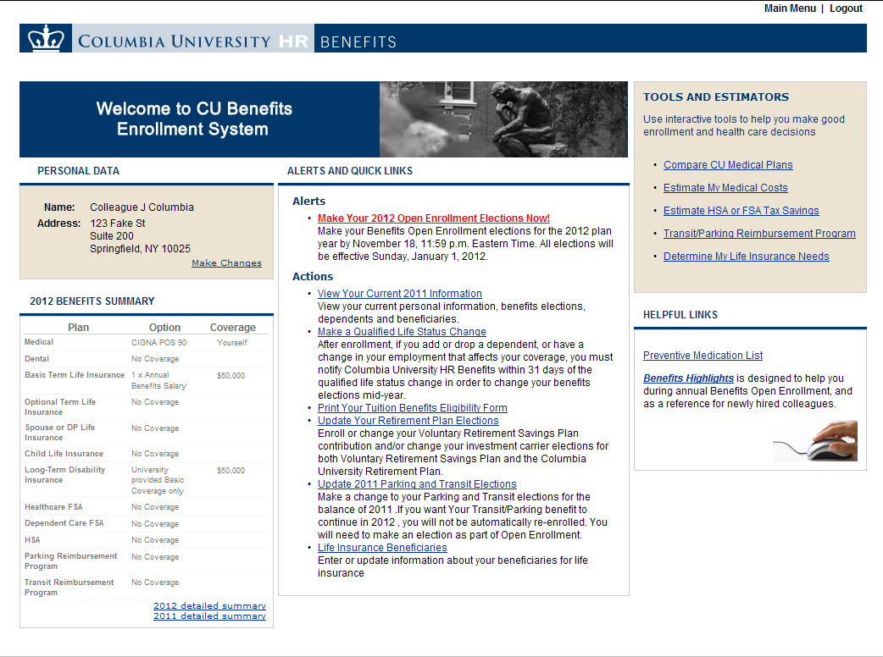
On-line enrollment

Slide 44
Questions?

Slide 45
Appendix

Slide 46
Plan Terminology
Copayment (copay): A fixed amount you may pay directly to the provider/facility when you receive services; e.g., a $30 copay for an office visit. Copays (medical and Rx) in the POS plans do not accumulate to the deductible.
Deductible: The amount you must meet annually before the plan pays for expenses; e.g., in the POS 90 once your expenses have accumulated to $200 per person, the medical plan pays for 90% of in-network medical expenses.
Coinsurance: The cost-sharing between you and the plan, which applies after you have met the deductible; e.g., the POS 90 covers 90% of in-network medical expenses; you pay the remaining 10%.
Out-of-Pocket Maximum (OOP): Is the amount you have to pay annually for covered medical services. The deductible and coinsurance accumulate to your OOP maximum. Once you reach the OOP maximum, the plan pays 100% of covered charges for the remainder of the calendar year.

Slide 47
HDHP Preventive Rx Therapeutic Classes
Anticoagulants
Antihypertensive agents ( high blood pressure)
Asthma/COPD medications
Cholesterol lowering agents
Diabetes medications
Heart disease medications
Hepatitis C medications
Immunosuppressant agents
Mental health agents
Pre-natal vitamins
Thyroid disease medications
Osteoporosis medications
Contraceptives medications

