Slide 1

Mailman School of Public Health Educator Development Series
The Nuts and Bolts of
Group Work

Slide 2



Introductions
Notes:
Think of a time when you participated in a “team.” You can define that term in whatever way make most sense for you – maybe a sports team, a collaborative working team, maybe the A-Team. What did you learn from the experience that you might not have learned on your own (i.e., had you not been in a team)? Think about this for a moment. Then turn and introduce yourself to the person next to you and talk about your answer. Then turn the person on your other side and do the same thing again.

Slide 3
Today’s Goals
Participants will be able to
  Identify advantages of learning groups
  Describe spectrum of uses for groups
  Brainstorm applications of group work for their own classroom practice
Notes:
Our goals for today are for you to identify why it’s advantageous to learn and teach in small groups. We’ll look at a spectrum of uses and formats for groups, and we’ll brainstorm ways of applying this content in your courses.

Slide 4
Why groups?
Students are less tolerant of “information dumping” lectures – they want a learning experience, not just facts
Active learning > passive learning
Employers want employees with human-interaction and problem-solving skills (not just content knowledge)
Notes:
This is review if you’ve attended other workshops in this series, but it’s worth repeating. Why should you use groups? Well, hopefully this session will convince you that it’s more fun, if nothing else, but the key ideas here are that students are less tolerant of lectures and want more active types of learning. And we know that active learning yields more understanding than passive learning. But a key feature behind using groups is feedback that we’ve gotten from employers in the field, who say that they want students who can work collaboratively and problem-solve – they want more than just “fact vessels.” Group work helps foster those desirable skills.

Slide 5

Uses of small groups
Notes:
The take-home message today is that one size does not fit all when it comes to using groups. We will not be promoting an orthodoxy. Rather, we’ll show you a spectrum and rationales for selecting types of group work/group structure, and we hope that you’ll find some applications for your own course.

Slide 6
Spectrum of group work
Casual use
Cooperative learning
Team learning

Slide 7
Casual Use
Flexible, easy to use
Relatively ad hoc
Cooperative Learning
Frequent use of carefully planned and structured group activities
Inserts small group activities into pre-existing course structure
Team Learning
Making small group work the primary in-class activity
Little or no advanced planning required*
No need to worry about grading or group composition
Pay attention to accountability, group formation, roles
Often requires a change in the structure of the course
Procedures that support the transformation of newly formed “groups” into “high performance learning teams”
Fink, L. Dee. Beyond small groups: harnesssing the extraordinary power of learning teams.
Used by permission of Roseanna Graham, DDS, PhD

Slide 8
Casual Use
FORMAT
Teacher lectures for 15-20 minutes
Students pair with others to discuss a topic or solve an issue
Teacher calls on students to share responses and discuss as a class
BENEFITS/DRAWBACKS
Can break up tedium for class
Adds variety and gets students active
Little preparation
Does not achieve a powerful form of learning
Used by permission of Roseanna Graham, DDS, PhD

Slide 9
Cooperative Learning
FORMAT
Frequent structured group activities
Advanced organization in order to plan the issues associated with individual and group accountability, how to form groups, how long to leave the groups together, whether to assign roles, etc.
BENEFITS/DRAWBACKS
Does not involve a substantial change in the overall structure of the course
Significant step from the casual use of small groups in terms of the potential for significant learning
Used by permission of Roseanna Graham, DDS, PhD

Slide 10
Ground Rules: Some Examples
Three Person Rule
Once you have spoken you may not make another contribution until three other people have spoken unless someone asks you directly to expand on your comment
Spiral Conversation
At the beginning of each session, once you have spoken, you do not speak again until everyone in the group has contributed
Talking Policy
Silence is allowed and does not mean you are disengaged or unintelligent. Talking frequently will not be interpreted as a sign of intelligence or extreme engagement
From the work of Stephen Brookfield

Slide 11
Roles
Reflective Analyst: Keeps a record of conversation development; periodically gives a summary of emerging ideas and issues
Devil’s Advocate: Listens for an emerging consensus and expresses a contrary view
Theme Spotter: Identifies themes that are being left unexplored
Contextual Focuser: Listens for comments that are unrelated to the topic at hand and makes sure group stays focused
From the work of Stephen Brookfield
Notes:
These are all described in the work of Brookfield; there are many more. The idea is that students are given a role to play during the discussion. Here are a few examples.

Slide 12
Roles (cont’d)
Detective: Listens carefully for unacknowledged, unchecked and unchallenged biases and brings them to the group’s attention
Scrounger: Keeps track of helpful resources and tips from members of the group
Connector: Shows how people’s comments are related to one another
Speculator: Introduces new ideas or interpretations (“I wonder what would happen if….)
Umpire: Listens for judgmental comments that sound offensive, insulting, or in contradiction to ground rules
Appreciator: Make comments indicating how she found another person's ideas interesting or useful.
Questioner: Asks questions to draw out or extend what others have said
From the work of Stephen Brookfield

Slide 13
Casual Use
Let’s try it…
Notes:
So let’s try it ourselves. We’ll do a simulated team-learning activity. [Explain that real team learning would involve a restructuring of a course and is not a one-off activity, but we want participants to get a sense of what might happen in a team learning exercise.]

Slide 14
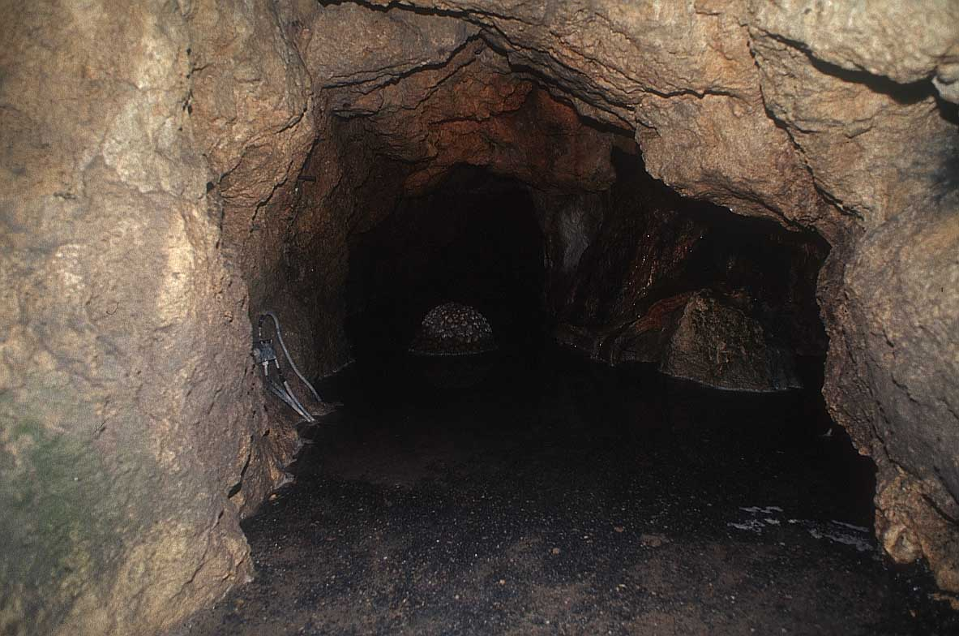
Notes:
Let’s imagine we’re in a course on the philosophical foundations of education in America. You’ve been given a passage of “The Republic” to read. In a real scenario I would have assigned this to you as homework. The passage you’re going to read is the famous “allegory of the cave.” Of course, we know that Plato wrote “The Republic” and that most of it is conversations between Socrates and other Athenians about what makes a man just and good. The part you’re reading is a Socratic dialogue with Glaucon. Take a moment know to read it now.

Slide 15
Group activity
Socrates describes the prisoner being “dragged” out of the cave and into ever closer contact with the light (from the fire to the daylight to the direct sunlight), suggesting that the prisoner himself is reluctant to leave the cave. Is it just to force education upon people who would rather remain ignorant?
Notes:
Now, get into teams of 5 [can adjust down if group is small]. Here is the question you as a group will discuss. You’ll have five minutes to discuss it, as well as any questions or reactions you had to the reading. Then you’ll give your group’s answer by indicating your response with the paddles.

Slide 16
Examples of Structured Activities
Quotes to Affirm and Challenge
Newsprint Dialogue
Circular Response
Hatful of Quotes
Snowballing
All described in detail in your handout.
From the work of Stephen Brookfield
Notes:
Now, what about the ground rules? Rather than just telling students to “talk,” it can be helpful to give them a specific task. I’m going to discuss these a little bit; a more complete description of each is in your packet. Then we’ll actually practice one together, and you’ll get to play a role. We’ll do Hatful of Quotes. Here’s how it works.

Slide 17
Troubleshooting
What if… | You can…
Group contributes an irrelevant idea | Acknowledge and promote relevant elements, ask for clarification of connection between topic and comments shared
Group presents vague responses | Ask for clarification and more details/ evidence to support comments
Group(s) hesitate to contribute | Recognize group’s prior contributions; alter discussion topic by asking “what was surprising or confusing about the topic?” “how did this feel connected to what we’ve discussed previously?”
Whole group seems to have exhausted discussion | Summarize contributions by saying “So, what I’ve heard is…. Are we all in agreement on this? Anyone want to challenge or add to this consensus?”
Conversation doesn’t begin or starts sluggishly | Clarify task; ask a student to summarize again for whole group what task is; solicit clarifying questions; remind group of time limit
Notes:
In case of emergency, you can always have a bag of tricks! Here are some tips and ideas for what to do during facilitation.

Slide 18
Debriefing
What was one thing you realized as a result of working in your team that you would not have realized otherwise?

Slide 19
Some principles of group work
Groups must be properly formed and managed
Students must be made accountable for individual and group performance
Group assignments must promote both learning and team development
Students must have frequent and timely feedback

Slide 20
Planning for action
How do you imagine implementing today’s content in your own classroom?
What questions remain?
Notes:
So how does all this apply to you?

Slide 21
Thank you!
Leah
lch2124@columbia.edu

