Slide 1
Computational experiments with knapsack
Vivian Wang

Slide 2


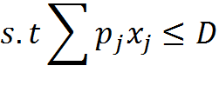
1 | |
Single Knapsack Problem
  LP formulation:
Greedy
Algorithm
Sort jobs by w_{j}/p_{j} and
Take jobs with largest
Weight per time used

Slide 3
Comparison with Dynamic programming
# jobs | Due date | Dynamic Programming | Greedy
1000 | 1000 | 0.0780 | 0
1000 | 5000 | 0.2824 | 0
5000 | 1000 | 0.2808 | 0
5000 | 5000 | 1.4976 | 0
7000 | 7000 | 3.9 | 0
50000 | 50000 | Out of memory | 0.0312
50000 | 500000 | -- | 0.0312
5000000 | 50000 | -- | 0.0936
Runtime |  | O(D*n) | O(n log n)
Space |  | O(D*n) | O(n)
As Problem grows larger, greedy algorithm become increasingly attractive

Slide 4
Accuracy of Greedy solution
Number of Jobs in sack | Average Accuracy (greedy)
5 | 8.1%
10 | 1.5%
20 | 0.8%
For large problems, greedy algorithm saves both time and space as well as provide close to optimal solution if large number of jobs can be scheduled
  Checking the upper bound for number of jobs that can be scheduled is O(nlogn) (sort and schedule longest process time first)

Slide 5
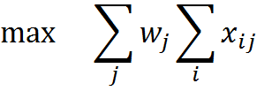

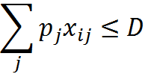

Multiple Knapsacks: P||
Formulation:
**Job j scheduled on machine i

Slide 6
Problems
NP - complete
LP provides a poor approximation
  tries to order by w_{j}/p_{j} and place 1/P of each job on each machine
IP has P*n number of decision variables; very slow for large problems

Slide 7
Possible Solutions
Schedule one machine at a time
  Greedy approach
  Dynamic programming
Pro – Very quick solution obtained
Con - hard to guarantee solution quality

Slide 8
Test Results
 | IP |  | dp |  | Greedy
 | Objective | Time | Objective | Time | Objective | Time
n=20, P=4 | 545 | 65 | 545 | 0 | 545 | 0
n=50, P=2 | 1181 | 394 | 1181 | 0 | 1135 | 0
n= 50, P = 3 | 223 | 657 | 223 | 0 | 205 | 0

Slide 9
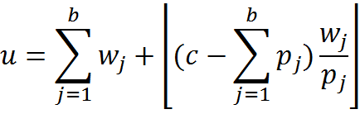
Evaluating solution quality for larger problems
A simple upper bound on the solution can be obtained by :
  Where b is the number of jobs that can be scheduled if we consider all machines as one
Machine 1
Machine 2
Machine 3
Machine 1

Slide 10
Evaluating solution quality for larger problems
 | Upper bound | Dynamic programming |  | Greedy
 |  | Error | Time | Error | Time
n=500, P=5 |  | 0.5% | 0.078 | 0.7% | 0
n=1000, P=10 | 21476 | 0.02% | 0.1560 | 1.3% | 0
n=20,000, P=15 | 70015 | <0.01% | 17.39 | 1.8% | 0.18
n=50,000, P=50 | 331023 | 0 | 69.87 | 0.5% | 0.86

Slide 11
Other Possible approach
Column Generation
  Effective where there are multiple instances of the same job
  Relatively simple IP implementation
  Good solutions found quickly
Using bounds – exact solution may be found
  Compute upper bound (solving a surrogate relaxed problem)
  Computer lower bound (finds optimal for each sack)
  Branch on each x_{ij} update bounds when needed
  Solves n=1000, p=10 in under 10 seconds

Slide 12
References
MARTELLO, S., AND TOTH, P. Heuristic algorithms for the multiple knapsack problem. Computing 27 (1981), 93-112.
Pisinger, David (1999) An exact algorithm for large multiple knapsack problems. European Journal of Operational Research

