Slide 1
USPS scheduling
Jonathan Yoo

Slide 2
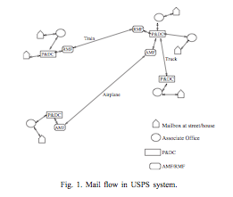
USPS: Current System
Not OR-optimized
Based on pre-determined scheduling of trucks
Government-protected monopoly

Slide 3
USPS: Current System Details
Step 1: Mail is collected from mailboxes at an associate office (AO) or a P&D center
Step 2: AO forwards mail to P&D center
Step 3: At P&DC, mail goes through various operations (processing)
Step 4: Mail sent to an AO or another P&DC
Step 5: Mail gets processed further until it is sent to the AO nearest to the destination
Step 6: Mail is delivered

Slide 4
USPS: Current System Details
Step 1: Mail is collected from mailboxes at an associate office (AO) or a P&D center
Step 2: AO forwards mail to P&D center
Step 3: At P&DC, mail goes through various operations (processing)
Step 4: Mail sent to an AO or another P&DC
Step 5: Mail gets processed further until it is sent to the AO nearest to the destination
Step 6: Mail is delivered
All of the transportation leads to many inefficiencies in the process!

Slide 5
USPS: Truck Schedules
There are long-term contracts with trucking companies that specify capacity and schedule
Cannot negotiate contracts on a short-term basis
However, USPS can try to sequence incoming mail to match outbound truck schedule
Current dispatching rule is generally FIFO
By modifying dispatch rule, USPS can lower delays, lessen storage and handling costs, and eliminate some customer complaints!

Slide 6
USPS: How to Optimize Scheduling
Objective: Minimize total unused truck capacity
  Usually impossible to sort all mail prior to first truck departure
Much analysis already exists on equipment and staff scheduling
Now we need to take into account the truck scheduling to optimize the process as a whole

Slide 7
USPS: Problem with Schedules
For this analysis, treat the entire P&DC system as one machine
Problem: How to decide the order in which incoming mail is processed such that the least amount of truck space is wasted
Important things to keep in mind:
  Proportion of mail from different locations differ
  Proportion of mail to different destinations differ
This scheduling problem is NP-hard!

Slide 8

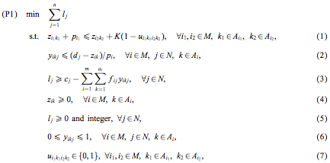
USPS: OR Problem Formulation
Decision Variables:
Mixed-Integer Problem Formulation:
  Where K is a large positive #, A_{i} = {1,…,a_{i}}, ∀i ∈M

Slide 9
USPS: OR Problem Explanation
Objective P1 is to minimize total unused truck capacity
Constraint 1 guarantees that the non-preemptive property holds at mail tray level
Constraint 2 calculates the portion of completed kth mail tray from origin i before time d_{j}
Constraint 3 calculates the completed mail trays for destination j at time d_{j} and assigns the unused capacity to a truck for destination j
This problem formulation is difficult to solve
  Number of variables usually ends up being very large

Slide 10
USPS: Dispatching Rules and Heuristics
Direct solution of the mixed integer problem using a commercial solver is impossible
Different methods to solving the formulated OR problem
  1) Dispatching rules
  2) LP Approximation
  3) Revised Greedy Algorithm

Slide 11
USPS: Dispatching Rules

