Slide 1
Observations of Heterogonous Earliest Finish Time (HEFT) Algorithm
Kevin Tzeng

Slide 2
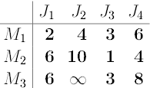
Task Scheduling for Heterogeneous Computing
Similar to R|pmtn|Cmax, but without preemptions and with precedence constraints
NP Complete Problem
HEFT is a Heuristic Algorithm

Slide 3
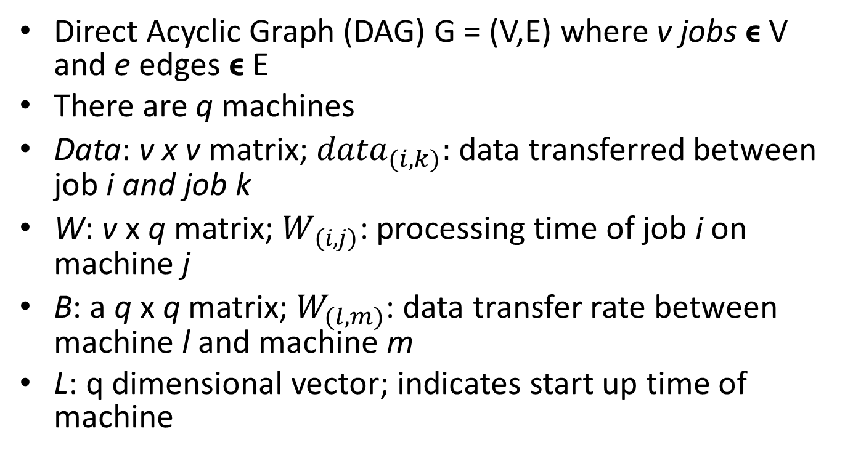
Formal Model
Direct Acyclic Graph (DAG) G = (V,E) where v jobs ϵ V and e edges ϵ E
There are q machines
Data: v x v matrix; ${data}_{(i,k)}:$ data transferred between job i and job k
W: v x q matrix; $W_{(i,j)}$: processing time of job i on machine j
B: a q x q matrix; $W_{(l,m)}$: data transfer rate between machine l and machine m
L: q dimensional vector; indicates start up time of machine

Slide 4
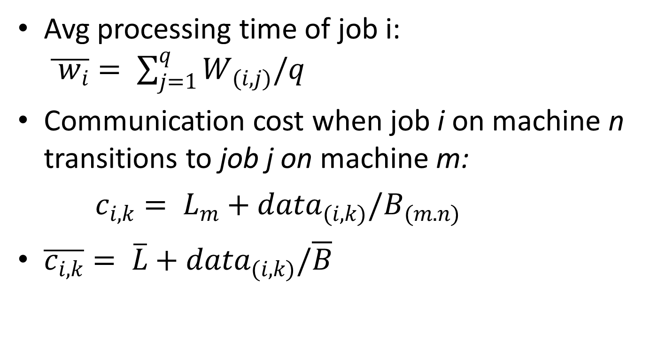
Formal Model (cont.)
Avg processing time of job i: $\overline{{ w}_{i}}= \sum_{j=1}^{q}{W_{(i,j)}/q}$
Communication cost when job i on machine n transitions to job j on machine m:
$c_{i,k}= L_{m}+{data}_{(i,k)}/B_{(m.n)}$
$\overline{c_{i,k}}= \overline{L}+{data}_{(i,k)}/\overline{B}$

Slide 5
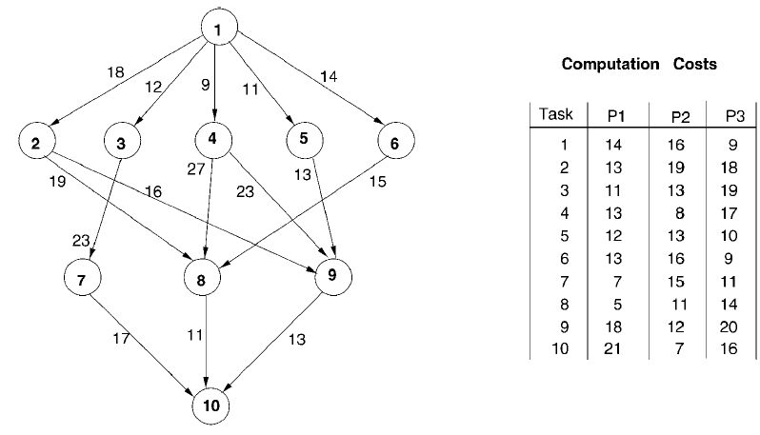
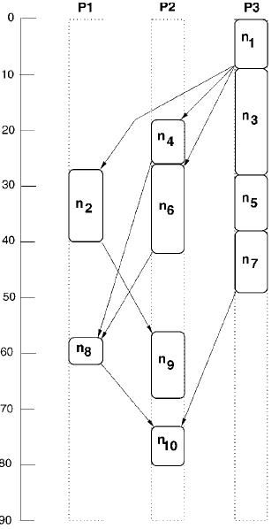

Slide 6
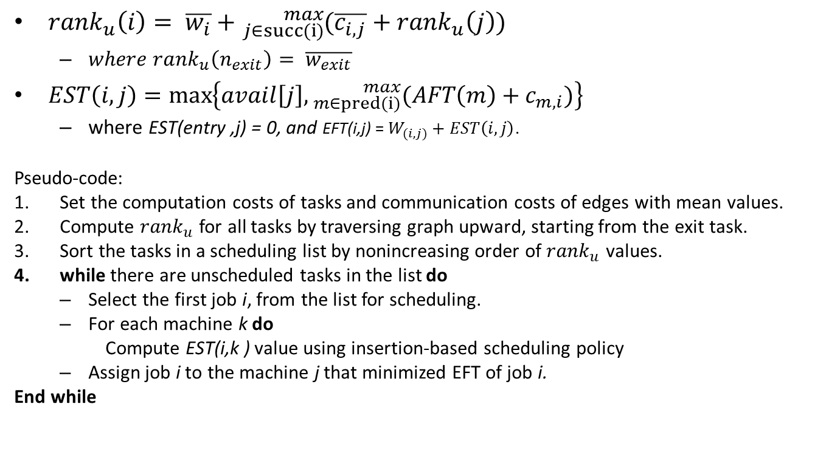
HEFT Algorithm
${rank}_{u}\left(i\right)= \overline{w_{i}}+{}_{j∈succ(i)}^{max}{(\overline{c_{i, j}}+{rank}_{u}\left(j\right)) }$
  $where {rank}_{u}\left(n_{exit}\right)= \overline{w_{exit}}$
$EST\left(i,j\right)=\max\left\{avail\left[j\right], {}_{m∈pred(i)}^{max}{(AFT\left(m\right)+c_{m,i}})\right\}$
  where EST(entry ,j) = 0, and EFT(i,j) = $W_{(i,j)}+EST\left(i,j\right)$.
Pseudo-code:
Set the computation costs of tasks and communication costs of edges with mean values.
Compute ${rank}_{u}$ for all tasks by traversing graph upward, starting from the exit task.
Sort the tasks in a scheduling list by nonincreasing order of ${rank}_{u}$ values.
while there are unscheduled tasks in the list do
  Select the first job i, from the list for scheduling.
  For each machine k do
Compute EST(i,k ) value using insertion-based scheduling policy
  Assign job i to the machine j that minimized EFT of job i.
End while

Slide 7
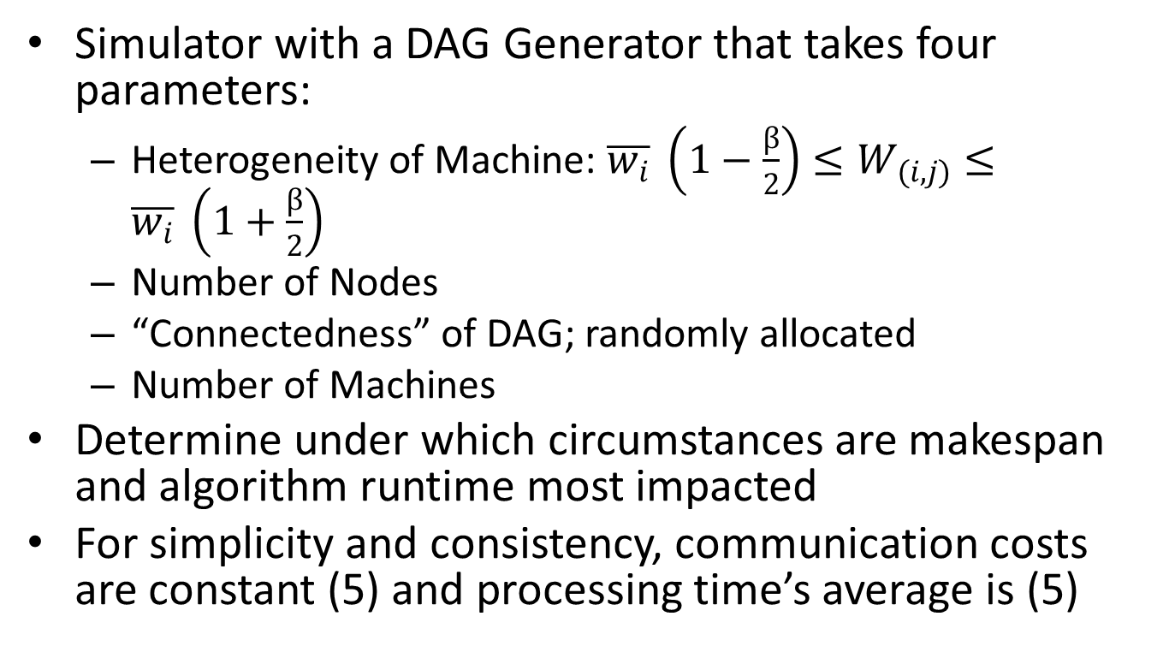
Experiment
Simulator with a DAG Generator that takes four parameters:
  Heterogeneity of Machine: $\overline{w_{i}} \left(1−\frac{β}{2}\right)≤W_{(i,j)}≤\overline{w_{i}} \left(1+\frac{β}{2}\right)$
  Number of Nodes
  “Connectedness” of DAG; randomly allocated
  Number of Machines
Determine under which circumstances are makespan and algorithm runtime most impacted
For simplicity and consistency, communication costs are constant (5) and processing time’s average is (5)

Slide 8
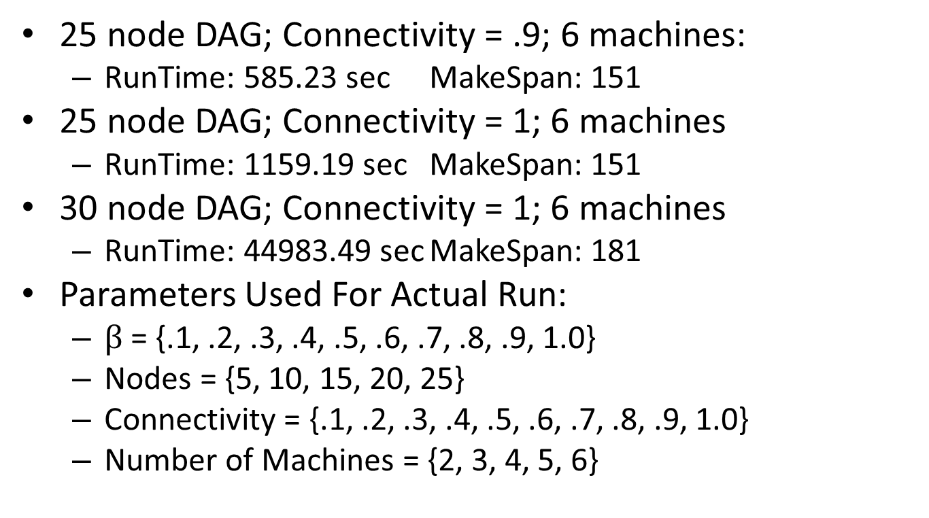
Test Run
25 node DAG; Connectivity = .9; 6 machines:
  RunTime: 585.23 sec MakeSpan: 151
25 node DAG; Connectivity = 1; 6 machines
  RunTime: 1159.19 sec MakeSpan: 151
30 node DAG; Connectivity = 1; 6 machines
  RunTime: 44983.49 sec MakeSpan: 181
Parameters Used For Actual Run:
  $β$ = {.1, .2, .3, .4, .5, .6, .7, .8, .9, 1.0}
  Nodes = {5, 10, 15, 20, 25}
  Connectivity = {.1, .2, .3, .4, .5, .6, .7, .8, .9, 1.0}
  Number of Machines = {2, 3, 4, 5, 6}

Slide 9
Observations (Runtime)

Slide 10
Observations (Makespan)

Slide 11
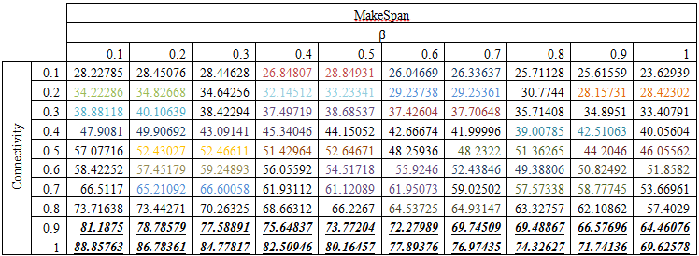
Analysis

Slide 12
Conclusion and Future Projects
More rigorous statistical techniques
Use similar simulation to compare with other heuristics

Slide 13
Work Cited
Topcuoglu, Haluk, Salim Hariri, and Min-You Wu. "Performance-Effective and Low-Complexity Task Scheduling for Heterogeneous Computing." IEEE Transactions On Parallel and Distributed Systems 13.3 (2002): 260-74. Web.
Rocklin, Matthew. "Mrocklin / Heft." GitHub. N.p., 14 Feb. 2013. Web. <https://github.com/mrocklin/heft>.

