Slide 1
Customized Stochastic Lot Scheduling Problem with
Due Date Management
Crew:
Pavel Babenkov
Kirill Kalinkin

Slide 2
Using Family Approach to Reduce Set-Ups
The main goal of our project is study the make-to-order production environment with batch setup times, where customers orders are grouped into family-dependent batches to limit the loss of capacity due to setups.
During the project we have covered the following:
We extensively studied approaches for Customized Stochastic Lot Scheduling Problem (CSLSP) based on works by R. Germs and N.D. van Foreest.
We extensively studied approaches for Due-Data Management – methods which are used to set up due dates for customers orders in a way to optimize production and satisfy customers.
We simulated the CSLSP environment using own developed MatLab program and get results with various input conditions.
We apply different current existing DDM methods and test performance of CSLSP under them.
We develop a new heuristic DDM policy to combine with CSLSP and improve performance of two objects – reducing number of setups and increasing amount of satisfied orders by optimal setting of due dates – which lead to increasing of manufacturer profit in the long term.

Slide 3



Customized Stochastic Lot Scheduling Problem
The main idea behind CSLSP is to group orders into families with similar production characteristics. This help to reduce amount of setups and total setup time, as a major setup time is incurred when production changes from one family to another.
There are the following details of environment:
The production situation at the supplier is modeled as a single machine that receives a stream of orders, which arrive according to a Poisson process.
Production of each order is one time unit.
There is a setup time after each family.
The supplier is allowed to reject orders, but if he accepts an order he commits to delivering it in time.
Consider a reference schedule:
Initially schedule with defined families
The schedule that results when a new family is created for a new order.
The schedule that results after a new order of family 1 has been combined at position 3 at the end of the first batch.

Slide 4




Scheduling Actions
At each arrival epoch it is necessary to decide whether to accept or reject the arriving order, and if it is accepted, it is required to decide where to insert the order in the schedule.
For each new order, the following actions are considered:
Combine - to combine an arriving order with a batch of its ‘kin’ in the schedule, with the aim of reducing the fraction of setups.
= 8
Spawn - to ‘spawn’ a new generation of its family in a fashion similar to the EDD rule.
= 11
Reject – not to accept an order.
= 11

Slide 5

Greedy and Threshold Heuristics
There are two heuristics which can be used to make scheduling decisions.
Greedy – first tries to combine a new arriving order with a family. If combine is not possible, it tries to spawn a new family.
However, this reduces opportunities for
combination for other upcoming orders (blue and
green).
= 8
= 11
= 13
Threshold – first tries to combine a new arriving order with a family. If combine fails, choose spawn only if allowed and the due-date slack of the arriving order is greater than or equal to c after acceptance of the order: 0 ≤ c ≤ h
= 11

Slide 6
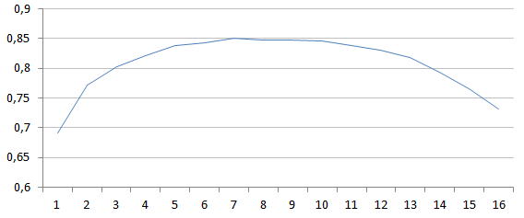
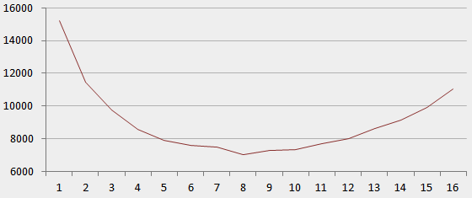
Simulation Results
We have created a simulation model in MatLab and executed various tests to better understand behavior of the threshold policy.
Fraction of accepted jobs for different minimal slack requirements:
Percentage of accepted orders
Minimum required slack
Amount of setups for different minimal slacks:
Amount of setups
Minimum required slack

Slide 7
Due Date Management (DDM) Policies Overview
Due Date Management is dealing with quoting a lead time as the difference between the promised date of an order and its arrival time.
Quoting unreliable lead times not only leads to potential loss of future business, but may also result in monetary penalties.
There are some dimensions of a DDM problem:
  Offline vs. Online
  Single vs. Multiple Servers
  Preemptive vs. Non-preemptive
  Stochastic vs. Deterministic Processing Time
  Setup times/ costs
  Server Reliability
  Single vs. Multiple Classes of Customers
  Service Level Constraints
  Common vs. Distinct Due Dates

Slide 8



CSLSP with DDM
Developing a method of combining the schedule problem with due-date management, we worked with a situation when we have just 2 families.
This case is the most easiest and can be used as a motivation for further research.
Consider the following situation, when an order for the family 1 arrives.
Obviously, we can quote a lead time for this order = workload in front of it + its processing time
Consider another situation, when an order for the family 2 arrives:
Similarly, we can quote a lead time for this order in the same way, as workload in front of it + its
processing time.
However, if the next order will be for the family 1 – we will need to spawn a new family and execute
a new setup, as the order #7 will be tight.

Slide 9

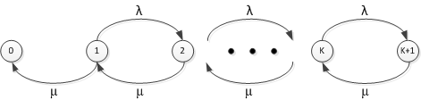
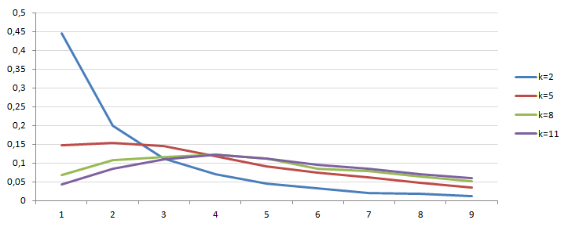
Approach to quote a lead time for CSLSP problem
The main idea behind our approach for lead time quoting is to calculate expected amount of orders, which may arrive in front of an order, which is scheduling now.
Once again consider the situation, when an order for the family 2 arrives:
We presented expected workload K as states of a Markov Chain:
Based on that we built distributions of expected workload for different K:
Probability

Slide 10
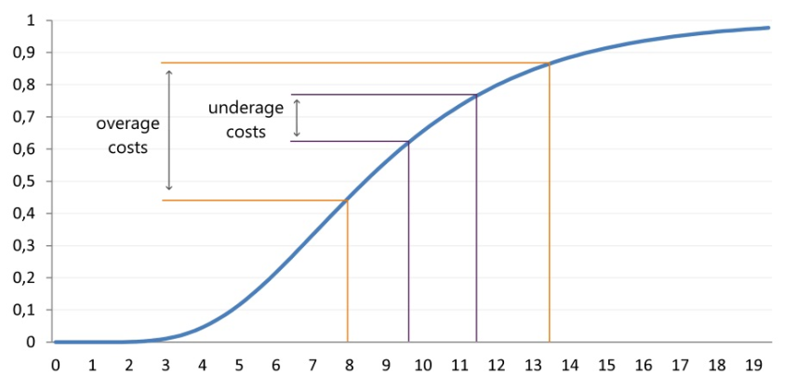
Calculating Optimal Slack
We are working on the two approaches – based on the NewsVendor Method.
We used the following – lognormal distribution – of a customer rejecting proposed due date:
Overage Costs (h) – slack is more than demand – so we have “missed opportunity” to put shorter lead time (due date)
Underage Costs (b) – slack is less than demand – so we will miss an opportunity to put new coming orders in the existence family (no slacks) – and will need to create a new family and put a new setup.
S* is (b/b+h) th-fractile of the distribution, which defines the optimum slack:
S*=min(S: P(D<=S) = b/b+h)
Probability
Amount of Time Units till Order Delivery (Due Date)

Slide 11
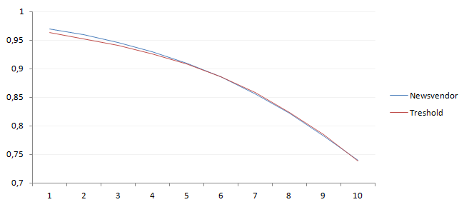
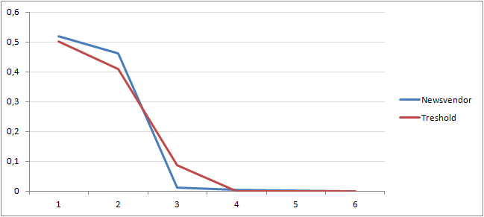
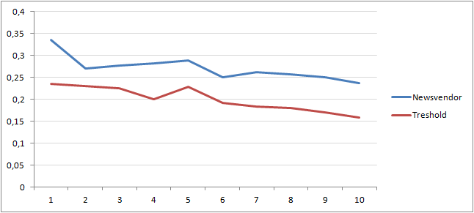
Current Result of Simulation for “NewsVendor” Approach
For now we get the following results from simulation of the presented method.
Fraction of accepted orders with flexible Due-Date (NewsVendor) and constant Due-Date (Threshold Heuristic)
Distribution of slacks of orders, which is up to production:
Fraction of orders for which new families were created, but orders were rejected by customers due to long lead time:

Slide 12
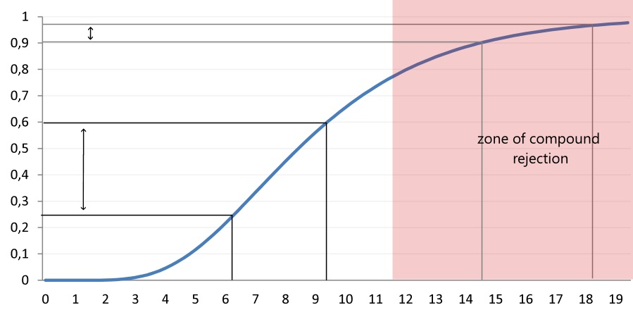
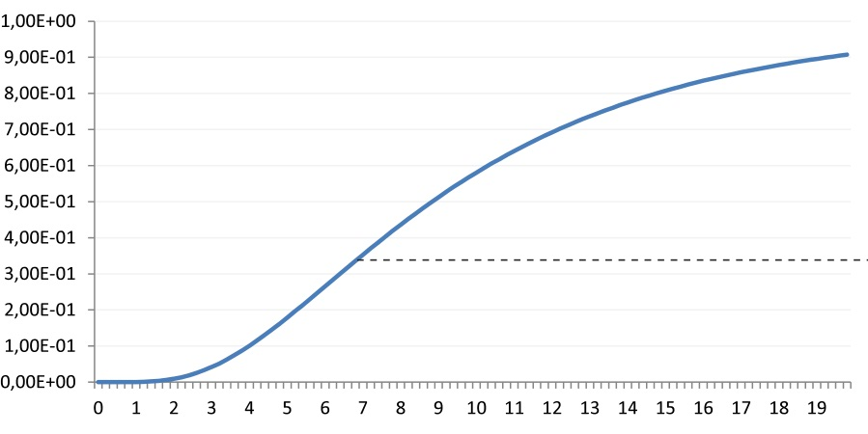
Policy of Compound Rejection
Until slack has not reached the predefined level, we need to consider a decision to spawn a new family, instead of compounding with the existing family.
Probability of Rejection:
Example of slack distribution:

