Slide 1

Scheduling for High Schools
Production Scheduling
Lorena Kawas lk2551
Raul Galindo rg2802

Slide 2
Introduction
The problem consists in assigning lectures to periods in such a way that no teacher (or class) is involved in more than one lecture at a time and other constraints are satisfied.
The high school scheduling problem is NP – hard.
Most early techniques were based on a simulation of human way of solving the problem. (direct heuristics)
  The schedule is filled, lecture by lecture, until either all lectures have been scheduled or no lecture can be scheduled without violating a constraint.
Later on, researchers started to apply general techniques to this problem:
  Integer Programming.
  Network Flow.
  Graph Coloring.
We analyze techniques proposed in different papers
We propose our own heuristic to find a feasible schedule that violates the least amount of soft constraints.
We made a program that finds solutions for a specific family of high school schedules.

Slide 3

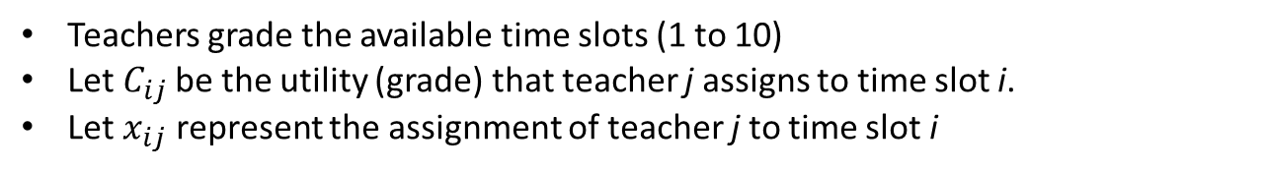

Tackling the problem
Teachers grade the available time slots (1 to 10)
Let $C_{ij}$be the utility (grade) that teacher j assigns to time slot i.
Let $x_{ij}$ represent the assignment of teacher j to time slot i
1 if teacher j is assigned to time slot i
$x_{ij}=$
0 otherwise
Objective: We want to maximize the utility of the system.
$$max\left\{\sum_{i}{\sum_{j}{C_{ij}x_{ij}}}\right\}$$

Slide 4

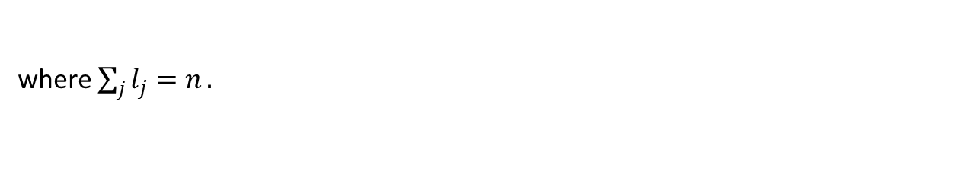
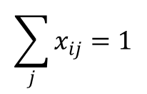

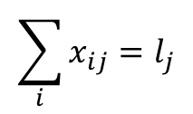
Tackling the problem
Hard Constraints; they must be satisfied.
One teacher per hour.
$$\sum_{j}{x_{ij}=1}$$
$$i=1,…,n$$
Teacher gives the designated number of lectures $l_{j}$
$$\sum_{i}{x_{ij}=l_{j}}$$
$$j =1,…,m$$
where $\sum_{j}{l_{j}=n}.$
No teacher is in different places at the same time

Slide 5
Tackling the problem
Soft Constraints; can be violated at a given penalty
No more than y times a day is the same class to be given
A specific class is not to be given at a certain hour
One class has to be scheduled before another
The heuristic proposed in this project tries to find a feasible schedule that meets all the possible soft constrains by changing the utility matrix.
In case there is no feasible scheduled where all soft constrains are met, an extra variable can be added (substitute teachers, extra salary, after-school activities etc…).

Slide 6
A simple problem
UTILITY TABLE
 |  | PREFERENCES
 | HOURS\CLASS | a | b | c
Monday | 1 | 9 | 1 | 7
 | 2 | 1 | 10 | 8
 | 3 | 7 | 6 | 7
Tuesday | 4 | 4 | 3 | 1
 | 5 | 9 | 7 | 3
 | 6 | 10 | 10 | 2
Wednesday | 7 | 8 | 10 | 7
 | 8 | 4 | 2 | 5
 | 9 | 6 | 4 | 4
Thursday | 10 | 5 | 3 | 8
 | 11 | 4 | 7 | 4
 | 12 | 9 | 8 | 2
Friday | 13 | 3 | 6 | 4
 | 14 | 2 | 4 | 4
 | 15 | 7 | 2 | 6
In this example:
Three hours a day
Three teachers a, b, and c.

Slide 7
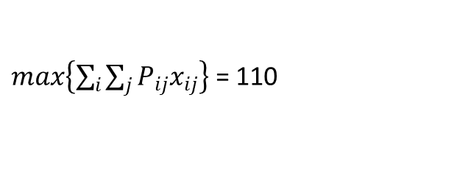
A simple probleM
Solutions for the example
 | a | b | c
1 | 1 | 0 | 0
2 | 0 | 1 | 0
3 | 0 | 0 | 1
4 | 1 | 0 | 0
5 | 1 | 0 | 0
6 | 0 | 1 | 0
7 | 0 | 1 | 0
8 | 0 | 0 | 1
9 | 1 | 0 | 0
10 | 0 | 0 | 1
11 | 0 | 1 | 0
12 | 1 | 0 | 0
13 | 0 | 1 | 0
14 | 0 | 0 | 1
15 | 0 | 0 | 1
 | Monday | Tuesday | Wednesday | Thursday | Friday
First Period | a | a | b | c | b
Second Period | b | a | c | b | c
Third Period | c | b | a | a | c
Excel Solver found a feasible schedule
$max\left\{\sum_{i}{\sum_{j}{P_{ij}x_{ij}}}\right\}$ = 110

Slide 8
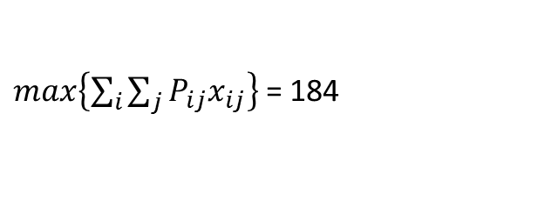
Adding constraints
We increase the difficulty of the problem by adding a second classroom.
CLASSES | a | b | c
1 | 9 | 1 | 7
2 | 1 | 10 | 8
3 | 7 | 6 | 7
4 | 4 | 3 | 1
5 | 9 | 7 | 3
6 | 10 | 10 | 2
7 | 8 | 10 | 7
8 | 4 | 2 | 5
9 | 6 | 4 | 4
10 | 5 | 3 | 8
11 | 4 | 7 | 4
12 | 9 | 8 | 2
13 | 3 | 6 | 4
14 | 2 | 4 | 4
15 | 7 | 2 | 6
1 | 8 | 0 | 6
2 | 0 | 9 | 7
3 | 6 | 5 | 6
4 | 3 | 2 | 0
5 | 8 | 6 | 2
6 | 9 | 9 | 1
7 | 7 | 9 | 6
8 | 3 | 1 | 4
9 | 5 | 3 | 3
10 | 4 | 2 | 7
11 | 3 | 6 | 3
12 | 8 | 7 | 1
13 | 2 | 5 | 3
14 | 1 | 3 | 3
15 | 6 | 1 | 5
CLASROOM 1 | Monday | Tuesday | Wednesday | Thursday | Friday
First Period | a | a | b | a | c
Second Period | c | b | c | b | c
Third Period | b | b | a | a | c
CLASROOM 2 | Monday | Tuesday | Wednesday | Thursday | Friday
First Period | c | b | a | c | b
Second Period | b | a | c | c | b
Third Period | c | a | c | b | a
$max\left\{\sum_{i}{\sum_{j}{P_{ij}x_{ij}}}\right\}$ = 184

Slide 9
Heuristic
We want to minimize the amount of soft constraints that are violated.
We solve the problem without considering the NO THREE SAME CLASS IN A ROW constraint.
If we find that the constraint is not respected we lower the coefficients of the utility matrix corresponding to 1 or 2 of the variables involved.
  The chosen coefficients are lowered by 1 unit.
  The process is repeated “M” times or until we find a new schedule that violates less soft constraints.

Slide 10
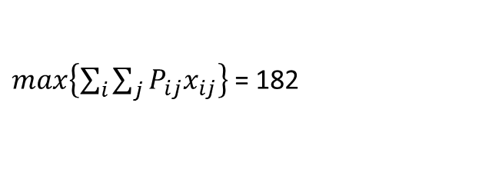
Heuristic
 | a | b | c
13 | 3 | 6 | 4
 | Monday | Tuesday | Wednesday | Thursday | Friday
First Period | a | a | b | a | c
Second Period | c | b | c | b | c
Third Period | b | b | a | a | c
 | NEW SCHEDULE
 | Monday | Tuesday | Wednesday | Thursday | Friday
First Period | a | a | b | c | a
Second Period | c | b | c | b | c
Third Period | b | b | a | a | c
After 3 steps we found a feasible scheduled such that no soft contrains are violated.
 | a | b | c
13 | 3 | 6 | 1
$max\left\{\sum_{i}{\sum_{j}{P_{ij}x_{ij}}}\right\}$ = 182

Slide 11
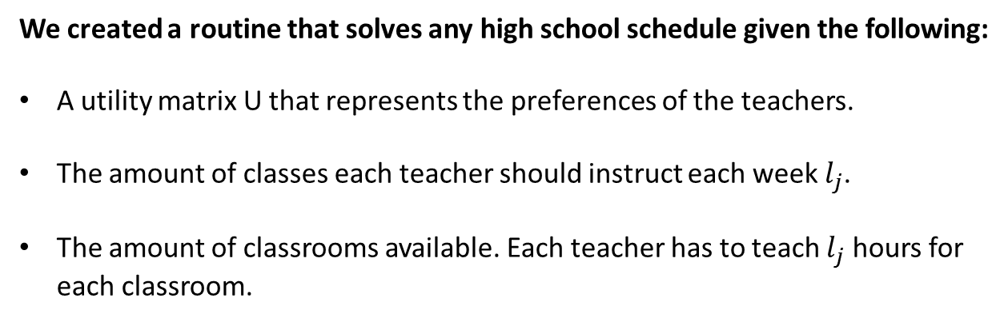
Matlab code
We created a routine that solves any high school schedule given the following:
A utility matrix U that represents the preferences of the teachers.
The amount of classes each teacher should instruct each week $l_{j}$.
The amount of classrooms available. Each teacher has to teach $l_{j}$ hours for each classroom.
Our program creates all the necessary hard constraints:
The amount of constraints we have to input in this problem might be “huge”.
We will get as a result a matrix X that solves such that
1 if teacher j is assigned to time slot i
$x_{ij}=$
0 otherwise

Slide 12
Examples
2 Classrooms 3 teachers 15 periods
l = (5,5,5)
l = (6,6,3)
l = (4,4,7)
l = (2,3,10)
U =
199
X =
1 0 0 1
2 0 0 1
3 1 0 0
4 0 1 0
5 0 1 0
6 1 0 0
7 0 0 1
8 0 0 1
9 1 0 0
10 0 0 1
11 0 1 0
12 1 0 0
13 0 1 0
14 0 1 0
15 1 0 0
16 1 0 0
17 0 1 0
18 0 0 1
19 1 0 0
20 1 0 0
21 0 1 0
22 0 1 0
23 1 0 0
24 0 1 0
25 1 0 0
26 0 0 1
27 0 1 0
28 0 0 1
29 0 0 1
30 0 0 1
U =
196
X =
1 0 0 1
2 0 0 1
3 0 1 0
4 0 1 0
5 0 1 0
6 0 1 0
7 1 0 0
8 1 0 0
9 1 0 0
10 1 0 0
11 1 0 0
12 0 1 0
13 0 0 1
14 0 1 0
15 1 0 0
16 1 0 0
17 0 1 0
18 1 0 0
19 1 0 0
20 1 0 0
21 1 0 0
22 0 1 0
23 0 1 0
24 0 1 0
25 0 0 1
26 0 1 0
27 1 0 0
28 0 1 0
29 0 0 1
30 0 0 1
U =
185
X =
1 0 0 1
2 0 0 1
3 0 0 1
4 1 0 0
5 1 0 0
6 0 1 0
7 0 1 0
8 0 0 1
9 1 0 0
10 1 0 0
11 0 1 0
12 0 1 0
13 0 0 1
14 0 0 1
15 0 0 1
16 1 0 0
17 0 1 0
18 0 1 0
19 0 0 1
20 0 0 1
21 1 0 0
22 0 0 1
23 1 0 0
24 0 0 1
25 0 0 1
26 0 0 1
27 0 0 1
28 0 1 0
29 0 1 0
30 1 0 0
U =
-Inf
X =
1 0 0 0
2 0 0 0
3 0 0 0
4 0 0 0
5 0 0 0
6 0 0 0
7 0 0 0
8 0 0 0
9 0 0 0
10 0 0 0
11 0 0 0
12 0 0 0
13 0 0 0
14 0 0 0
15 0 0 0
16 0 0 0
17 0 0 0
18 0 0 0
19 0 0 0
20 0 0 0
21 0 0 0
22 0 0 0
23 0 0 0
24 0 0 0
25 0 0 0
26 0 0 0
27 0 0 0
28 0 0 0
29 0 0 0
30 0 0 0
C1
C2

Slide 13
Examples
3 Classrooms 3 teachers 15 periods
l = (5,5,5)
U =
243
X =
1 0 1 0
2 0 1 0
3 0 0 1
4 0 0 1
5 0 0 1
6 1 0 0
7 1 0 0
8 1 0 0
9 1 0 0
10 0 0 1
11 0 1 0
12 0 1 0
13 1 0 0
14 0 1 0
15 0 0 1
C1
C2
C3
16 0 0 1
17 1 0 0
18 0 1 0
19 0 1 0
20 0 1 0
21 0 0 1
22 0 0 1
23 0 0 1
24 0 0 1
25 1 0 0
26 1 0 0
27 1 0 0
28 0 1 0
29 1 0 0
30 0 1 0
31 1 0 0
32 0 0 1
33 1 0 0
34 1 0 0
35 1 0 0
36 0 1 0
37 0 1 0
38 0 1 0
39 0 1 0
40 0 1 0
41 0 0 1
42 0 0 1
43 0 0 1
44 0 0 1
45 1 0 0
The problem stops being feasible for c > 3

Slide 14
Examples
3 Classrooms 3 teachers 15 periods
l = (5,5,5)
U =
243
X =
1 0 1 0
2 0 1 0
3 0 0 1
4 0 0 1
5 0 0 1
6 1 0 0
7 1 0 0
8 1 0 0
9 1 0 0
10 0 0 1
11 0 1 0
12 0 1 0
13 1 0 0
14 0 1 0
15 0 0 1
C1
C2
C3
16 0 0 1
17 1 0 0
18 0 1 0
19 0 1 0
20 0 1 0
21 0 0 1
22 0 0 1
23 0 0 1
24 0 0 1
25 1 0 0
26 1 0 0
27 1 0 0
28 0 1 0
29 1 0 0
30 0 1 0
31 1 0 0
32 0 0 1
33 1 0 0
34 1 0 0
35 1 0 0
36 0 1 0
37 0 1 0
38 0 1 0
39 0 1 0
40 0 1 0
41 0 0 1
42 0 0 1
43 0 0 1
44 0 0 1
45 1 0 0
The problem stops being feasible for c > 3

Slide 15
Examples
3 Classrooms 7 teachers 35 periods
This simulation of a high school schedule:
Requires 735 binary variables.
We get a solution in microseconds.
U = 817
The solution is feasible.
4 Classrooms 7 teachers 35 periods
This schedule takes approximately 20 seconds.
980 variables
U = 989
6 Classrooms 8 teachers 35 periods
This instance of the problem had 1,680 binary variables.
We let the computer run for 2 hours and couldn’t get a result.
Matlab reached the maximum number of iterations.

