Slide 1
Elevator Scheduling
Mingzhou Hu Yujian Gao Haogang Su Xiangya Yan

Slide 2
Importance of Elevator Scheduling
Percentages of buildings with elevators
Wait Time : New York 16.6 years, Los Angeles 13 years
Time spent in the elevator : o.5 ~ 6 years

Slide 3
Energy Associated with Elevator
10 floors, Traction Elevator (tall building), one year, 20900 KWH, 22 month
Counterweight is 40% of Elevator Capacity
Using stairs won’t help

Slide 4
Motivations
Decrease wait time
Decrease energy consumption, Boost efficiency (total distance traveled)

Slide 5
Assumptions
Arrival rate, different time periods, External Calls, Internal Calls, Queue
Number of floors
Traverse Time between floors, Time between door open and close

Slide 6
Objectives
Minimize wait time
Compare distance traveled for different algorithms
Worst case scenarios

Slide 7

Algorithms
First Come First Serve (FCFS)
Round Robin
Shortest Distance First (SDF)

Slide 8
Algorithm 1
First Come First Serve (FCFS):
Very similar to the FIFO algorithm
If nobody in the elevator, the elevator goes to the floor that has the earliest queued request
Services all the request from the requested floor the
Along the way, the elevator services all requests on the way in the same direction

Slide 9
Algorithm 2
Round Robin
Travels in a circular fashion
The elevator only serve one direction
Service all requests in the same direction along the way
The elevator goes from the ground floor to the top floor and come back to the ground floor

Slide 10
Algorithm 3
Shortest Distance First (SDF)
If nobody in the elevator, the elevator goes to the floor that has a queued request that has shortest distance from the current floor
Services all the request from the requested floor the
Along the way, the elevator services all requests on the way in the same direction

Slide 11
Result
 | FCFS | Round Robin | SDF
Avg Wait | 83.19 | 75.48 | 72.65
Max Wait | 227.54 | 353.68 | 188.16
Distance Travel | 184 | 416 | 153

Slide 12
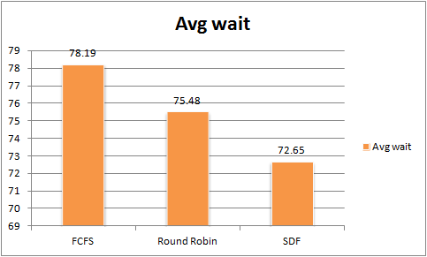
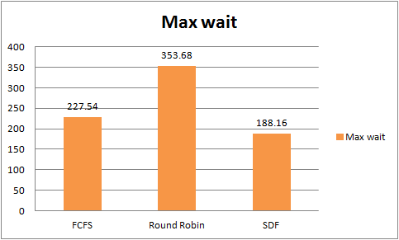
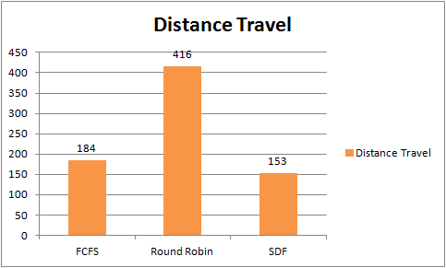
Comparison Chart

Slide 13
Conclusion
Elevator scheduling is a complex problem
Different passenger preference and arrival rate yield different optimal algorithm
Further research of other algorithm such as Nearest Car

Slide 14
Limitations
There are variabilities in actual passenger arrival rate and destination floors
Passenger may reacts differently regarding to wait time (taking steps instead)
The conflict between two objective less wait time and total distance traveled

Slide 15
References
M. Brand and D. Nikovski, “Optimal Parking in Group Elevator Control,” Proceedings of the 2004 IEEE International Conference on Robotics & Automation (2004) 1002-1008.
D. Nikovski and M. Brand, “Decision-theoretic group elevator scheduling,” 13th International Conference on Automated Planning and Scheduling (2003).
D. Nikovski and M. Brand, “Exact Calculation of Expected Waiting Times for Group Elevator Control,” IEEE Transportation Automation Control 49(10) pp. 1820-1823.
T. Strang and C. Bauer, “Context-Aware Elevator Scheduling,” 21st International Conference on Advanced Information Networking and Applications Workshops (2007) vol. 2 pp. 276-281.

