Slide 1


Nurse Scheduling Problems
IEOR 4405: Production Scheduling
April 26th, 2016
Zhenxin Chen
Jing Hu

Slide 2
The Nurse Scheduling Problem
Objective: Creating weekly schedules for wards containing up to 30 nurses at a Nottingham City Hospital
Requirements:
      Schedules must respect working contracts
      Schedules must meet demand for a given number of nurses of different grades on each shift
      Schedules must be perceived to be fair by all nurses
Nurse Shifts:
      Day Shift: (1) Earlies (2) Lates
      Night Shift
      Full-Time Nurse Shifts Example: 5 days/4 nights;
      Part-Time Nurse Shifts Example: 3 days/3 nights; 3 days/2nights
      Shift Pattern: 5 days/0 nights 0-1 vector with 14 elements 1111100|0000000
      Usually there are 411 different shift patterns
Problem Decomposition:
  Stage One: Knapsack Problem
  Stage Two: Allocation of days/nights for each nurse
  Stage Three: Create network flow model

Slide 3
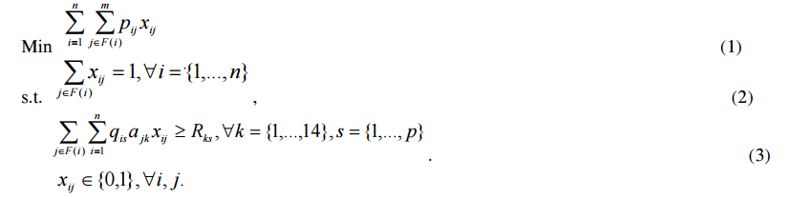
Nurse Scheduling Integer Programming Formulation
x_{ij} = 1 if nurse i works shift pattern j; 0 otherwise
a_{jk} = 1 if shift pattern j covers day/night k; 0 otherwise
q_{is} = 1 if nurse i is of grade s or higher; 0 otherwise
p_{ij} = preference cost of nurse i working shift pattern j range from 0(perfect) to 100(unacceptable)
m = number of shift patterns
n = number of nurses
p = number of grades
F(i) = set of feasible shift patterns for nurse i
(1) Objective function: Minimize total preference cost of all nurses
(2) Shift pattern constraint: every nurse works exactly one shift pattern
(3) Demand constraint: demand for nurses is fulfilled for every grade on every day & night

Slide 4
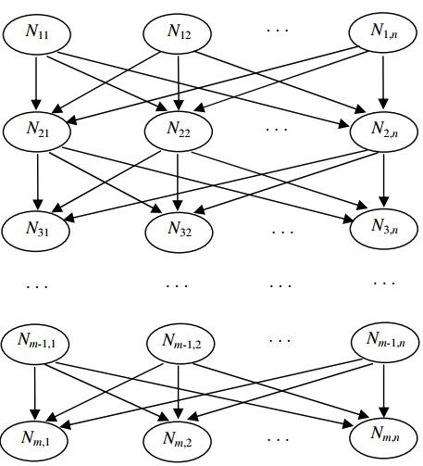
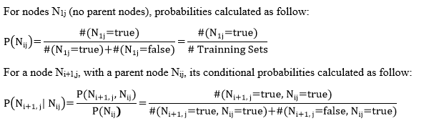
BOA for Nurse Scheduling - Bayesian Network for Nurse Problem
Bayesian Networks (Directed Graphical Models)
Node: a nurse/rule pair, nurse i is assigned by rule j
Edge: causal relationship of N_{ij} causing N_{i+1,j}
Potential Solution: directed path from nurse 1 to nurse m connecting m nodes
Fixed network structure: all variables are fully observed

Slide 5
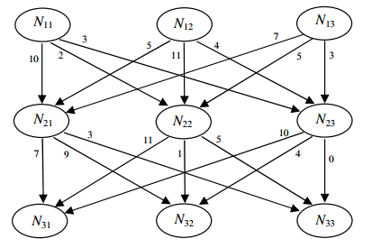
Baysian Network Example
Three nurses & three rules scheduling
Scheduling process repeated 50 times and each time rules are randomly used to get a solution
Number on the edge represents the total number of times this edge has been used in 50 runs

Slide 6
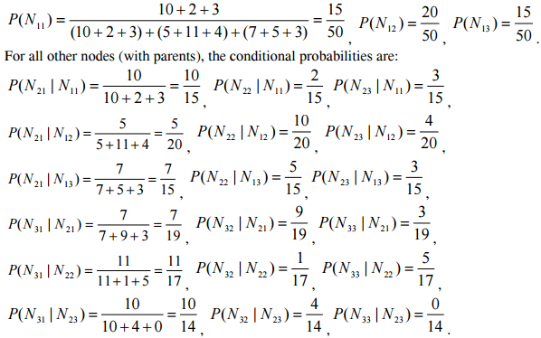
Baysian Network Example - Probability Calculation
First rule in a solution has no parents, it will be chosen from nodes N1j according to their probabilities.
Next rule will be chosen from nodes Nij according to the conditional probabilities.
Building process is repeated until the last node Nmj has been chosen.
A path formed from Nurse 1 to Nurse m, as a new potential solution

Slide 7
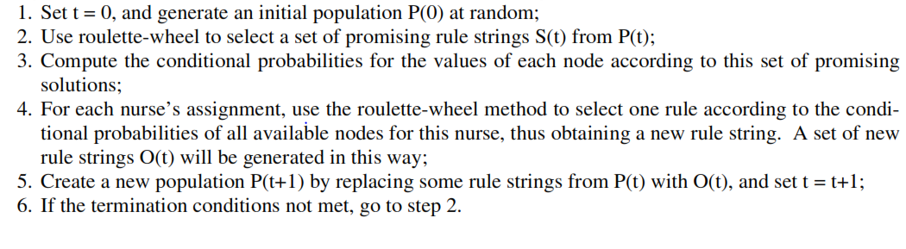
Steps of BOA for Nurse Scheduling

Slide 8
A Greedy Double Swap Heuristic
Objective: A greedy double swap heuristic for nurse scheduling satisfies not only hard constraints, but also soft constraints
Hard constraints: regulatory requirements, patient demands, etc., can be formulated into mathematical programming
      H1: Minimum Rest Days Constraint;
      H2: Maximum Consecutive Work Days with Rest Day constraint;
      H3: Nurse Requirement Constraint;
      H4: Annual Leave and Training Leave Constraint;
      H5: No consecutive shift constraint;
Soft constraints: We take penalty cost as the indicator of preference. The higher the penalty cost, the lower the preference, and vice versa.
      S1: An afternoon shift should not be followed by a morning shift the next day;
      S2: Continuous rest days are not preferred unless it meant to follow 4 consecutive night shifts;
      S3: A rest day should be followed by more than 1 work day;
      S4: Three or four consecutive night shifts are not preferred.
Greedy double swap heuristic(GDSH):
Two-phase algorithm
Pros and cons

Slide 9
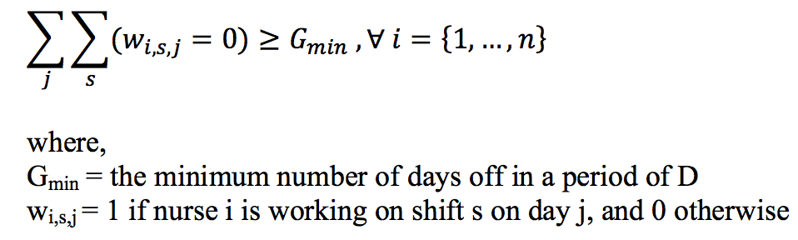
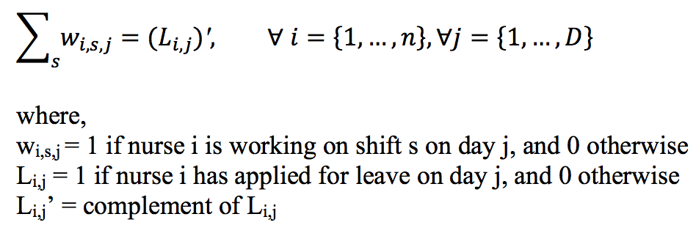
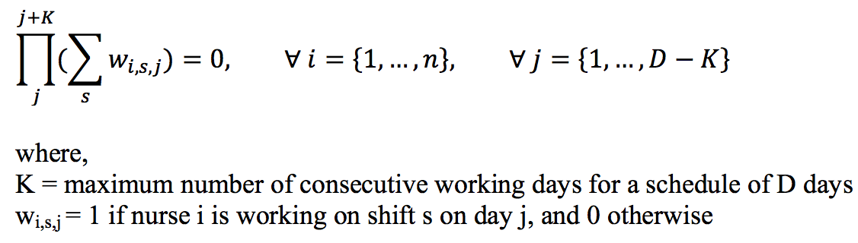
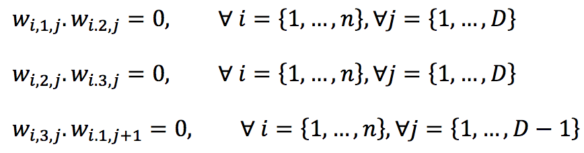
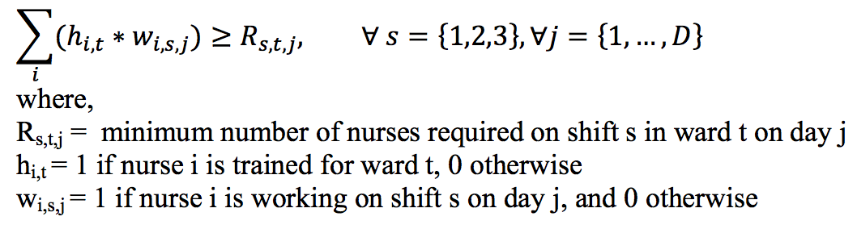
Hard Constraints Mathematical Programming Formulation
H1: Minimum rest day constraint
H4: Annual leave and training leave constraint
H2: Maximum Consecutive Work Days with Rest Day constraint
H5: No consecutive shift constraint
H3: Nurse requirement constraint

Slide 10
Greedy Double Swap Algorithm
Initialization
total number of nurses meets the total duty requirements
initialize the initial schedule of nurses
will probably not satisfy the hard constraint
define the required days for leave of absence
Initialization
Read in the parameters.
Calculate the manpower supply and demand.
I. If demand exceeds supply, terminate.
II. Else, continue.
3. Initialize an initial schedule of the nurse based on the nurses required number of working days. This initial solution may violate the hard constraints.
4. Input the required days for leave of absence.

Slide 11
Greedy Double Swap Algorithm-Phase I and Phase II
Phase I
Swap the shift for day i and day j for nurse n.
To find schedules that meet the hard constraints
For each iteration, we adapt the schedule that improves the percentage of hard constraints met after swap
Phase II
To minimize the penalty cost function incurred by every nurse.
The lower the penalty cost means that the higher the nurse’s preference on that schedule.
Phase 2 - Double swap with minimization of penalty cost
Calculate the total penalty cost incurred by every nurse.
Search for the nurse n which contributes most to the penalty cost objective function.
Select another nurse m randomly.
Randomly select two days i and j.
Swap shifts of nurse n and m for day i and day j.
Check for hard constraints conditions. If there is violate, reverse and move;else, continue.
7. If step 6 continues, check for penalty cost objective function improvement. If there is no improvement, move and reverse; otherwise, continue.
8. Repeat steps 1-8 until penalty cost objective function equal to 0 or iterations exceed 10,000.
Phase 1- First swap between shifts for the same nurse
Randomly select a nurse n.
Swap the shift for day i and day j for nurse n.
Check for hard constraints condition.
I. If the percentage of hard constraints met improves, then use the new solution.
II. Use back the old solution.
4. Repeat steps 1 to 3 until 100% of hard constraints are met or iterations exceed 1,000,000.

Slide 12
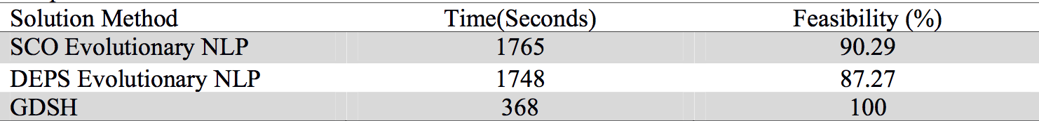
Greedy Double Swap Heuristic(GDSH)-Evaluation
The paper by Murphy Choy and Michelle Cheong’s paper provides valuable simulation results for evaluating the greedy double swap heuristic.
Compare to simplified version of the NSP problem, GDSH takes soft constraints, namely, nurses’ preference into consideration.
Higher feasibility means higher percentage of the constraints met.
Get result quickly.
(100 simulations runs for a case of 6 nurses without any specialist training for a single ward for a 5-day schedule)
(100 simulations run for 15 nurses with specialist requirements for a single ward for a 14-day schedule)
Limitation
10% of the simulation runs resulted in failure.
It cannot account for cases where multiple swaps among several variables are needed to meet the hard constraints.
Have assumed a preference structure which is uniform among the nurses.

Slide 13
Further Studies
We’ve obtained 52 real data sets, each data set consists of one week’s requirements for all shift and grade combinations and a list of available nurses together with their preference costs pij and qualifications
Data was collected from three wards over a period of several months and covers a range of scheduling situations
We will make comparisons, identify pros and cons

