Slide 1

Semiconductor Factory
Should we take on this additional order?
Chaun M.
Haozheng K.
Hsuan-Wei C.
Renyuan Y.
Notes:
Our team has started to process
the production data to come up with a model that we are able to solve.
First, the most interesting aspect of the structure of our production factory is that it
contains characteristics of both a flow shop and a job shop. The production for the 5 different
projects go through similar set of machines under same precedence constraints, much like an
assembly line. However, our shop also has the aspect of recirculation. Some products must
circulate through some of the machines multiple times. In this report, we will outline how we
apply scheduling theories of both flow shop and job shop to come up with a feasible schedule.
We made a few reasonable assumptions in our preliminary data processing. First, some of
the products go through the same machine multiple times and others don’t. For example, the
3x2.5 semiconductors have to go through multiple die attaches, requiring a total of 21 steps to
complete. (This is the product that requires the most steps.) On the other hand, the 10.2x11
semiconductors require 16 steps in the same sequence of machines but only with die attach once.
When we tabulate the processing time for different machines, we assumed all jobs must go
through all 21 steps. For the jobs that do not actually go through those additional steps, we
assumed the processing time of those jobs on those additional “machines” to be 0. Since these
additional steps are actually the recirculation, assuming 0 processing time for the products that
don’t recirculate would simplify our problem. (See table below)
Also, we have several quantity of machines of each type. We normalized our processing
time using: processing time of job j on machine i= (processing time of job j on 1 machine
i)/(number of machine i) Another factor we had to consider was the overall equipment
effectiveness, or OEE. This figure includes considerations such as set up time, maintenance, and
repair. Fortunately, the company provided us with these percentages. We then used our
processing time to divide by these percentages. For example, if job j takes 10 minutes to
complete on machine i, and machine i has an OEE of 80%, job j on machine i actually takes
10/0.8 = 12.5 minutes.

Slide 2
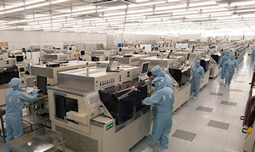

Background
Info:
Global Taiwanese Semiconductor Firm
5 Different Products for a given manufacturing floor of plant in Kaohsiung, Taiwan
Inefficient Current Solution in terms of determining whether new jobs should be accepted
Goal:
Optimize Resource Allocation
Yan
Notes:
We are working with a global semiconductor firm in terms of optimizing their production schedule for a specific product that has 5 different batch sizes. Upon further discussion with the company regarding the technical features in this process, we have concluded that the process flow must be in the following order as shown in the first diagram, where the 4 processes: 2600, 2700, 2800 and 3100 follow a cycle until the inspection is complete.

Slide 3
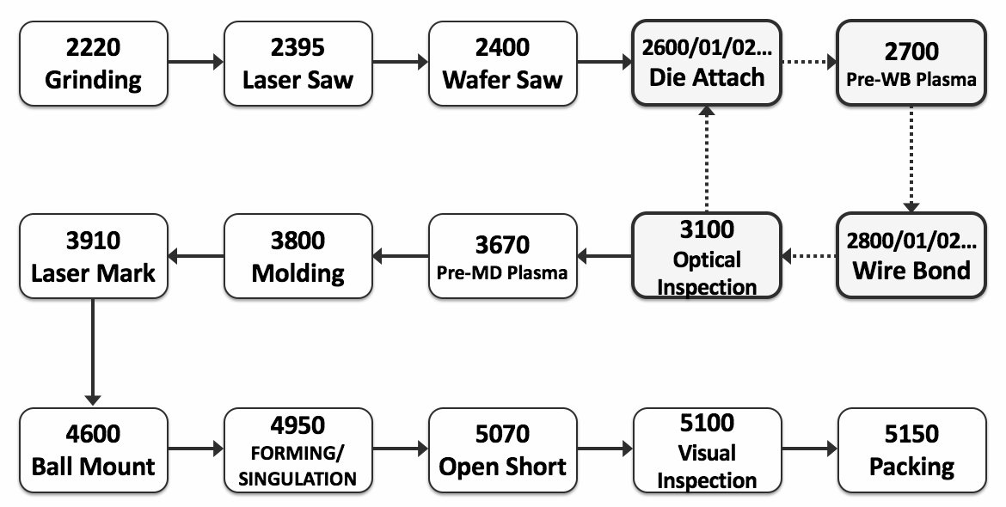
Establishing the Manufacturing Process
Semiconductors
Cycle
1
2
3
4
5
Yan
Notes:
We are working with a global semiconductor firm in terms of optimizing their production schedule for a specific product that has 5 different batch sizes. Upon further discussion with the company regarding the technical features in this process, we have concluded that the process flow must be in the following order as shown in the first diagram, where the 4 processes: 2600, 2700, 2800 and 3100 follow a cycle until the inspection is complete.

Slide 4

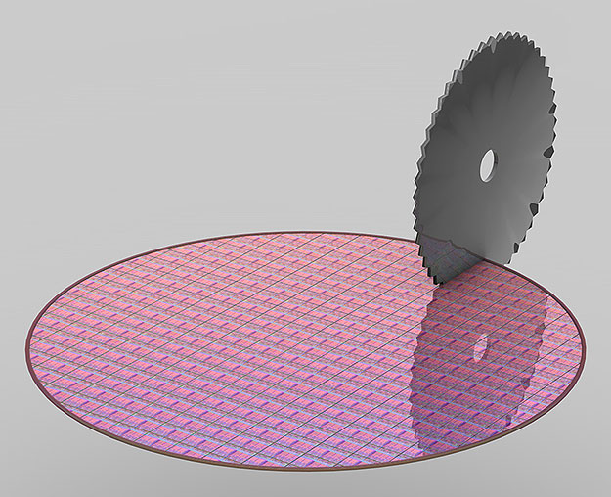
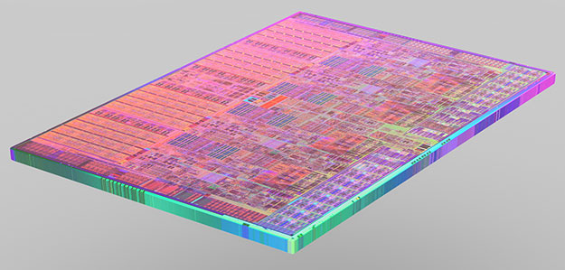


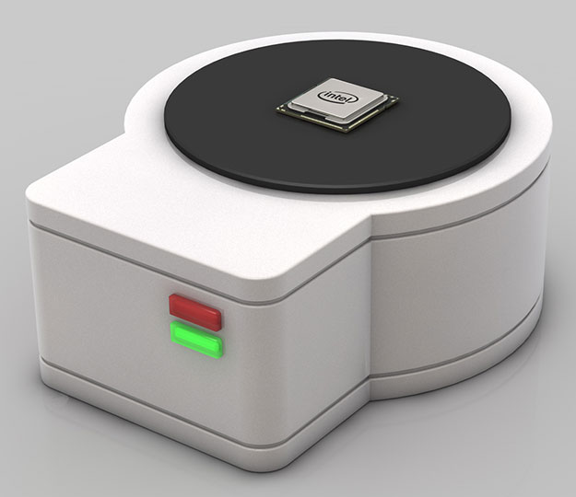

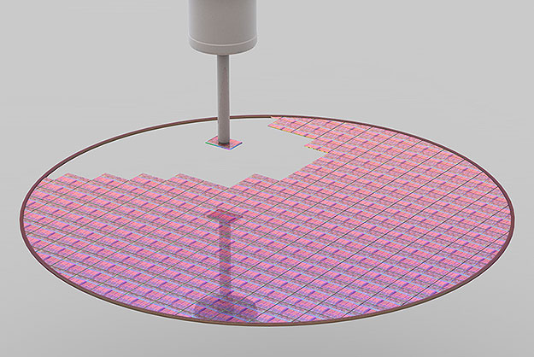
Maybe this is easier to comprehend?
Yan

Slide 5
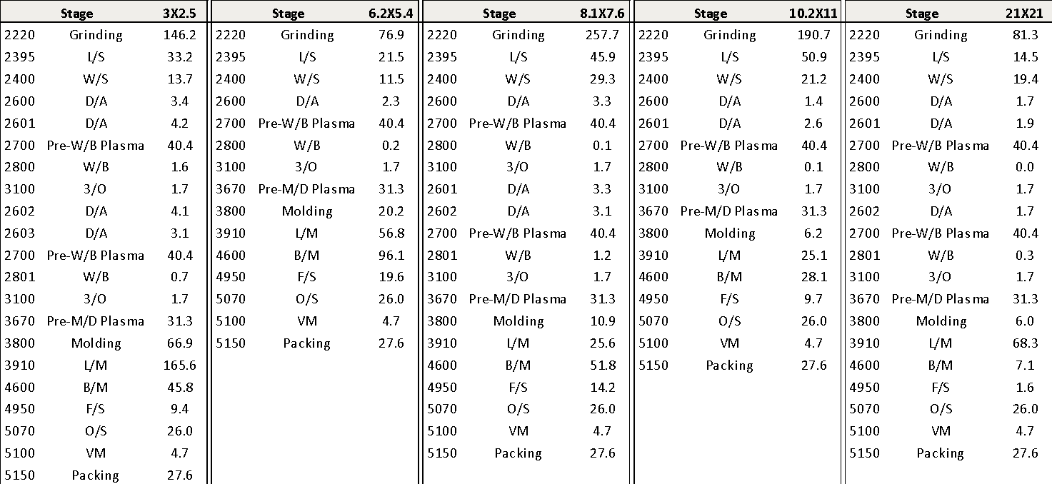
Number of Units Processed Per Station Per Hour
Yan
Notes:
As shown in the diagram, we are working with products that have product sizes of 3X2.5, 6.2X5.4, 8.1X7.6, 10.2X11 and 21X21 respectively. Each of these products have different utilization requirements at each stage.

Slide 6
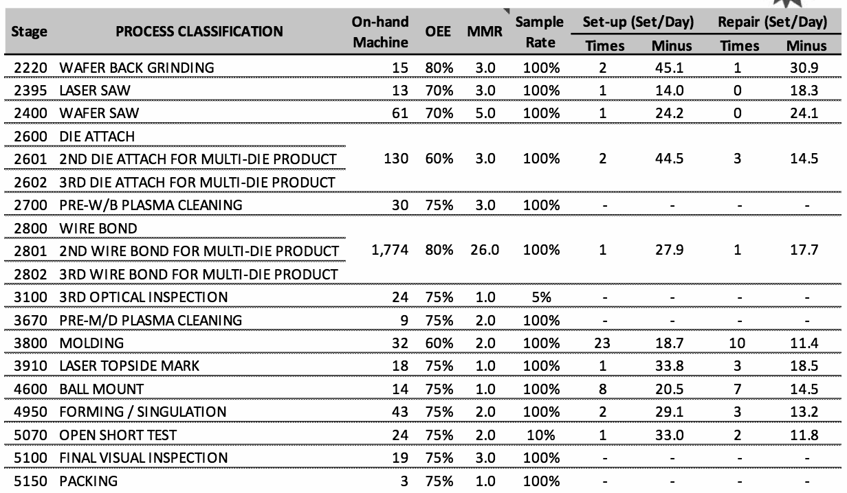
Quantity of Machines Additional Parameters
Yan
Notes:
As shown in the diagram, every machine, each corresponding to a stage process, has an average utilization rate per 24 hours (OEE), average setup/repair times and frequencies per day.

Slide 7
Thought Process
Want an Integer Program
Help Firm Decide to Take Additional Jobs or Not
Chen
Notes:
Thus, we thought creating a linear program that will optimize the allocation of resources in a manner according to how many batches of each product needs to be produced and what their specific due dates are.
Help the firm to make decisions whether valuable or not to take additional jobs

Slide 8


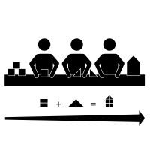

Thought Process
Flow Shop
Job Shop
Chen
Notes:
First, the most interesting aspect of the structure of our production factory is that it contains characteristics of both a flow shop and a job shop. The production for the 5 different projects go through similar set of machines under same precedence constraints, much like an assembly line. However, our shop also has the aspect of recirculation. Some products must circulate through some of the machines multiple times. In this report, we will outline how we apply scheduling theories of both flow shop and job shop to come up with a feasible schedule.

Slide 9

Assumptions
Assume all jobs have 21 steps
  Some have less
  Those with less have P_{j,i} = 0 on extra steps
Normalize processing time
  P_{j,i} = P_{j,i (one machine)}÷ (# machine i’s)
  Overall Equipment Effectiveness
Unlimited intermediate inventory space
A S S
U M E
Chen
Notes:
We made a few reasonable assumptions in our preliminary data processing. we assumed all jobs must go through all 21 steps. For the jobs that do not actually go through those additional steps, we assumed the processing time of those jobs on those additional “machines” to be 0. Since these additional steps are actually the recirculation, assuming 0 processing time for the products that don’t recirculate would simplify our problem. (See table below) Also, we have several quantity of machines of each type.
We normalized our processing time using: processing time of job j on machine i= (processing time of job j on 1 machine i)/(number of machine i) Another factor we had to consider was the overall equipment effectiveness, or OEE. This figure includes considerations such as set up time, maintenance, and repair. Fortunately, the company provided us with these percentages. We then used our processing time to divide by these percentages. For example, if job j takes 10 minutes to complete on machine i, and machine i has an OEE of 80%, job j on machine i actually takes 10/0.8 = 12.5 minutes.
The third assumption is that we have unlimited intermediate inventory space. We specifically contacted the factory and they told us that due to the small sizes of semiconductors, intermediate inventory is not a major concern.

Slide 10

The IP
Min Σ_{j=1,n}[f_{j}•U_{j} ]
S.t.
C_{j,m}– U_{j}•M ≤ Σ_{i=1,n} x_{i,j}•d_{i}
C_{1,m}= Σ_{k=1,n-1} (Σ_{i=1,n} (x_{i,1}•P_{i,k}) + w_{1,k})+Σ_{i=1,n} x_{i,1}•P_{i,m}
C_{j,m}= C_{j-1,m}+ I_{j-1,m}+Σ_{i=1,n} (x_{i,j}•P_{i,m})
I_{j,k}+ Σ_{i=1,n} (x_{i,j+1}•P_{i,k}) + w_{j+1,k}= w_{j+1,k}+ Σ_{i=1,n} (x_{i,j}•P_{i,k+1}) + I_{j,k+1}
Σ_{i=1,n} x_{i,j} = 1
Σ_{j=1,n} x_{i,j} = 1
x_{i,j} ε {0,1}
w_{i,j}, I_{i,j} ≥ 0
for j = 1, … ,n
for j = 2, … ,n
for j = 1, … ,n for i = 1, … ,n
Special Thanks to Chun Ye!
Citation: “Mixed-integer programming models for flowshop scheduling problems minimizing the total earliness and tardiness”, Debora P. Ronconi, Ernesto G. Birgin, University of Sao Paulo
Kong
Notes:
We made a few reasonable assumptions in our preliminary data processing. we assumed all jobs must go through all 21 steps. For the jobs that do not actually go through those additional steps, we assumed the processing time of those jobs on those additional “machines” to be 0. Since these additional steps are actually the recirculation, assuming 0 processing time for the products that don’t recirculate would simplify our problem. (See table below) Also, we have several quantity of machines of each type.
We normalized our processing time using: processing time of job j on machine i= (processing time of job j on 1 machine i)/(number of machine i) Another factor we had to consider was the overall equipment effectiveness, or OEE. This figure includes considerations such as set up time, maintenance, and repair. Fortunately, the company provided us with these percentages. We then used our processing time to divide by these percentages. For example, if job j takes 10 minutes to complete on machine i, and machine i has an OEE of 80%, job j on machine i actually takes 10/0.8 = 12.5 minutes.
The third assumption is that we have unlimited intermediate inventory space. We specifically contacted the factory and they told us that due to the small sizes of semiconductors, intermediate inventory is not a major concern.

Slide 11
The IP
Parameters
Min Σ_{j=1,n}[f_{j}•U_{j} ]
S.t.
C_{j,m}– U_{j}•M ≤ Σ_{i=1,n} x_{i,j}•d_{i}
C_{1,m}= Σ_{k=1,n-1} (Σ_{i=1,n} (x_{i,1}•P_{i,k}) + w_{1,k})+Σ_{i=1,n} x_{i,1}•P_{i,m}
C_{j,m}= C_{j-1,m}+ I_{j-1,m}+Σ_{i=1,n} (x_{i,j}•P_{i,m})
I_{j,k}+ Σ_{i=1,n} (x_{i,j+1}•P_{i,k}) + w_{j+1,k}= w_{j+1,k}+ Σ_{i=1,n} (x_{i,j}•P_{i,k+1}) + I_{j,k+1}
Σ_{i=1,n} x_{i,j} = 1
Σ_{j=1,n} x_{i,j} = 1
x_{i,j} ε {0,1}
w_{i,j}, I_{i,j} ≥ 0
- n # jobs
- m # machines
- P_{i,k} Processing time job i on m
- d_{i} due date of job i
- M Large constant variable
- f_{j} Late fee of job j
for j = 1, … ,n
for j = 2, … ,n
for j = 1, … ,n for i = 1, … ,n
Kong
Notes:
We made a few reasonable assumptions in our preliminary data processing. we assumed all jobs must go through all 21 steps. For the jobs that do not actually go through those additional steps, we assumed the processing time of those jobs on those additional “machines” to be 0. Since these additional steps are actually the recirculation, assuming 0 processing time for the products that don’t recirculate would simplify our problem. (See table below) Also, we have several quantity of machines of each type.
We normalized our processing time using: processing time of job j on machine i= (processing time of job j on 1 machine i)/(number of machine i) Another factor we had to consider was the overall equipment effectiveness, or OEE. This figure includes considerations such as set up time, maintenance, and repair. Fortunately, the company provided us with these percentages. We then used our processing time to divide by these percentages. For example, if job j takes 10 minutes to complete on machine i, and machine i has an OEE of 80%, job j on machine i actually takes 10/0.8 = 12.5 minutes.
The third assumption is that we have unlimited intermediate inventory space. We specifically contacted the factory and they told us that due to the small sizes of semiconductors, intermediate inventory is not a major concern.

Slide 12
The IP
Variables
Min Σ_{j=1,n}[f_{j}•U_{j} ]
S.t.
C_{j,m}– U_{j}•M ≤ Σ_{i=1,n} x_{i,j}•d_{i}
C_{1,m}= Σ_{k=1,n-1} (Σ_{i=1,n} (x_{i,1}•P_{i,k}) + w_{1,k})+Σ_{i=1,n} x_{i,1}•P_{i,m}
C_{j,m}= C_{j-1,m}+ I_{j-1,m}+Σ_{i=1,n} (x_{i,j}•P_{i,m})
I_{j,k}+ Σ_{i=1,n} (x_{i,j+1}•P_{i,k}) + w_{j+1,k}= w_{j+1,k}+ Σ_{i=1,n} (x_{i,j}•P_{i,k+1}) + I_{j,k+1}
Σ_{i=1,n} x_{i,j} = 1
Σ_{j=1,n} x_{i,j} = 1
x_{i,j} ε {0,1}
w_{i,j}, I_{i,j} ≥ 0
-U_{j} Late job indicator
- x_{i,j} 1 if i^{th} job in j^{th} position
- I_{j,k} idle time b/w j^{th} & (j+1)^{th}
job on machine k
- w_{j,k} wait time job j b/w
machine m & (m+1)
- C_{j,m} Compl. Time job j on m
for j = 1, … ,n
for j = 2, … ,n
for j = 1, … ,n for i = 1, … ,n
Kong
Notes:
We made a few reasonable assumptions in our preliminary data processing. we assumed all jobs must go through all 21 steps. For the jobs that do not actually go through those additional steps, we assumed the processing time of those jobs on those additional “machines” to be 0. Since these additional steps are actually the recirculation, assuming 0 processing time for the products that don’t recirculate would simplify our problem. (See table below) Also, we have several quantity of machines of each type.
We normalized our processing time using: processing time of job j on machine i= (processing time of job j on 1 machine i)/(number of machine i) Another factor we had to consider was the overall equipment effectiveness, or OEE. This figure includes considerations such as set up time, maintenance, and repair. Fortunately, the company provided us with these percentages. We then used our processing time to divide by these percentages. For example, if job j takes 10 minutes to complete on machine i, and machine i has an OEE of 80%, job j on machine i actually takes 10/0.8 = 12.5 minutes.
The third assumption is that we have unlimited intermediate inventory space. We specifically contacted the factory and they told us that due to the small sizes of semiconductors, intermediate inventory is not a major concern.

Slide 13
The IP
Min Σ_{j=1,n}[f_{j}•U_{j} ]
S.t.
C_{j,m}– U_{j}•M ≤ Σ_{i=1,n} x_{i,j}•d_{i}
C_{1,m}= Σ_{k=1,n-1} (Σ_{i=1,n} (x_{i,1}•P_{i,k}) + w_{1,k})+Σ_{i=1,n} x_{i,1}•P_{i,m}
C_{j,m}= C_{j-1,m}+ I_{j-1,m}+Σ_{i=1,n} (x_{i,j}•P_{i,m})
I_{j,k}+ Σ_{i=1,n} (x_{i,j+1}•P_{i,k}) + w_{j+1,k}= w_{j+1,k}+ Σ_{i=1,n} (x_{i,j}•P_{i,k+1}) + I_{j,k+1}
Σ_{i=1,n} x_{i,j} = 1
Σ_{j=1,n} x_{i,j} = 1
x_{i,j} ε {0,1}
w_{i,j}, I_{i,j} ≥ 0
If we are late, U_{j} = 1
Otherwise, U_{j} = 0
for j = 1, … ,n
for j = 2, … ,n
for j = 1, … ,n for i = 1, … ,n
Kong

Slide 14
The IP
Min Σ_{j=1,n}[f_{j}•U_{j} ]
S.t.
C_{j,m}– U_{j}•M ≤ Σ_{i=1,n} x_{i,j}•d_{i}
C_{1,m}= Σ_{k=1,n-1} (Σ_{i=1,n} (x_{i,1}•P_{i,k}) + w_{1,k})+Σ_{i=1,n} x_{i,1}•P_{i,m}
C_{j,m}= C_{j-1,m}+ I_{j-1,m}+Σ_{i=1,n} (x_{i,j}•P_{i,m})
I_{j,k}+ Σ_{i=1,n} (x_{i,j+1}•P_{i,k}) + w_{j+1,k}= w_{j+1,k}+ Σ_{i=1,n} (x_{i,j}•P_{i,k+1}) + I_{j,k+1}
Σ_{i=1,n} x_{i,j} = 1
Σ_{j=1,n} x_{i,j} = 1
x_{i,j} ε {0,1}
w_{i,j}, I_{i,j} ≥ 0
If we are late, U_{j} = 1
Otherwise, U_{j} = 0
for j = 1, … ,n
for j = 2, … ,n
for j = 1, … ,n for i = 1, … ,n
The job ordered in the 1st position
only depends on its own processing
time and the waiting time between the
machines.
Kong
Notes:
We made a few reasonable assumptions in our preliminary data processing. we assumed all jobs must go through all 21 steps. For the jobs that do not actually go through those additional steps, we assumed the processing time of those jobs on those additional “machines” to be 0. Since these additional steps are actually the recirculation, assuming 0 processing time for the products that don’t recirculate would simplify our problem. (See table below) Also, we have several quantity of machines of each type.
We normalized our processing time using: processing time of job j on machine i= (processing time of job j on 1 machine i)/(number of machine i) Another factor we had to consider was the overall equipment effectiveness, or OEE. This figure includes considerations such as set up time, maintenance, and repair. Fortunately, the company provided us with these percentages. We then used our processing time to divide by these percentages. For example, if job j takes 10 minutes to complete on machine i, and machine i has an OEE of 80%, job j on machine i actually takes 10/0.8 = 12.5 minutes.
The third assumption is that we have unlimited intermediate inventory space. We specifically contacted the factory and they told us that due to the small sizes of semiconductors, intermediate inventory is not a major concern.

Slide 15
The IP
Min Σ_{j=1,n}[f_{j}•U_{j} ]
S.t.
C_{j,m}– U_{j}•M ≤ Σ_{i=1,n} x_{i,j}•d_{i}
C_{1,m}= Σ_{k=1,n-1} (Σ_{i=1,n} (x_{i,1}•P_{i,k}) + w_{1,k})+Σ_{i=1,n} x_{i,1}•P_{i,m}
C_{j,m}= C_{j-1,m}+ I_{j-1,m}+Σ_{i=1,n} (x_{i,j}•P_{i,m})
I_{j,k}+ Σ_{i=1,n} (x_{i,j+1}•P_{i,k}) + w_{j+1,k}= w_{j+1,k}+ Σ_{i=1,n} (x_{i,j}•P_{i,k+1}) + I_{j,k+1}
Σ_{i=1,n} x_{i,j} = 1
Σ_{j=1,n} x_{i,j} = 1
x_{i,j} ε {0,1}
w_{i,j}, I_{i,j} ≥ 0
If we are late, U_{j} = 1
Otherwise, U_{j} = 0
for j = 1, … ,n
for j = 2, … ,n
for j = 1, … ,n for i = 1, … ,n
The job ordered in the 1st position
only depends on its own processing
time and the waiting time between the
machines.
Completion Time Constraint
Kong
Notes:
We made a few reasonable assumptions in our preliminary data processing. we assumed all jobs must go through all 21 steps. For the jobs that do not actually go through those additional steps, we assumed the processing time of those jobs on those additional “machines” to be 0. Since these additional steps are actually the recirculation, assuming 0 processing time for the products that don’t recirculate would simplify our problem. (See table below) Also, we have several quantity of machines of each type.
We normalized our processing time using: processing time of job j on machine i= (processing time of job j on 1 machine i)/(number of machine i) Another factor we had to consider was the overall equipment effectiveness, or OEE. This figure includes considerations such as set up time, maintenance, and repair. Fortunately, the company provided us with these percentages. We then used our processing time to divide by these percentages. For example, if job j takes 10 minutes to complete on machine i, and machine i has an OEE of 80%, job j on machine i actually takes 10/0.8 = 12.5 minutes.
The third assumption is that we have unlimited intermediate inventory space. We specifically contacted the factory and they told us that due to the small sizes of semiconductors, intermediate inventory is not a major concern.

Slide 16
The IP
Min Σ_{j=1,n}[f_{j}•U_{j} ]
S.t.
C_{j,m}– U_{j}•M ≤ Σ_{i=1,n} x_{i,j}•d_{i}
C_{1,m}= Σ_{k=1,n-1} (Σ_{i=1,n} (x_{i,1}•P_{i,k}) + w_{1,k})+Σ_{i=1,n} x_{i,1}•P_{i,m}
C_{j,m}= C_{j-1,m}+ I_{j-1,m}+Σ_{i=1,n} (x_{i,j}•P_{i,m})
I_{j,k}+ Σ_{i=1,n} (x_{i,j+1}•P_{i,k}) + w_{j+1,k}= w_{j+1,k}+ Σ_{i=1,n} (x_{i,j}•P_{i,k+1}) + I_{j,k+1}
Σ_{i=1,n} x_{i,j} = 1
Σ_{j=1,n} x_{i,j} = 1
x_{i,j} ε {0,1}
w_{i,j}, I_{i,j} ≥ 0
If we are late, U_{j} = 1
Otherwise, U_{j} = 0
for j = 1, … ,n
for j = 2, … ,n
for j = 1, … ,n for i = 1, … ,n
The job ordered in the 1st position
only depends on its own processing
time and the waiting time between the
machines.
Completion Time Constraint
Wait Time and Idle Time Constraint
Kong
Notes:
We made a few reasonable assumptions in our preliminary data processing. we assumed all jobs must go through all 21 steps. For the jobs that do not actually go through those additional steps, we assumed the processing time of those jobs on those additional “machines” to be 0. Since these additional steps are actually the recirculation, assuming 0 processing time for the products that don’t recirculate would simplify our problem. (See table below) Also, we have several quantity of machines of each type.
We normalized our processing time using: processing time of job j on machine i= (processing time of job j on 1 machine i)/(number of machine i) Another factor we had to consider was the overall equipment effectiveness, or OEE. This figure includes considerations such as set up time, maintenance, and repair. Fortunately, the company provided us with these percentages. We then used our processing time to divide by these percentages. For example, if job j takes 10 minutes to complete on machine i, and machine i has an OEE of 80%, job j on machine i actually takes 10/0.8 = 12.5 minutes.
The third assumption is that we have unlimited intermediate inventory space. We specifically contacted the factory and they told us that due to the small sizes of semiconductors, intermediate inventory is not a major concern.

Slide 17
Wait and Idle Times Explained
I_{j,k}
I_{j,k}+ P_{j+1}+ w_{j+1,k}
w_{j+1,k}
I_{j,k}+ P_{j+1}+ w_{j+1,k}
=
w_{j,k}+ P_{j}+ I_{j,k+1}
M_{k}
J^{th} Job
(J+1)^{th} Job
M_{k+1}
J^{th} Job
(J+1)^{th} Job
w_{j,k}
I_{j,k+1}
w_{j,k}+ P_{j}+ I_{j,k+1}
Kong
Notes:
We made a few reasonable assumptions in our preliminary data processing. we assumed all jobs must go through all 21 steps. For the jobs that do not actually go through those additional steps, we assumed the processing time of those jobs on those additional “machines” to be 0. Since these additional steps are actually the recirculation, assuming 0 processing time for the products that don’t recirculate would simplify our problem. (See table below) Also, we have several quantity of machines of each type.
We normalized our processing time using: processing time of job j on machine i= (processing time of job j on 1 machine i)/(number of machine i) Another factor we had to consider was the overall equipment effectiveness, or OEE. This figure includes considerations such as set up time, maintenance, and repair. Fortunately, the company provided us with these percentages. We then used our processing time to divide by these percentages. For example, if job j takes 10 minutes to complete on machine i, and machine i has an OEE of 80%, job j on machine i actually takes 10/0.8 = 12.5 minutes.
The third assumption is that we have unlimited intermediate inventory space. We specifically contacted the factory and they told us that due to the small sizes of semiconductors, intermediate inventory is not a major concern.

Slide 18
The IP
Min Σ_{j=1,n}[f_{j}•U_{j} ]
S.t.
C_{j,m}– U_{j}•M ≤ Σ_{i=1,n} x_{i,j}•d_{i}
C_{1,m}= Σ_{k=1,n-1} (Σ_{i=1,n} (x_{i,1}•P_{i,k}) + w_{1,k})+Σ_{i=1,n} x_{i,1}•P_{i,m}
C_{j,m}= C_{j-1,m}+ I_{j-1,m}+Σ_{i=1,n} (x_{i,j}•P_{i,m})
I_{j,k}+ Σ_{i=1,n} (x_{i,j+1}•P_{i,k}) + w_{j+1,k}= w_{j+1,k}+ Σ_{i=1,n} (x_{i,j}•P_{i,k+1}) + I_{j,k+1}
Σ_{i=1,n} x_{i,j} = 1
Σ_{j=1,n} x_{i,j} = 1
x_{i,j} ε {0,1}
w_{i,j}, I_{i,j} ≥ 0
If we are late, U_{j} = 1
Otherwise, U_{j} = 0
for j = 1, … ,n
for j = 2, … ,n
for j = 1, … ,n for i = 1, … ,n
The job ordered in the 1st position
only depends on its own processing
time and the waiting time between the
machines.
Completion Time Constraint
Permutation Constraints
Wait Time and Idle Time Constraint
Binary Constraint
Waiting Time and Idle Time Constraint
Kong
Notes:
We made a few reasonable assumptions in our preliminary data processing. we assumed all jobs must go through all 21 steps. For the jobs that do not actually go through those additional steps, we assumed the processing time of those jobs on those additional “machines” to be 0. Since these additional steps are actually the recirculation, assuming 0 processing time for the products that don’t recirculate would simplify our problem. (See table below) Also, we have several quantity of machines of each type.
We normalized our processing time using: processing time of job j on machine i= (processing time of job j on 1 machine i)/(number of machine i) Another factor we had to consider was the overall equipment effectiveness, or OEE. This figure includes considerations such as set up time, maintenance, and repair. Fortunately, the company provided us with these percentages. We then used our processing time to divide by these percentages. For example, if job j takes 10 minutes to complete on machine i, and machine i has an OEE of 80%, job j on machine i actually takes 10/0.8 = 12.5 minutes.
The third assumption is that we have unlimited intermediate inventory space. We specifically contacted the factory and they told us that due to the small sizes of semiconductors, intermediate inventory is not a major concern.

Slide 19



The Code: Assumptions
1
2
3
Due Dates
Late Fees
Job Batch
Size of 10,000
Medeiros
Notes:
The team coded in AMPL the integer program Andy just discussed. However, some additional assumptions were required to formulate the program. We did our best using the information we were given to approximate the actual job batch sizes, due dates for jobs, and the associated late fees.

Slide 20
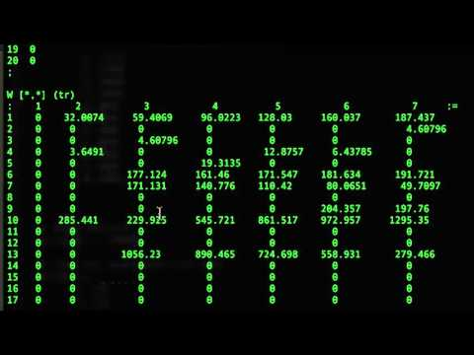

The AMPL Output
Demo
Medeiros
Notes:
Now let’s take a look at a brief demo of what the program outputs. As you can see, it shows the objective value, completion time, lateness matrix, permutated matrix (X), outputs wait time and idle times.

Slide 21

The AMPL Output
Demo
Medeiros
Notes:
So it’s pretty cool what it outputs, and we are certainly pleased with the results. Now to help visualize the first case, we put together a ∆

Slide 22
Idle Time M₆
Permutation Schedule - Case 1
Job Batch Order:
6-3-4-10-9-2-7-5-1-17-14-20-13-12-19-16-11-15-18-8
Machines
Finish Time: 25,905
Wait Time J₁₀
Time (hours)
Medeiros
Notes:
Permutation schedule to display our results. There is a lot going on here but this can give you an idea of what is going on through the 21 machines and 20 job batches. For Case one, we had a completion time of 25,905 hours, and the optimal job batch order as shown.

Slide 23




Solving Our Case
20
Job Batches
∆ of 3 Job Batches
Added
23
Job Batches
1350
Obj. Value
∆ of 600
To Objective Value
1950
Obj. Value
If ∆ Revenue > 600
Take Job Batches
Medeiros
Notes:
So in summary of our results, we see that if there is an increase in 3 job batches to the current order, this yields a change in objective value by 600. So as long as the company can make more than the 600 that costs them in this simulation, then they should accept the new jobs. And now I will pass it to Matt to close off our presentation,

Slide 24


Limitations to Our Methodology
OEE assumes setup and repairs times
  Could further enhance IP to consider setup times
  Would repair times increase with possibly more frequent batch switching
Determination of batch size
  Need to work closely with factory to figure out a realistic batch size - current model requires LCM of the number machines per station
Chen

Slide 25
Thank You
Any Questions?
Chaun M.
Haozheng K.
Hsuan-Wei C.
Renyuan Y.
Notes:
Our team has started to process
the production data to come up with a model that we are able to solve.
First, the most interesting aspect of the structure of our production factory is that it
contains characteristics of both a flow shop and a job shop. The production for the 5 different
projects go through similar set of machines under same precedence constraints, much like an
assembly line. However, our shop also has the aspect of recirculation. Some products must
circulate through some of the machines multiple times. In this report, we will outline how we
apply scheduling theories of both flow shop and job shop to come up with a feasible schedule.
We made a few reasonable assumptions in our preliminary data processing. First, some of
the products go through the same machine multiple times and others don’t. For example, the
3x2.5 semiconductors have to go through multiple die attaches, requiring a total of 21 steps to
complete. (This is the product that requires the most steps.) On the other hand, the 10.2x11
semiconductors require 16 steps in the same sequence of machines but only with die attach once.
When we tabulate the processing time for different machines, we assumed all jobs must go
through all 21 steps. For the jobs that do not actually go through those additional steps, we
assumed the processing time of those jobs on those additional “machines” to be 0. Since these
additional steps are actually the recirculation, assuming 0 processing time for the products that
don’t recirculate would simplify our problem. (See table below)
Also, we have several quantity of machines of each type. We normalized our processing
time using: processing time of job j on machine i= (processing time of job j on 1 machine
i)/(number of machine i) Another factor we had to consider was the overall equipment
effectiveness, or OEE. This figure includes considerations such as set up time, maintenance, and
repair. Fortunately, the company provided us with these percentages. We then used our
processing time to divide by these percentages. For example, if job j takes 10 minutes to
complete on machine i, and machine i has an OEE of 80%, job j on machine i actually takes
10/0.8 = 12.5 minutes.

