Slide 1
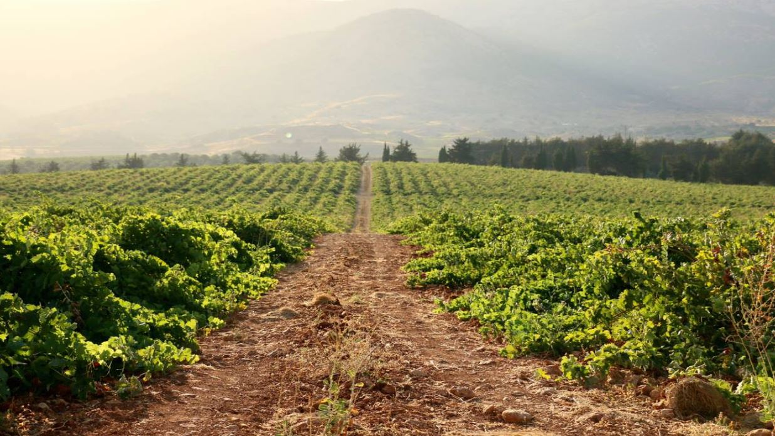
Bottling process of a winery
Scheduling 2017, Prof. Stein, Columbia University
Kamil Chaoui, Barbara Stickel, Snorri Tomasson

Slide 2
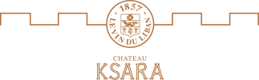
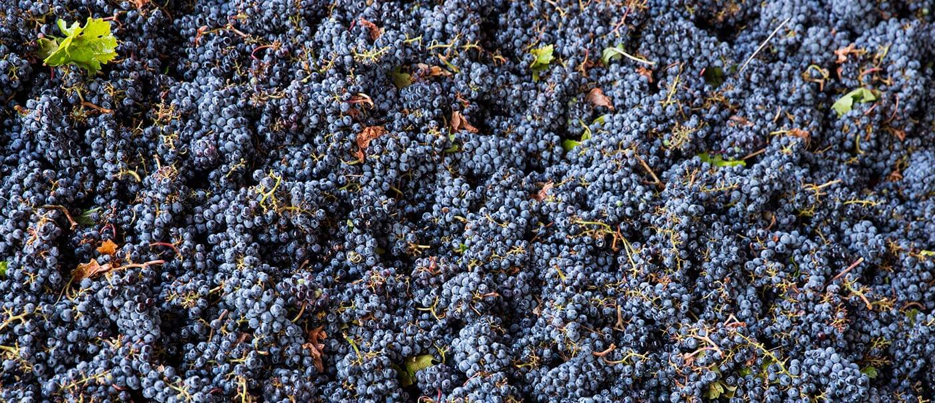
A winery could benefit from good scheduling practices due to increased produciton
1
Objective
2016 Production
2025 Production
  3,200,000
  bottles
  4,000,000
  bottles
Problems the winery is facing
Project Objective
  Meet demand on time for different products
  Limited storage capacity of bottled wine
  Create an annual schedule for the bottling process for 2025 based on forcaset demand
Notes:
With the current facilities, would it be possible to meet the demand on time for all of the different products?
Taking into account the storage capacity of bottled wines, by minimizing the storing time of final products?
We will also create tow different bottling schedule and compare them with the schedule that is current implemented

Slide 3
2
Project definition

Slide 4
Assumptions to organize the data
3
Assumptions
Assumptions
Sample of jobs
  One job represents the demand per product per month
Jobs | d_{j} | r_{j} | p_{j}
Pri_mar | 35 | 40 | 0.8
Pri_apr | 55 | 40 | 0.6
Pri_mai | 75 | 40 | 0.6
RDC_fev | 15 | 20 | 3.7
RDC_mar | 35 | 20 | 2.9
RDC_apr | 55 | 20 | 3.0
RDC_mai | 75 | 80 | 3.7
CDP_fev | 15 | 0 | 0.1
CDP_mar | 35 | 0 | 0.1
CDP_apr | 55 | 0 | 0.1
CDP_mai | 75 | 0 | 0.1
B2B-fev | 15 | 0 | 2.7
B2B_mar | 35 | 0 | 3.4
B2B_apr | 55 | 0 | 3.5
B2B_mai | 75 | 0 | 3.9
Sun_fev | 15 | 0 | 4.4
Sun_mar | 35 | 0 | 3.8
Sun_apr | 55 | 0 | 4.2
Sun_mai | 75 | 0 | 5.1
Due date
Processing time
  Due Date (d_{j}) is estimated as the demand per month per wine.
  The size of each job is forecasted based on the previous years demand and scaled up to 4,000,000 annual bottles
  Processing time (p_{j}) is then calculated based on the following:
  Total bottling capacity is 20,000 bottles per day
  Bottling is performed 20 days per month (240 days a year)
  Time to switch between products is neglected
Release date
  Release time (r_{j}) is dependent on the fermentation and maturation precess of each wine

Slide 5
To create the schedule multiple algorthims were explored
4
First Model
L_{max} algorithms
Final L_{max} Algorithm
  Problem to solve: 1 | r_{j} , d_{j} | 𝐿_{max}
  Separate the jobs per deadline
  For each month, there is a certain number of jobs which have to be completed
    we use the time when the schedule of the previous months end
    then we determine the best schedule based on the release date and the deadline
  Then we compute 𝐿_𝑚𝑎𝑥 for each schedule
  Result: 𝐿_{max}=11.1 days
First Try
Second try
  Branch & Bound
  Algorithm extremely complex due to recursivity
  Enumerate all the schedules
  Compute𝐿_{max} for each schedule
  Take the best on
  Issue: 66 jobs
  number of different schedules: 66!=5.4∗10⁹²

Slide 6
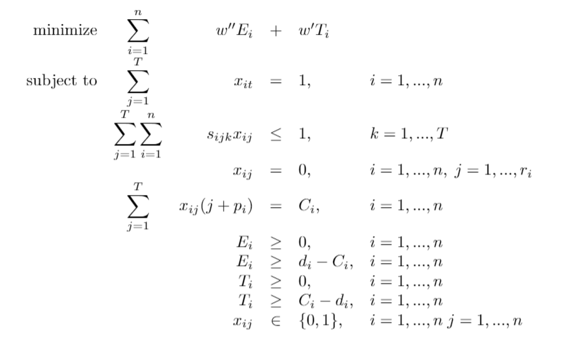
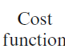
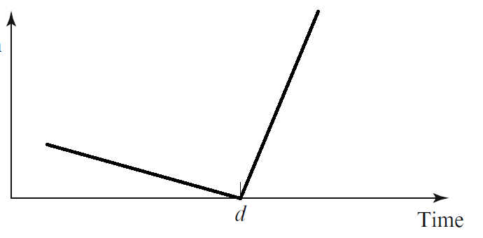

To better account for inventory restrictions, a weighted algorithm was explored
5
Second Model
Weighted earliness and tardiness
1
  The objective function is a weighted sum of Earliness and Tardiness
2
  Our program puts more weight on Tardiness by a factor of 1:10
Notes:
In order to better account for the inventory restrictions, and the realtively small size of our problem, we decided to look at algorithms which would take into consideration both Earlyness and Tardiness.
The Integer program here is an NP-hard problem and even though we were only working with 66 jobs, to begin with we had processing times rounded up to one decimal point but that turned out to be too big for our computers as the gurobi required around 1 billion constraints. We therefore approximated the processing times to integers which had a manageble 10 million constraints.
The weights of earliness and tardiness can be set to account for the seriousness of each variable. Because being late for a delivery we put a higher weight on tardiness rather than earliness. The graph shows the cost of each job and as we can see, if the job is ready excactly when it is due, the objective cost is zero.

Slide 7
Both algorithms produced satisfactory schedules
6
Model Comparison
Assumptions:
2016 schedule modeled schedules
  Less inventory due to better spreading of bottling per wine
Notes:
Here we can see the bottling schedules from 2016 compared to the schedule the L_max algorithm gave as well as the Weighted Earliness-Tardiness algorithm gave. Because of the increased overall volume of bottles there are more bottles processed each month. But we can also see that each wine is better spread out across the year which will allow for less inventory costs.
When comparing the L_max schedule to the weighted Earliness –tardiness schedule we can see that the L_max schedule schedules more bottles at release date of jobs, this is especially noticeable in January when a lot of jobs are released.
The Weighted algorithm has overall better statistics with 84% of jobs completing within 10 days of the due date and only 4 jobs being late. The L_max is 9 and E_max is 92.
L_max is 9
The earliest job is 92 days early
84% of jobs finish within 10 days of due date
4 jobs are late
10 jobs finish more than 10 days early

Slide 8
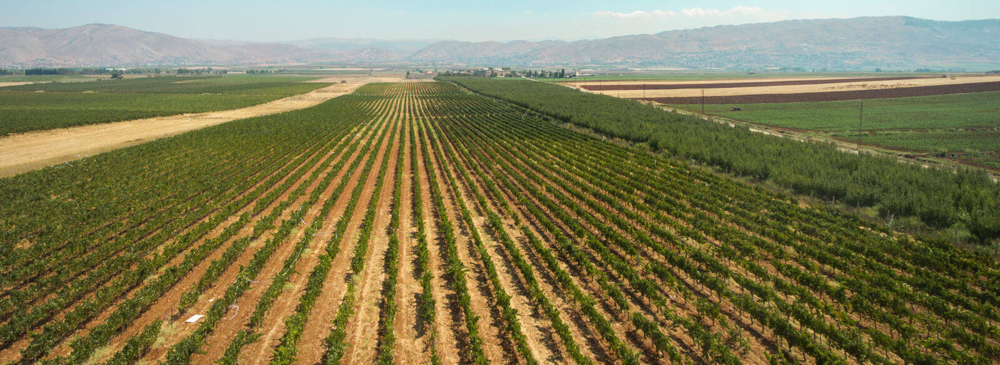
Even with approximations, good results were obtained
7
Conclusions
Lessons learned
Next steps
  The number of operation increase very auicly with the number of jobs -> need to be careful in the algorithm
  We can decrease the inventory cost by implementing better scheduling practices
  Dealing with two opposite objectives: inventory and tardiness
  Make the schedulue more realistic by including more processes in the factory (ticketing, packaging and so on)
  Take into considerations sesonal labor allocation constraints (harvesting season)
  Include stochastic elements in the schedule
  Improve the assigmnet algorithm for the assignment for different cuves for different wines

Slide 9

Bottling process
Thanks, questions?
Kamil Chaoui, Barbara Sofie, Snorri Tomasson

