Slide 1
Production Scheduling: Mel’s Burger Bar
Mitchell Bustillo, Jibben Hillen, Morgan Maccherone, and Elaine MacDonald
Notes:
Elaine

Slide 2

Goal: Maximize the number of people that move through the restaurant
Minimize wait times
Maximize profit
Notes:
Elaine

Slide 3
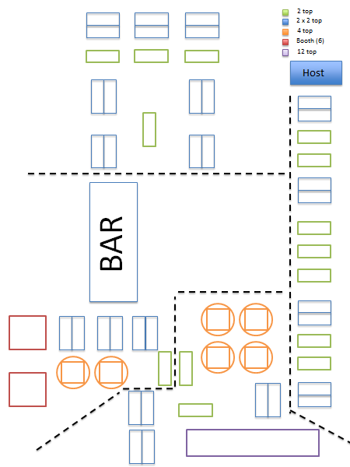
Problem setup
2-top, 4-top, and 6-tops, 12-top
Sections seat approximately same number of customers
Each table is a machine with a given capacity
All tables/servers have the same processing times
Each party is a job with characteristics based on size
Notes:
Elaine

Slide 4
Problem setup continued
Queue is dumped upon restaurant close
Model dinner for 5 hours
Preemption not allowed
If not in use, tables/machines can be combined for greater capacities (later modification)
Notes:
Elaine

Slide 5
Party sizes are distributed according to this PDF
Party Size | Probability
1 | 0 (they all sat at the bar)
2 | 0.24
3 | 0.22
4 | 0.29
5 | 0.10
6 | 0.12
7 | 0.01
8+ | 0.02
Notes:
Mitchell

Slide 6
Length of stay according to party size (normally distributed)
Party Size | Mean Length of Stay (hrs) | Variance in Length of Stay (hrs)
1 | N/A | N/A
2 | 1.1 | 0.15
3 | 1.2 | 0.20
4 | 1.25 | 0.23
5 | 1.4 | 0.24
6 | 1.6 | 0.28
7 | 1.65 | 0.30
8+ | 2.0 | 0.35
Notes:
Mitchell

Slide 7
Arrivals
Poisson with rate λ = .083 hours = 5 minutes
Obviously, as the time of day changes, so will λ
  Ideas for future research: create a function λ(t) that models the change in arrival rate over time
Wait Time in Queue | Probability of Staying
L_{q} ≤ 0.25 | 0.9
0.25 < L_{q} ≤ 0.50 | 0.8
0.50 < L_{q} ≤ 0.75 | 0.5
0.25 < L_{q} ≤ 1.00 | 0.3
1.00 < L_{q} | 0.1
Notes:
Mitchell

Slide 8
What we did…
Coded simulator in Python and tested different algorithms to see how they perform
Notes:
Jibben

Slide 9
Algorithm 1: Round Robin (currently used in Mel’s)
For all sections: Get feasible tables and place party at any available table (lowest table number). If current section is full, go to next (if at section 3, go to 0).
Performance measures based on Monte Carlo Simulation with 1000 trials:
Parties dropped: | 34.69
People dropped: | 198.343
Parties seated: | 145.149
People seated: | 475.911
Notes:
Jibben
{'avg_wait_time': 3.604103295058157,
'parties_dropped': 34.691,
'parties_seated': 145.149,
'people_dropped': 198.343,
'people_seated': 475.911}

Slide 10
Algorithm 2: Random Assignment
Iterate through all available tables in a random order until you find one you can seat the party at
Performance measures based on Monte Carlo Simulation with 1000 trials:
Parties dropped: | 34.08
People dropped: | 195.443
Parties seated: | 145.692
People seated: | 479.086
Notes:
Jibben
parties_dropped': 34.08,
'parties_seated': 145.692,
'people_dropped': 195.443,
'people_seated': 479.086

Slide 11
Algorithm 3: Restrict parties to certain table sizes
Only 5 or 6 people could sit at a six top & only 3 or 4 people at four top
Performance measures based on Monte Carlo Simulation with 1000 trials:
Parties dropped: | 33.594
People dropped: | 193.371
Parties seated: | 146.779
People seated: | 483.589
Notes:
Morgan
{'avg_wait_time': 3.1419769974025797,
'parties_dropped': 33.594,
'parties_seated': 146.779,
'people_dropped': 193.371,
'people_seated': 483.589}

Slide 12
Algorithm 4: Seat them at the smallest table available
Take set of tables that could fit current party
Sort these tables according to size
Seat at first available table (lowest table number)
Performance measures:
Parties dropped: | 33.155
People dropped: | 191.286
Parties seated: | 146.726
People seated: | 483.374
Notes:
Morgan
{'avg_wait_time': 3.1440352215364835,
'parties_dropped': 33.155,
'parties_seated': 146.726,
'people_dropped': 191.286,
'people_seated': 483.374}

Slide 13
Algorithm 5: Only seat parties of 4 or fewer
Not the best for reputation, but let’s give it a try!
Performance measures
Parties dropped: | 34.1
People dropped: | 204.681
Parties seated: | 146.087
People seated: | 471.188
Notes:
Morgan
{'avg_wait_time': 1.734653858263471,
'parties_dropped': 34.1,
'parties_seated': 146.087,
'people_dropped': 204.681,
'people_seated': 471.188}

Slide 14
Algorithm 6: Seat parties in sections where fewest number of people have been seated
Good for balancing the server load
Performance measures
Parties dropped: | 34.5
People dropped: | 197.697
Parties seated: | 145.602
People seated: | 477.631
Notes:
Morgan
{'avg_wait_time': 3.6016048093233044,
'parties_dropped': 34.5,
'parties_seated': 145.605,
'people_dropped': 197.679,
'people_seated': 477.631}

Slide 15
Algorithm 7: Do different things depending on state
if there are a lot of free tables, seating people fast is optimal —> maybe round robin or random
if the queue is long (demand is > supply) or if tables are all occupied, try combining tables which might be optimal
Performance measures
Parties dropped: | 26.13
People dropped: | 117.23
Parties seated: | 152.29
People seated: | 554.28
Notes:
Morgan
{'avg_wait_time': 5.564305645430331,
'parties_dropped': 26.13,
'parties_seated': 152.29,
'people_dropped': 117.23,
'people_seated': 554.28}

