Slide 1
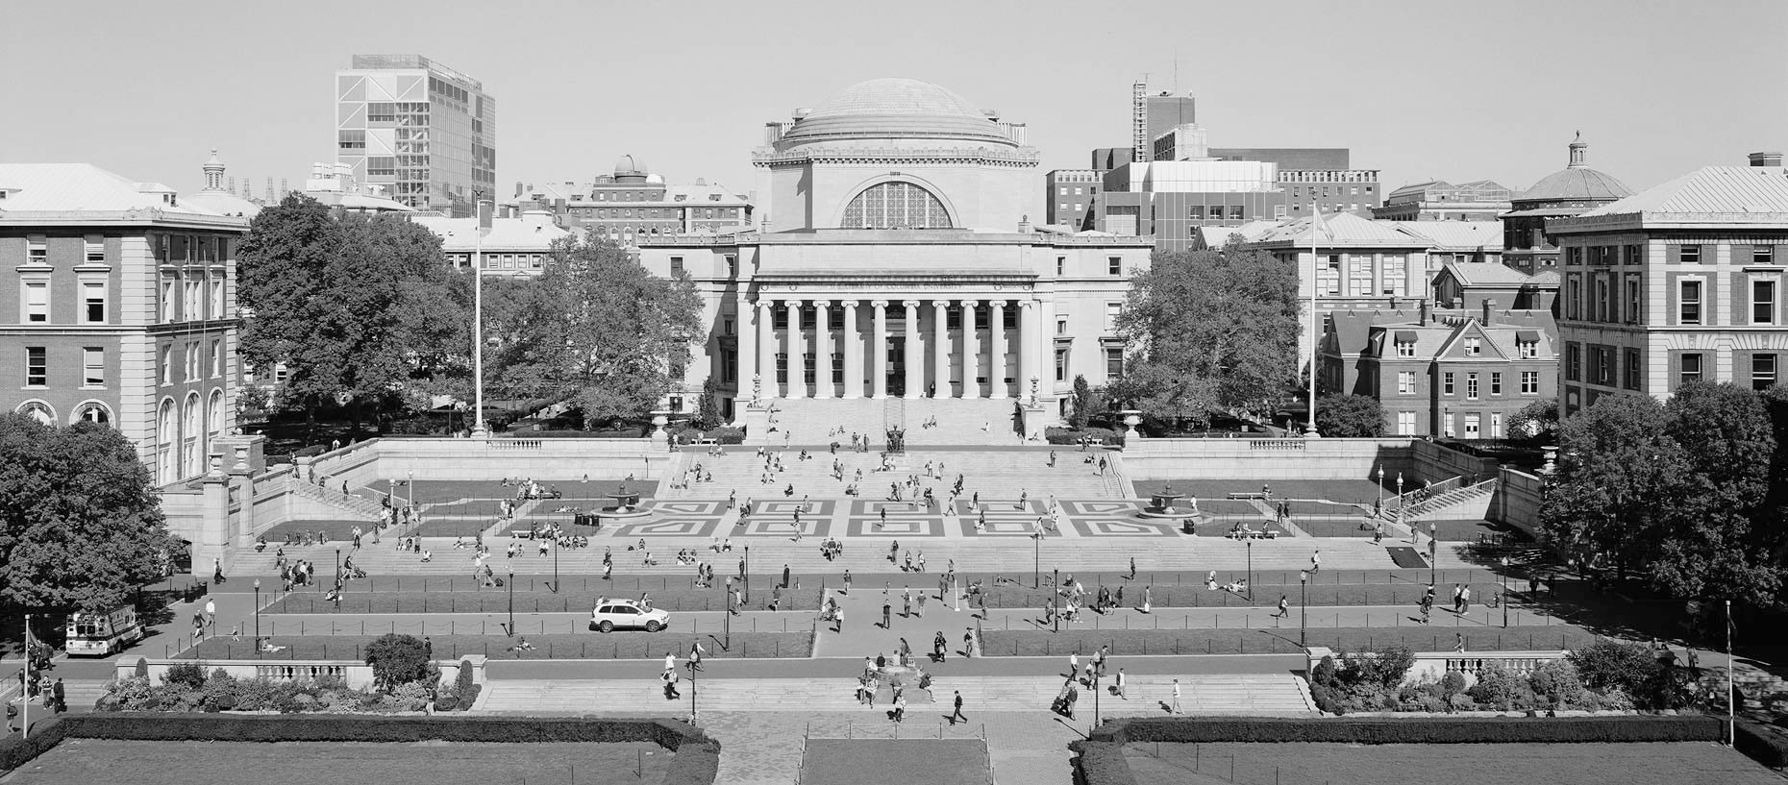


Housing Maintenance
Zachary Ho, Irin Phatraprasit, Emma Xie, and Ava Zhu

Slide 2
Our Goal
Background
  Students can request for housing maintenance by filling in an online form, calling, or emailing housing
  Jobs are to be completed within 3-14 days
  No current scheduling rules
Objective
  Reduce maintenance request completion time to below 9 days and improve student life at Columbia University
  Minimize the average time a student has to wait for the job to be complete
Notes:
We talked to housing and they currently do not follow any schedule

Slide 3
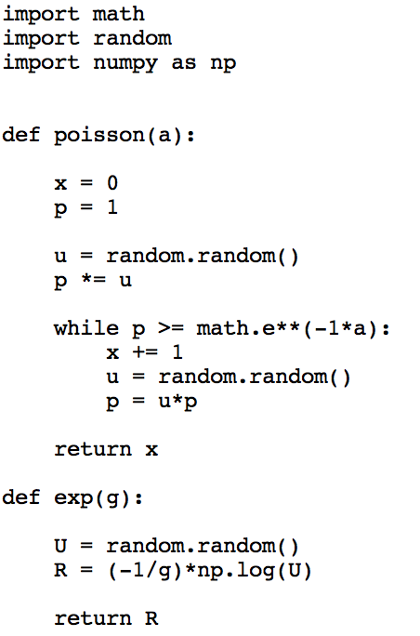
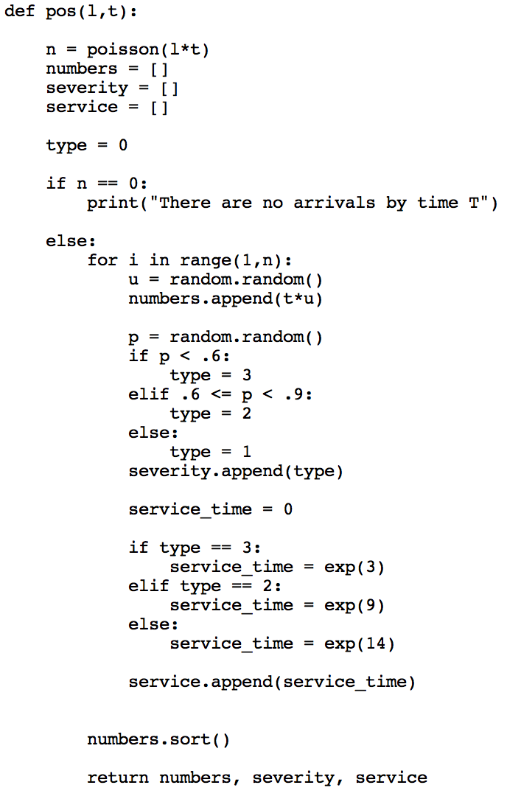
Simulation
Formulation:
Grouped maintenance types into 3 severities - high(1), medium(2), low(3)
Assumptions:
Low severity job occurs with the highest probability
Service time for high, medium, and low severity is 3, 9, 14 days respectively
Poisson arrivals and exponential service times
Limiting scope to 1 residence hall
Recalculate schedule every time a new ticket is submitted
Notes:
We tried to get real data from housing, but they were unable to give it to us, but we were able to get a rough idea of how many tickets they get per day
20 rooms, 10 floors > 200 room, 5% breakage per day > 10
Residence hall maintenance staff are assigned to specific halls so we can assume that the problem scales linearly as you add more buildings

Slide 4
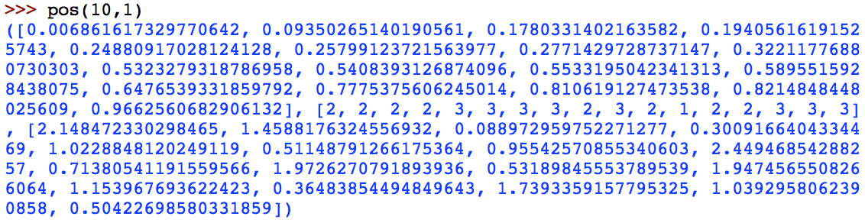
Generated Data
Python output:
j | rj | wj | pj | wj/pj
1 | 0.01 | 2 | 2.15 | 0.93
2 | 0.09 | 2 | 1.46 | 1.37
3 | 0.18 | 2 | 0.09 | 22.22
4 | 0.19 | 2 | 0.3 | 6.67
5 | 0.25 | 3 | 1.02 | 2.94
6 | 0.26 | 3 | 0.51 | 5.88
7 | 0.28 | 3 | 0.96 | 3.13
8 | 0.32 | 3 | 2.45 | 1.22
9 | 0.53 | 2 | 0.71 | 2.82
10 | 0.54 | 3 | 1.97 | 1.52
11 | 0.55 | 2 | 0.53 | 3.77
12 | 0.59 | 1 | 1.95 | 0.51
13 | 0.65 | 2 | 1.15 | 1.74
14 | 0.78 | 2 | 0.36 | 5.56
15 | 0.81 | 3 | 1.74 | 1.72
16 | 0.82 | 3 | 1.04 | 2.88
17 | 0.97 | 3 | 0.5 | 6.00
Problem we are trying to solve:
Objective Function: 3 | rj | ⅀wjCj
NP-Hard
Assume machines are number of workers: m = 3
rj - the time when ticket is submitted
wj - the severity of request
pj - processing time (service time)
Data snapshot at time t
Notes:
Talked to housing and they told us that there are around 2-3 maintenance staff per residence house. Work there permanently
Non-preemptive as once they start task have to finish the task

Slide 5
Method 1 - Smith’s Rule
Algorithm:
Results:
Step 1: Construct non-preemptive schedule using Smith’s rule, wj/pj decreasing
Step 2: Assign jobs to machine that has completed task
Step 3: Ensure that job does not start before release date
Average wait time (Cj - rj) = 2.67
⅀wjCj = 124.39
Schedule:
Notes:
Tried out smith’s rule because it had similar objective function

Slide 6
Method 2 - CONVERT
According to the algorithm CONVERT, the 1-machine model works for multiple parallel machines.
Step 1: Construct pre-emptive schedule on single machine
Algorithm by Smith: At any time we schedule the job j with the greatest Smith ratio w_{j}/p_{j}, where p_{j} is the remaining processing time of job j.
Step 2: Form a list L of the jobs, ordered by their pre-emptive completion times.
Step 3: List schedule non-preemptively using L, with the constraint that no job J starts before its release date rj.
To slightly simplify our analysis, we specify that our list scheduling algorithm will not start the jth job in L until the (j - 1)st is completed (in the one machine environment) or started (in the parallel machine environment)
*There is an on-line non-preemptive 2-approximation algorithm for 1 | rj | ⅀Cj
Given a schedule P for 1 | rj, pmtn | ⅀wjCj, algorithm CONVERT produces a schedule N for the corresponding instance of 1 | rj l ⅀wjCj with C_N ≤ 2C_P. *
Notes:
Source:https://books.google.com/books?id=RII-493lABsC&pg=PA198&lpg=PA198&dq=P%7C%20rj%20%7C%20%E2%85%80wjCj%20lower%20bound&source=bl&ots=R-Z8ILBjvU&sig=WT5bOFf4dh7dyPRFTAdj2y5_IGw&hl=en&sa=X&ved=0ahUKEwiHid3M8cLTAhXCwiYKHUVFB8cQ6AEILTAE#v=onepage&q=P%7C%20rj%20%7C%20%E2%85%80wjCj%20lower%20bound&f=false
https://link.springer.com/article/10.1007/BF01585872

Slide 7
Algorithm 2 - CONVERT
Results:
Average wait time (Cj - rj) = 2.62
⅀wjCj = 126.99

Slide 8
Results and Recommendations
Both algorithms delivered an average waiting time lower than the range provided by housing
Smith’s Algorithm and CONVERT Algorithms produce close results
After various trials, CONVERT Algorithm was shown to have slight improvement over Smith’s Algorithm
Next Steps:
  Run algorithm with real data
  Explore other types of algorithms e.g. Maintenance Scheduling
Notes:
Other algorithms might include constraints on time, skills, and resources

