Slide 1
Aircraft Landing Problem
Ruyue Xu, Michelle Liu, Tian Liang, Shuyin Hua
Notes:
Today we are presenting to you our findings on the Aircraft Landing Problem, which aims to schedule aircrafts on one or multiple runways as close as possible to their target landing times.

Slide 2
Executive Summary
Objective Functions
Algorithms
Example and Analysis
Conclusion
Notes:
First, we will introduce the 4 objective functions.
Next, we will examine the 4 optimize each of these objectives.
Then, we will take a look at one example and our analysis.
We will close with some final thoughts.

Slide 3
Objective functions
Cmax – makespan
Landing time of the last aircraft
2. ∑Lj / ∑wjLj- total (weighted) lateness
Positive - aircraft lands after target time
Negative - aircraft lands before target time (negated)
3. ∑Tj / ∑wjTj - total (weighted) tardiness
Positive - aircraft lands after target time
4. ∑Uj / ∑wjUj - total (weighted) unit cost
Number of aircrafts that land after target time

Slide 4
Algorithms
First Come First Served (FCFS)
Constrained Position Shifting (CPS)
Mixed Integer Programming (MIP)
Branch and Bound (BB)

Slide 5
Algorithm I: First Come First Serve (FCFS)
Simple to implement
Optimal for minimizing makespan
Fair in sense that aircrafts are scheduled in order of arrival
Used as initial feasible sequence for other methods
Notes:
simplest and most ideal case, scheduling landing and takeoff order if each aircraft lands/takes-off without considering other aircraft
estimated landing time (ELT) is estimated from inputs such as planned arrival route, flight speed, and standard procedure descent => each flight is then assigned a scheduled landing time (SLT) and in the event of multiple runways also assigned to a particular runway.
The FCFS sequence thus lands the aircraft in order of their SLT at the runway and air traffic controllers enforce minimum separation requirements between aircrafts with respect to their weight class.
Under these simple assumptions the FCFS method is fair in the sense that aircrafts are scheduled in the order they arrive and should be optimal for minimizing total makespan. Other advantages of FCFS include promoting safety by reducing controller workload as well as minimizing the standard deviation of aircraft delays. However, it may not be optimal in terms of other objectives such as average aircraft delay, average passenger delay, or runway throughput

Slide 6
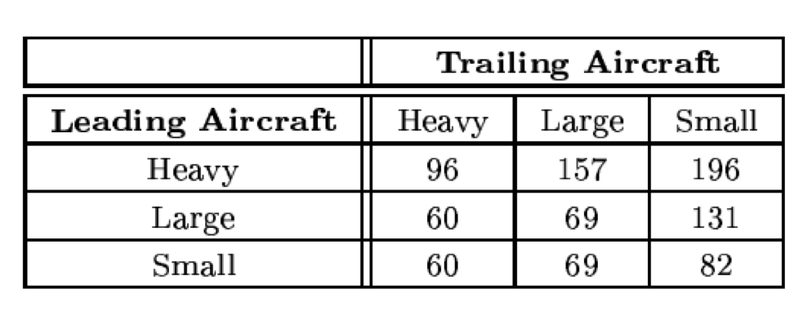
Algorithm I: FCFS
Not optimal for other objectives (average passenger delay, runway throughput)
Reduced runway throughput due to large spacing requirements
  Eg: 5 Heavy and 5 Small alternating vs. 5 Heavy first then 5 Small
Motivation for CPS

Slide 7
Algorithm II: Constrained Position Shifting (CPS)
Undesirable to shift aircraft by large number of positions from FCFS
CPS limits k = maximum number of shifts allowed from FCFS
(Balakrishnan and Chandran):
  Construct CPS network
  Solve shortest path problem with dynamic programming

Slide 8
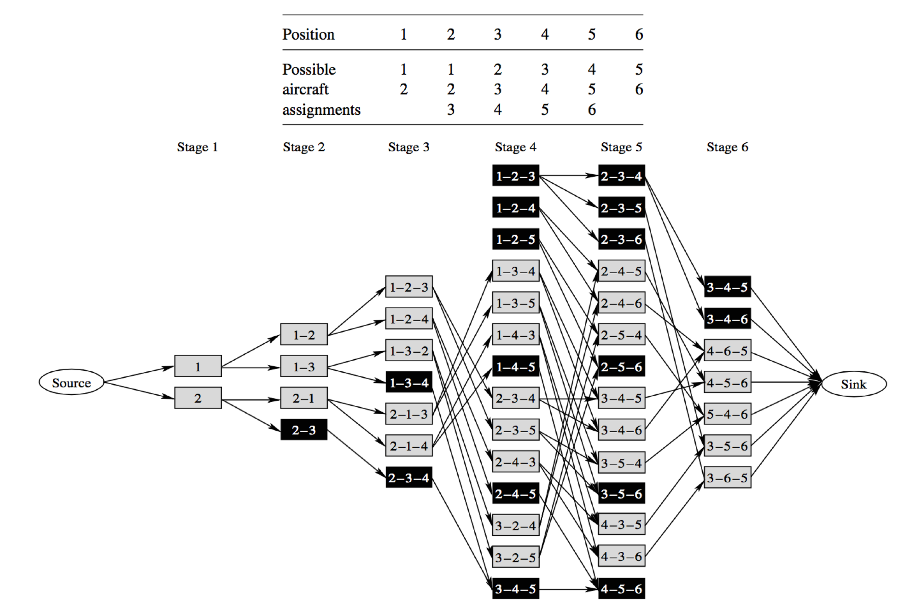
Algorithm II: CPS - Network
k = 1, n = 6
At each stage p
  Node consists of subsequence of length min{2k + 1, p}
Arc(i,j) from stage p to p+1 is added if the aircraft subsequence of node j can follow that of node i
Notes:
At stage 2, node for every possible sequence of length 2 ending at position 2

Slide 9
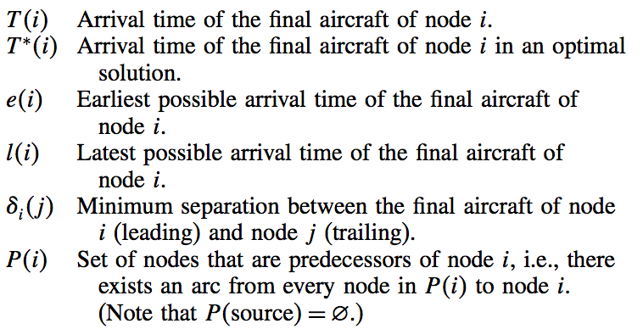
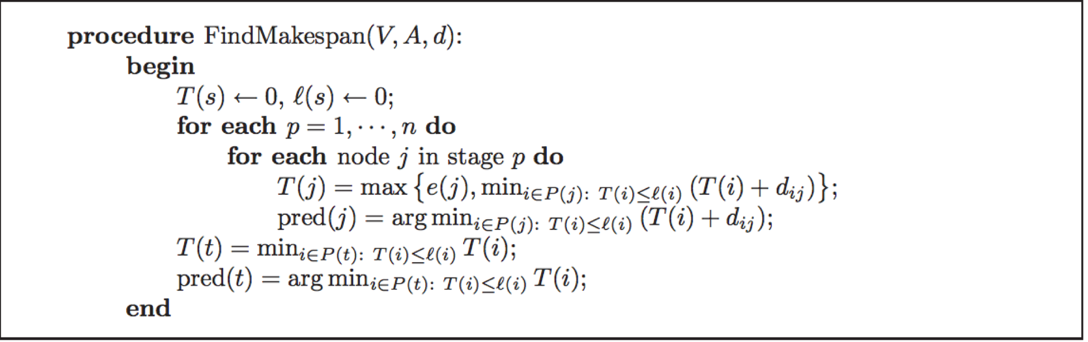
Algorithm II: CPS - Dynamic Programming

Slide 10
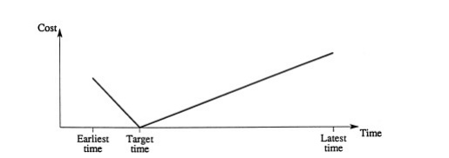
Algorithm III:Mixed Integer Programming(MIP)
Optimal for (weighted) lateness or tardiness
Single Runway: assign a certain landing time to one flight
Multiple Runways: assign a flight a landing time and a runway
  additional constraints
Notes:
The next algo that we are going to talk about is MIP. it is optimal for lateness or tardiness and could be applied to solve both single runway and multiple runway with additional constraints. Here, the figure shows how we set up our problem. Ang landing occurring not at the target time will result in a penalty due to inefficient use of fuel. So here we need to find a assigned landing time to each flight so that we could minimize the total weighted lateness.

Slide 11
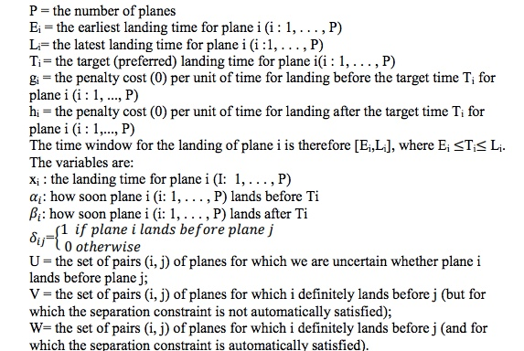
Algorithm III: MIP---Single Runway
Notation:
Notes:
Here is our notations. But for our simulated example, we reduce these complex variables into 6 necessary inputs, which will be talked about later in the simulated example section.

Slide 12


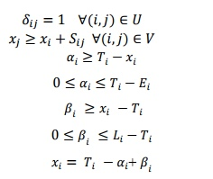
Algorithm III: MIP---Single Runway
Objective Function
Constraints
Notes:
Here shows how we quantify our objective function into mathematical equation. Our decision variable is to find xi between Ei and Li.

Slide 13
Algorithm III: MIP---Single Runway
3P continuous variables
at most P(P - 1) binary (zero–one) variable
at most [3P * 3P(P -1)/2] constraints(excluding bounds on variables)

Slide 14
Algorithm III: MIP---LP-based Tree Search & Relaxed Formulation
Although the formulations given above for both the single- and multiple-runway cases are sufficient to describe the problems, we intend solving them numerically through the use of LP-based tree search.
Relaxing the zero-one variables
Adding a number of additional valid constraints to strengthen (improve) the value of the LP relaxation in continuous space

Slide 15
Algorithm IV
Branch and Bound (B&B)
n! different schedules
UB - objective value of FCFS schedule, LB - generally hard to find
Branching Reduction Techniques:
Assumption: objective value does not decrease when the next aircraft is added to the partial schedule.
Constraint Branching Reduction
Discard all branches built on a partial schedule that violates a constraint.
Objective Branching Reduction
Discard all branches built on a partial schedule whose objective value exceeds UB.
Moving-Window Method
Restrict B&B computation to a subset of aircrafts. Increment the window by the step size repeatedly.
□□■■■■■■ → □■■■■■■① → ■■■■■■②①
Notes:
If there are n aircrafts to be scheduled, then we would have n! different schedules. If n is large, then explicit enumeration is practically impossible. Therefore we need to come up with tight UB and LB.
UB: we will use the result from FCFS
LB: generally hard to find given the complexity of the constraints in real-life ALP. Instead, we can develop different methods to eliminate branches that need not be searched, while ensuring optimality.
Under the assumption that the objective value does not decrease when the next aircraft is added to the partial schedule, we can apply three branching reduction techniques.
1. Constraint Branching Reduction:
If a partial sequence violates some constraint, then any sequence built on that partial sequence violates that constraint, and we can discard all branches below the node that corresponds to that partial sequence.
2. Objective Branching Reduction:
If the objective value of a partial sequence exceeds the UB, then we can discard all branches below the node that corresponds to that partial sequence.
3. Moving-Window Method:
Since n is large in real life, we can restrict B&B computation to a subset of aircrafts, and increment the window by the step size to generate a new subset, and repeat the process.
E.g. n=8, subset size=6, step size=1. B&B on first 6 aircrafts, leave out the first aircraft in the resulting schedule as the first to be scheduled in the entire process. B&B on second 6 aircrafts, repeat, until we get the final schedule.

Slide 16
Our Data
Data input:
Attributes: Latest landing time; Earliest landing time; Target time; Landing time(decision variable); Time before target time=(landing time-target time); Time after target time=landing time -target time; Separation time; Penalty cost for being early; Penalty cost for being late
We build 22 instances of above attributes, and run the simulations using FCFS to minimize the makespan, MIP method to minimize weighted lateness and weighted tardiness. We also compare the result of other objectives using these three algorithms.
Instance Example
Flight No. | target time | target time in min from 12:00 | latest landing time | earliest landing time | weight class of aircraft j, e.g., heavy, large, or small | penalty cost for being early | penalty cost for being late
1 | 12:35 | 35 | 253 | 32 | large | 16 | 19
2 | 12:45 | 45 | 258 | 38 | heavy | 19 | 4

Slide 17
Simulation: FCFS versus MIP
MIP: Minimizing weighted lateness
Sequence of plane:
1 | 3 | 2 | 4 | 5 | 6 | 7 | 8 | 9 | 14 | 10 | 11 | 13 | 12 | 19 | 16 | 15 | 18 | 20 | 21
17 | 22
Number_Tardiness | Weighted Tardiness | Weighted Lateness | Makespan
7 | 60 | 111 | 3:15(195)

Slide 18
Simulation: FCFS versus MIP
MIP: minimizing weighted tardiness
Sequence of plane:
Objectives:
1 | 3 | 2 | 4 | 5 | 6 | 7 | 9 | 8 | 13 | 12 | 14 | 10 | 11 | 17 | 16 | 19 | 15 | 18 | 20
21 | 22
Number_Tardiness | Weighted Tardiness | Weighted Lateness | Makespan
0 | 0 | 350 | 3:15(195)

Slide 19
Simulation: FCFS versus MIP
FCFS
Sequence of plane:
Objectives:
1 | 2 | 3 | 4 | 5 | 6 | 7 | 8 | 9 | 14 | 13 | 11 | 10 | 12 | 15 | 16 | 17 | 18 | 19 | 21
20 | 22
Number_Tardiness | Weighted Tardiness | Weighted Lateness | Makespan
2 | 22 | 778 | 187

Slide 20
Conclusion
 | Number of Tardiness | Weighted Tardiness | Weighted Lateness | Makespan
FCFS | 2 | 22 | 778 | 187
MIP: minimizing weighted lateness | 7 | 60 | 111 | 3:15(195)
MIP: minimizing weighted tardiness | 0 | 0 | 350 | 3:15(195)

