Slide 1
Production Scheduling
Scheduling
Stochastic Simulations
Hy Nguyen
Tyler Tsang
Haohan Xu
Jake Poliner
Notes:
Everyone

Slide 2
01.
Stochastic Simulation
Outline
02.
Minimize Weighted Makespan
03.
Minimize Tardiness
04.
Minimize Weighted Tardiness
Notes:
Haohan

Slide 3
Objective
Throughout the class we have primarily focused on deterministic scheduling problems
These can be hard (or even NP hard) to solve for optimal schedules
Test different stochastic situations to see how optimal schedule changes when there is randomness involved
  Normal and exponential distributions
  Varying variances
Notes:
Haohan 0:40

Slide 4
Three Scheduling Problems
Weighted completion
Tardiness
Weighted Tardiness
Notes:
Haohan 0:50

Slide 5
Three Scheduling Problems
For each one testing 4 stochastic scenarios
  Normal Low Var
  Normal High Var
  Normal High Var for low processing time and Low Var for high processing time
  Exponential
Notes:
Hy 1:20

Slide 6
Testing Methodology
Generate all permutations ordering of jobs
For each permutation, ran 100,000 simulations and computed average objective function
Brute forced permutations
Returned the schedule with the objective function best minimized
Notes:
Hy 1:42

Slide 7
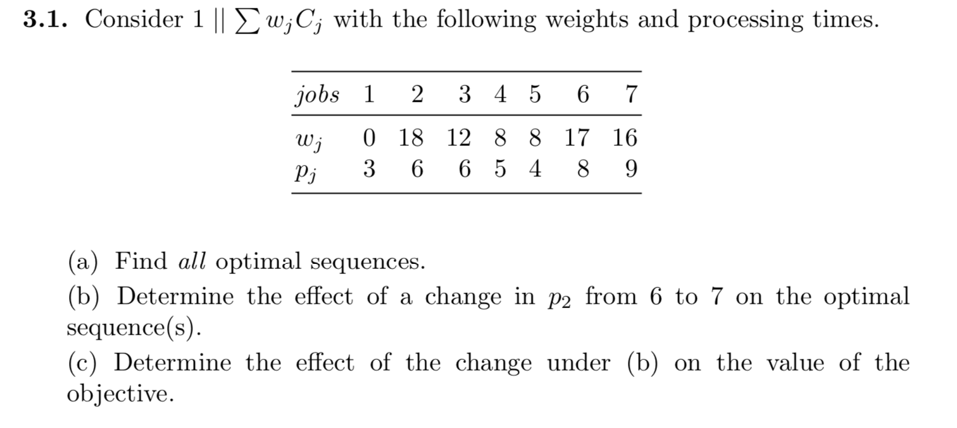
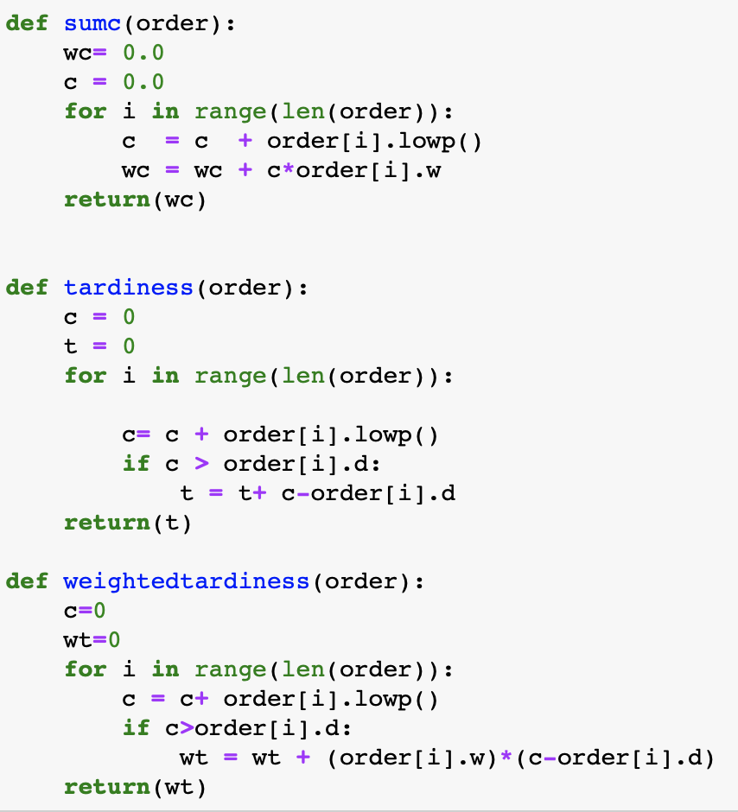
Minimize Weighted Makespan
Notes:
Tyler

Slide 8
Minimize Weighted Makespan
Normally solved by weighted shortest processing time
Optimal schedules
  2 – 6 – 3 – 5 – 7 – 4 – 1
  2 – 6 – 5 – 3 – 7 – 4 – 1
Notes:
Tyler

Slide 9
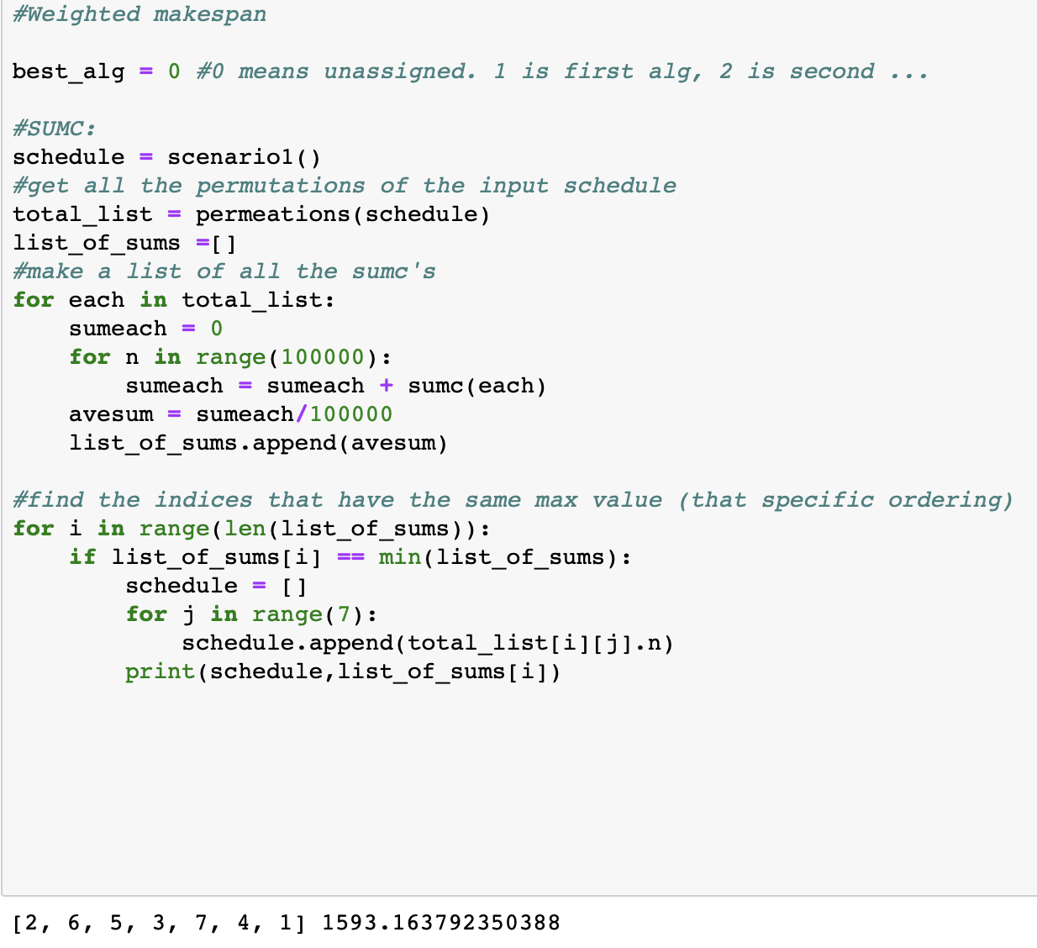
Minimize Weighted Makespan: Stochastic Results
Optimal Schedule
  2-6-3-5-7-4-1
  2-6-5-3-7-4-1
Normal Low Var
  2-6-5-3-4-7-1
Normal Mix
  2-3-6-5-7-4-1
Normal High Var
  2-5-3-6-7-4-1
Exponential
  3-2-6-5-4-7-1
Notes:
Tyler

Slide 10
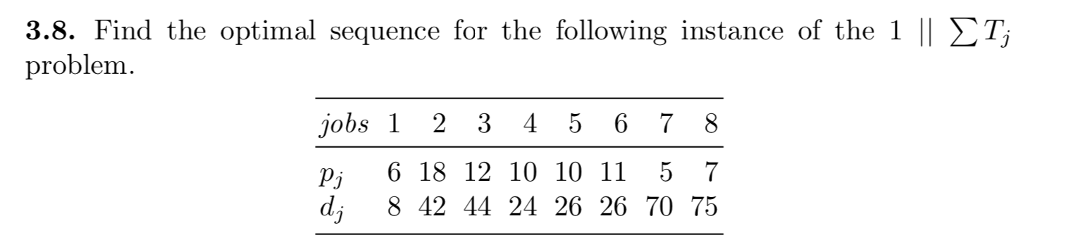
Minimize Tardiness
Notes:
Hy

Slide 11
Minimize Tardiness
Need to use a dynamic processing algorithm to solve
Optimal schedule:
1-4-5-6-3-2-7-8
Notes:
Hy

Slide 12
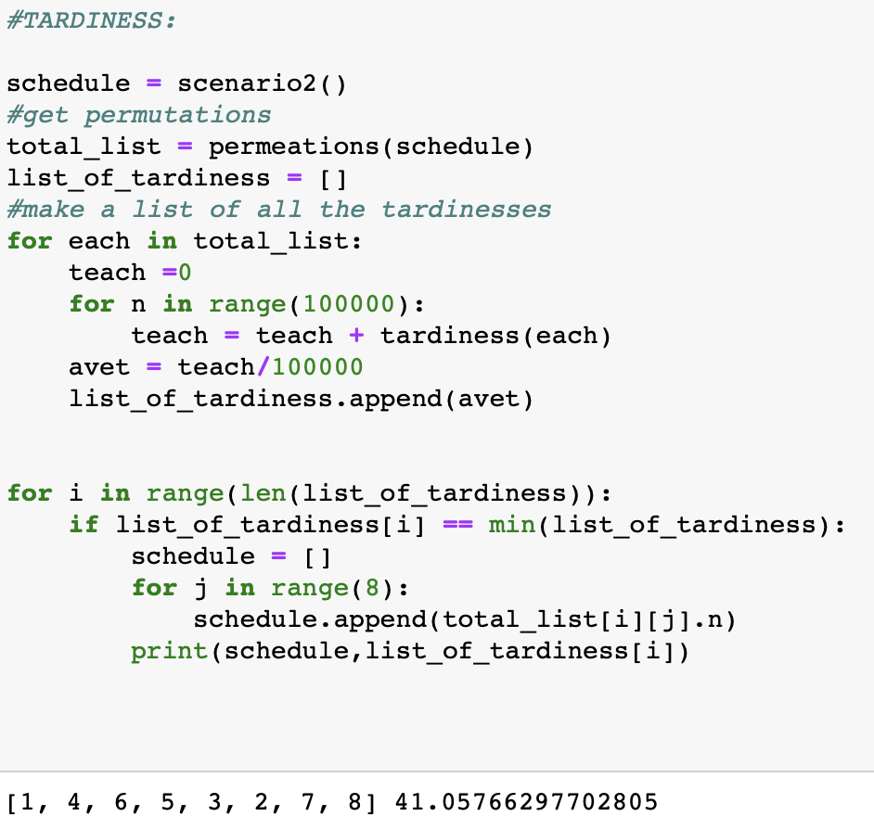
Minimize Tardiness: Stochastic Results
Optimal Schedule
  1-4-5-6-3-2-7-8
Normal Low Var
  1-4-5-6-3-2-7-8
Normal Mix
  1-4-6-5-3-2-7-8
Normal High Var
  1-6-4-5-2-7-8-3
Exponential
  1-6-5-4-2-3-8-7
Notes:
Hy

Slide 13
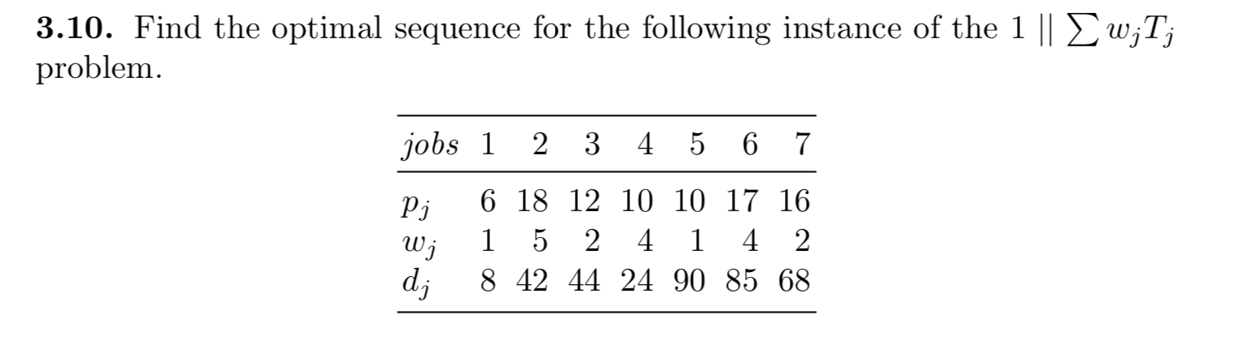
Minimize Weighted Tardiness
Notes:
Tyler

Slide 14
Minimize Weighted Tardiness
Is NP Hard
Need to use a dynamic processing algorithm to solve
Optimal schedule: 1-4-2-3-7-6-5
Notes:
Tyler

Slide 15
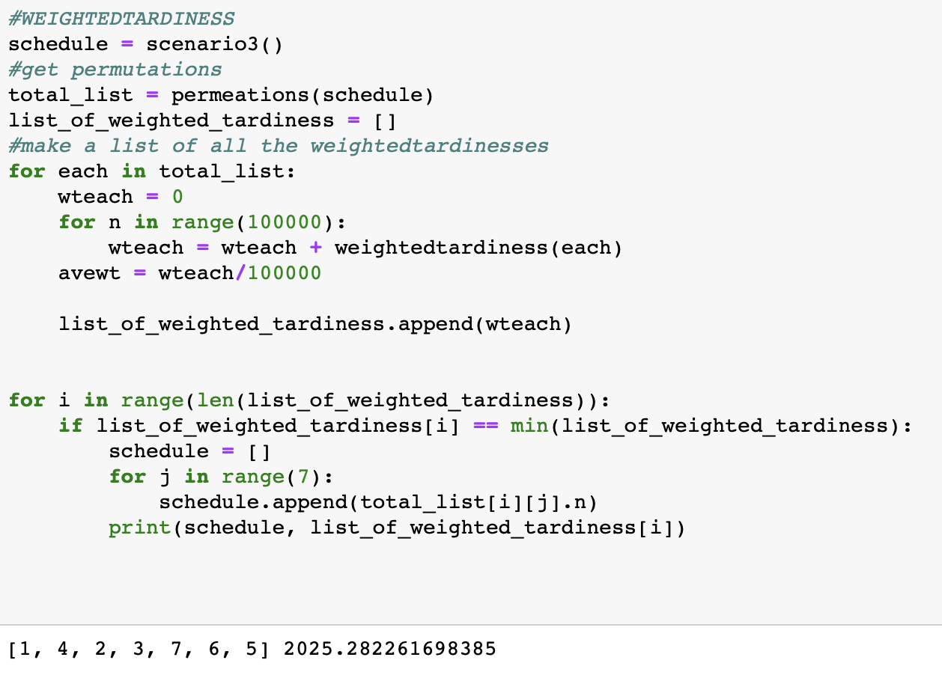
Minimize Weighted Tardiness: Stochastic Results
Optimal Schedule
  1-4-2-3-7-6-5
Normal Low Var
  1-4-2-3-7-6-5
Normal Mix
  1-4-2-3-7-6-5
Normal High Var
  1-4-2-3-6-7-5
Exponential
  1-2-4-6-3-7-5
Notes:
Tyler 3:20

Slide 16
Conclusions
Normal distribution had results very similar to deterministic
As Variance grew the optimal schedule tended to change more
Exponential distribution tended to have very different results from deterministic
We think this is because there is symmetry in the normal distribution whereas the exponential distribution is not symmetrical
The inclusion of randomness makes finding the optimal schedule very hard, and most if not all are NP hard
Notes:
Hy

Slide 17
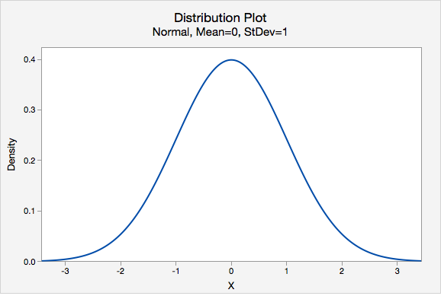
Conclusions
Exponential distribution tended to have very different results from deterministic
We think this is because there is symmetry in the normal distribution whereas the exponential distribution is not symmetrical
Notes:
Hy

Slide 18
Limits of Experiment
As there are more jobs, our brute force method becomes more unfeasible.
However, we still find immense value in being able to:
  Write flexible code
  Obtain empirical answers
Notes:
Hy

Slide 19
Potential Future Tests
Test further distributions, preferably ones nonsymmetrical
Make different scenarios where the variance is not related to processing time
Parallel and other multi machine schedules
Notes:
Hy 1:42

Slide 20
THANK YOU!
Questions & Comments
Notes:
Hy

