Slide 1


Scheduling the NBA Regular Season
Pranav Arora, Endric Daues, Ellie Lipe, Berrak Ozer

Slide 2
Table of Contents
Background
NBA Schedule Formatting
Our Solution
Visualization
Evaluating Our Solution

Slide 3
Background
NBA annual revenue is $7.4 billion.
Average NBA team is worth $1.65 billion.
More than 22 million people attended at least 1 game in the 2017-2018 regular season.
  60% of games were sold out.
TNT’s live NBA game telecasts averaged 1.7 million viewers.
It exists behind professional football, NFL, and Major League Baseball based on the money it earns in the U.S., succeeded by Premier League.
The NBA’s League Pass increased 63 % in their digital subscriptions.
Season 2017-2018

Slide 4
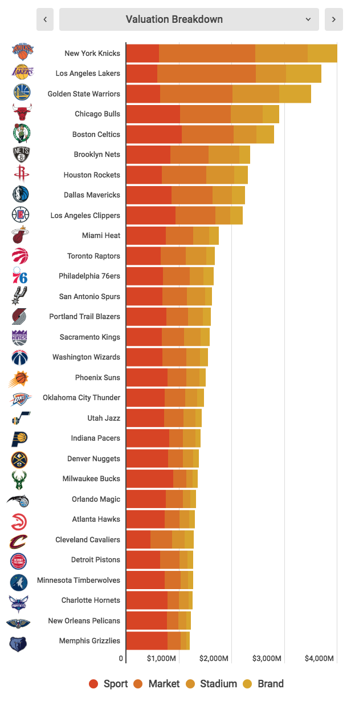
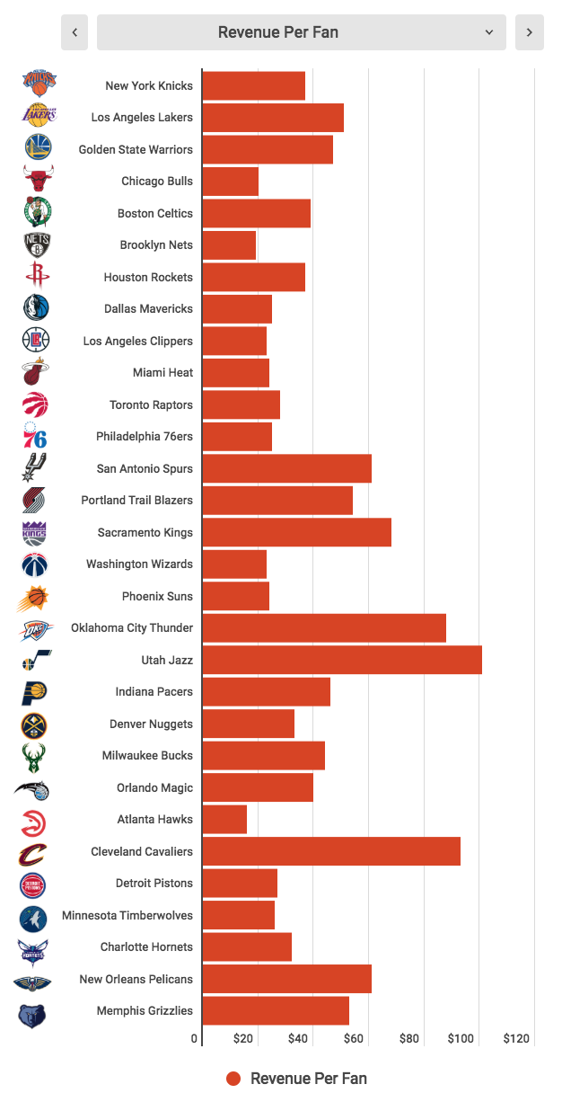
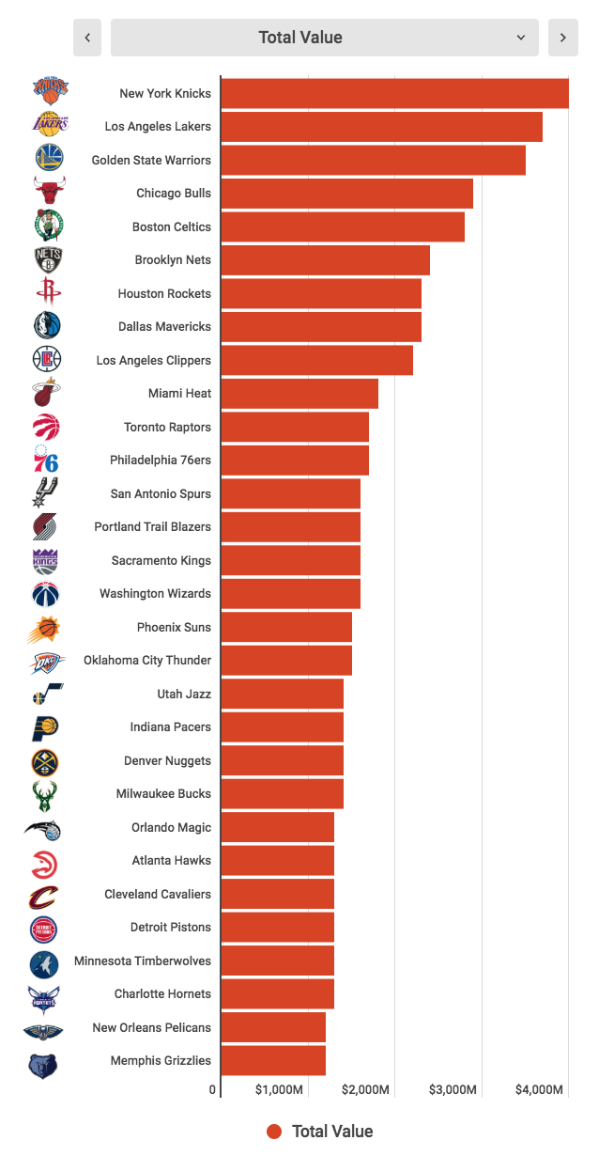
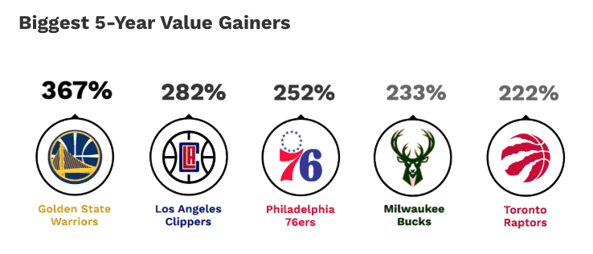
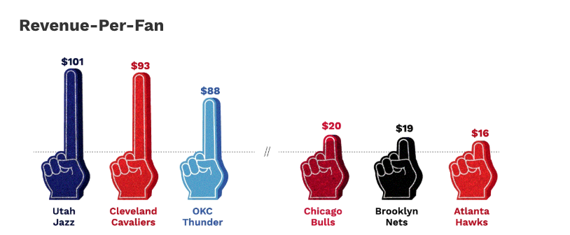
2019

Slide 5






























Western Conference | Eastern Conference
Northwest Division | Atlantic Division
Pacific Division | Central Division
Southwest Division | Southeast Division

Slide 6
NBA Schedule Formatting
NBA must schedule its 30 teams in 29 arenas.
Each team must play a total of 82 games in one season ( season=176 days)
Teams are divided into two conferences.
Each conference has three divisions.
NBA sets several constraints on the opponents, each team must play:
4 games against the other 4 division opponents (4×4 = 16 games)
4 games against 6 (out-of-division) conference opponents (4×6 = 24 games)
3 games against the remaining 4 conference opponents (3×4 = 12 games)
2 games against teams in the opposing conference (2×15 = 30 games)
41 home games and 41 away games.

Slide 7
Our Solution
Construct an integer program that finds feasible schedules for all regular season matchups
Further constrain the schedule based on features that improve the quality of the schedule
Measure and compare the quality of various feasible schedules based on metrics
Understand the complexity of the integer program and compare this to the impact on the schedule quality

Slide 8
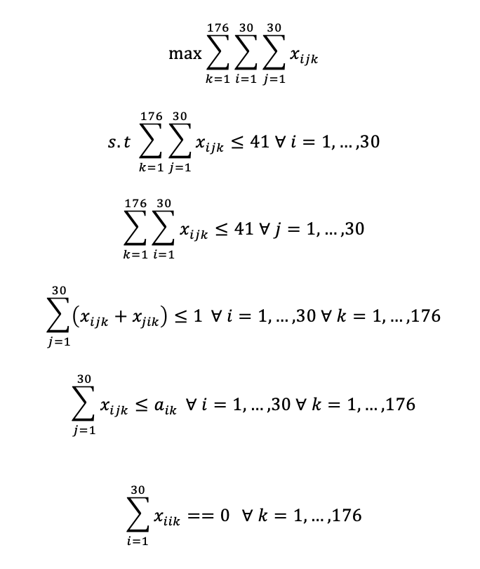
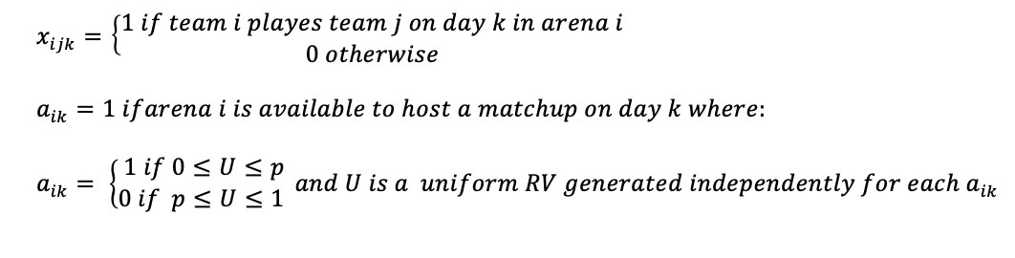
Our Solution
Basic formulation without specific regular season matchup constraints

Slide 9
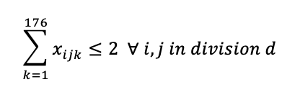
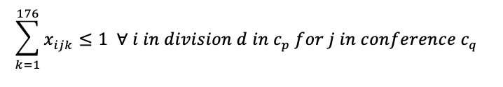
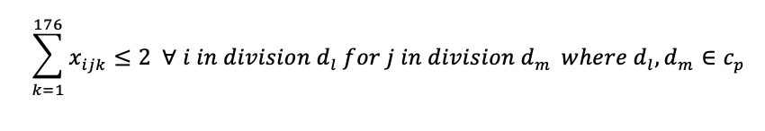
Our Solution
Adding specific regular season matchup constraints for an 86 game schedule
  Interdivision matchups
  Opposite conference matchups
  Interconference matchups simplified

Slide 10
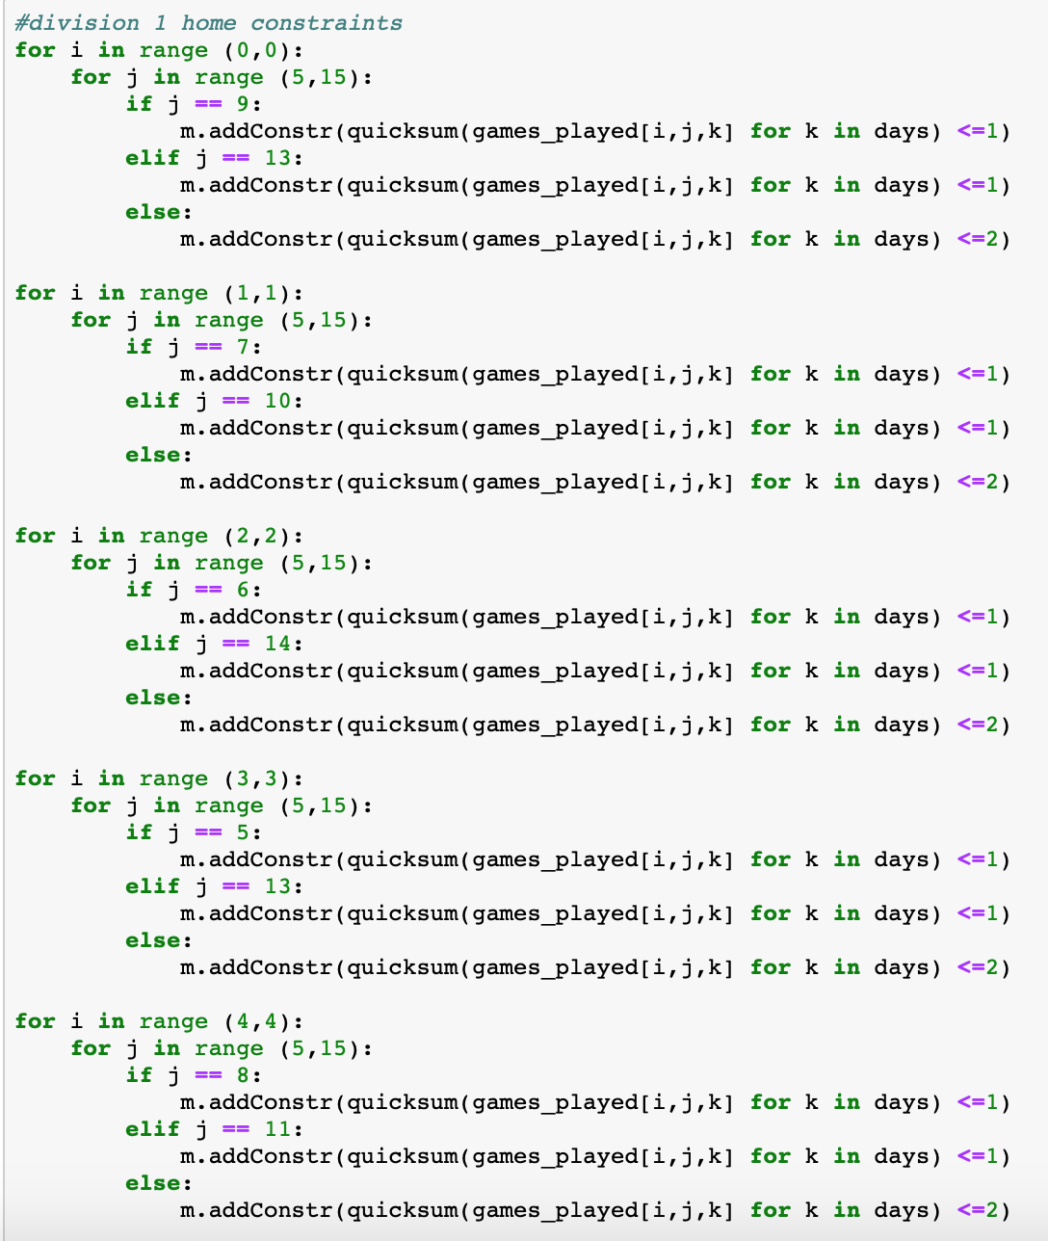
Our Solution
Adding realistic interconference matchups using a 5-year rotation
  Teams alternate playing interconference teams in other divisions 3 and 4 times.

Slide 11
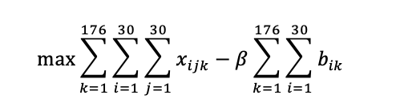
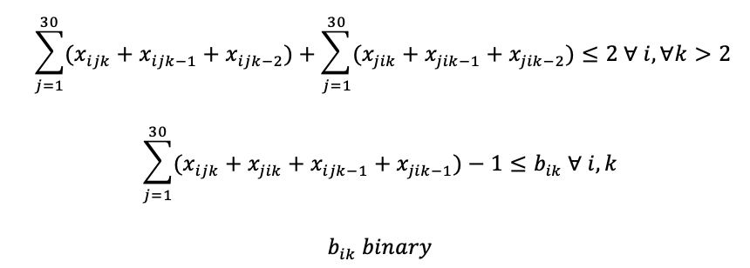
Our Solution
Adding constraints to improve the quality of the schedule
  Preventing identical matchups in short time periods
    By randomizing the tuples used to initiate the objective variables, identical matchups are minimized and patterns resulting from the order of input variables are eliminated.
  Eliminating back-to-back-to-back games
New objective function
Eliminates b2b2b situations
Penalizes b2b games

Slide 12
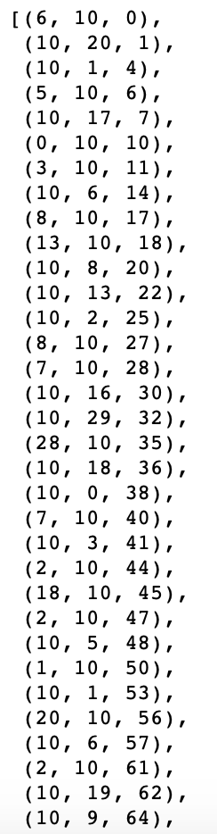
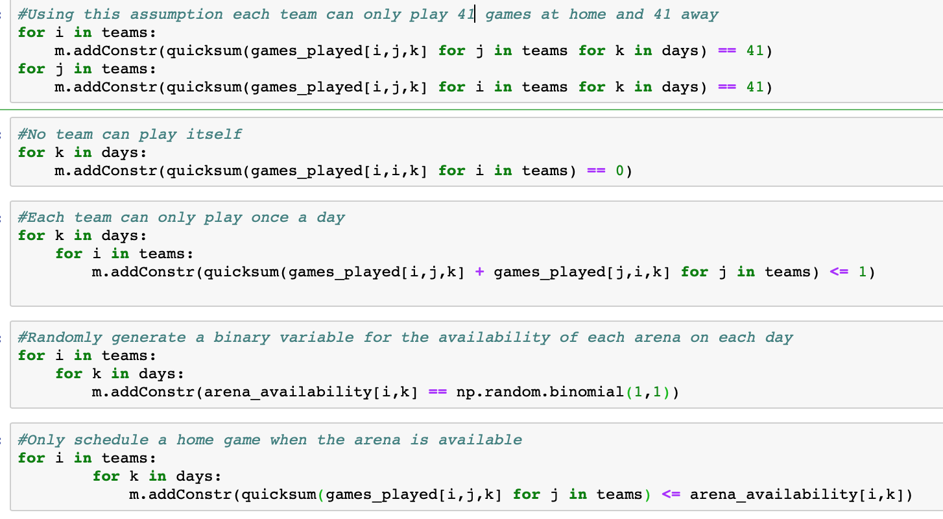
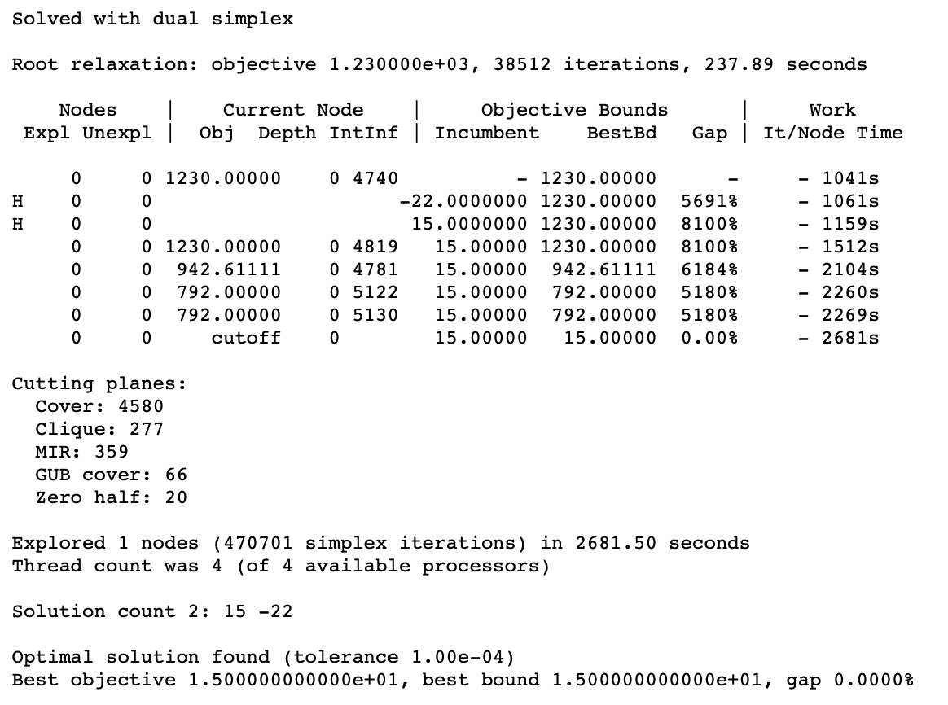
Results
Evaluating run time against improvements to the schedule
  Reduction of b2b2b game scenarios and minimization of b2b games
  Addition of break variables that are used in the objective function
    Reduces to same problem

Slide 13
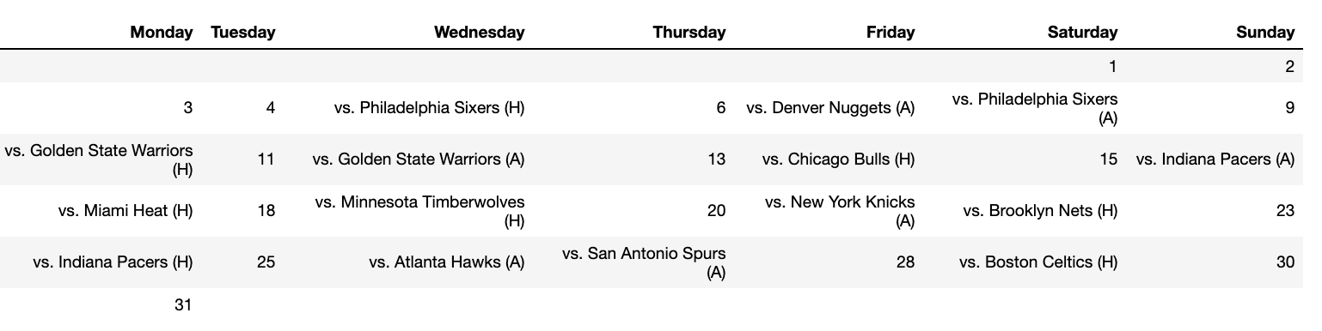
Sample Schedule for Memphis Grizzlies
December 2018

Slide 14
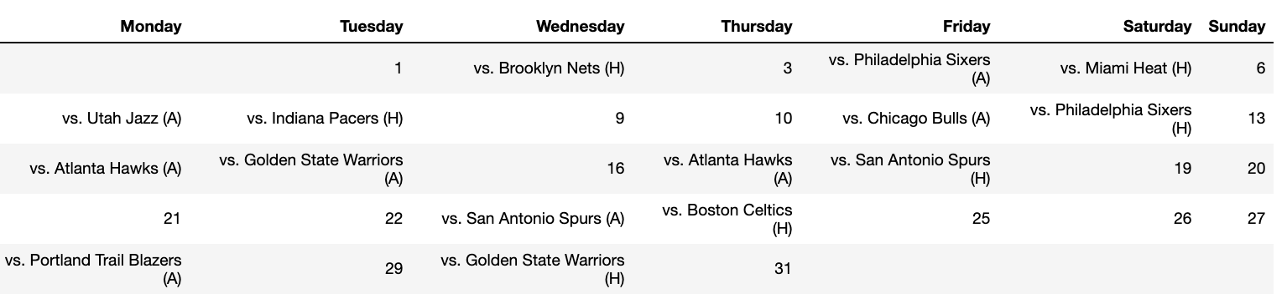
Sample Schedule for Memphis Grizzlies
January 2019

Slide 15
Evaluating Our Schedule
We compared a sample schedule from our solution to this past season’s schedule in the following ways:
Back-to-backs
Every year the NBA aims to further reduce the number of consecutive games a team plays.
Fresh, Tired, Even (FTE)
In order to ensure the fairness of a matchup, the NBA tries to pair teams who are equally rested. FTE is a team’s ratio of fresh, tired, and even matchups where, compared to their opponent, a team has had more, less, or equal rest time, respectively.
Distance Traveled

Slide 16
Evaluating Our Schedule: Back-to-backs
Our schedule has a greater number of back-to-back games.
We could alter our formulation and increase its complexity to constrain specifically against back-to-back games.
 | Actual 2018-2019 | Our 2018-2019
Team Average | 13 | 30
Team Variance | 11 | 9
Season Total | 397 | 927

Slide 17
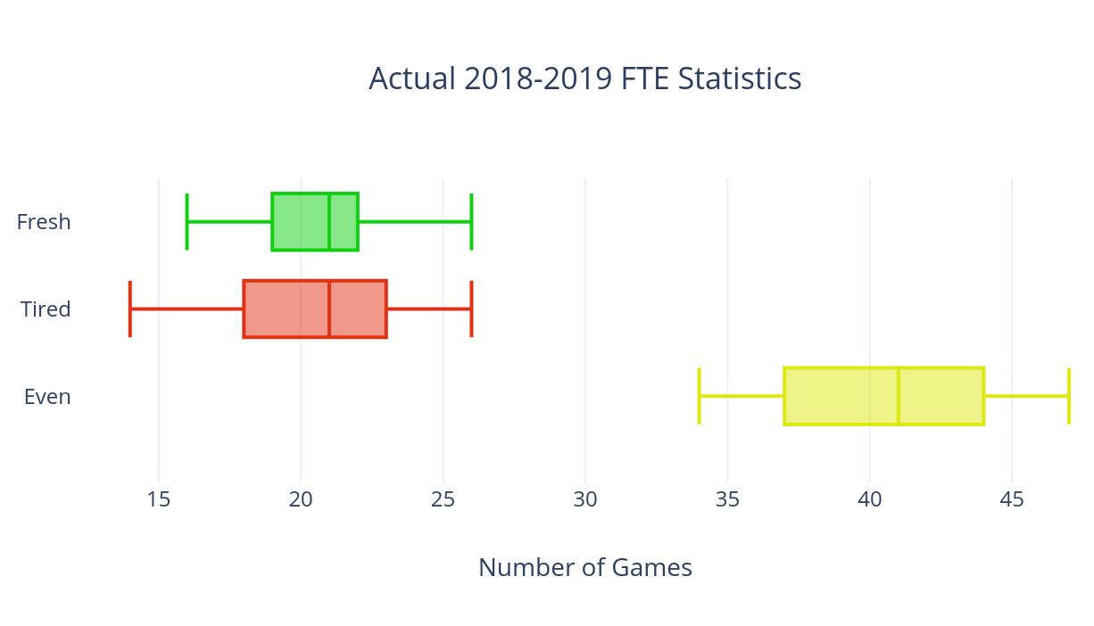
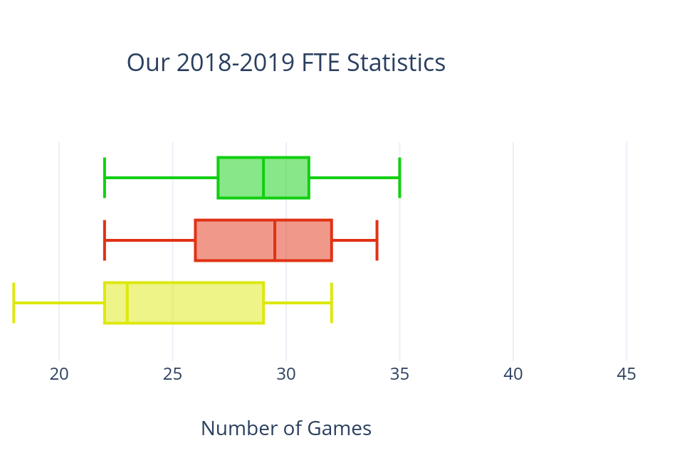
Evaluating Our Schedule: FTE
Comparatively, our schedule has a greater number of uneven games but maintains a similar variance and spread for each category.
Median: 21
Median: 29
Median: 21
Median: 29.5
Median: 41
Median: 23

Slide 18

Evaluating Our Schedule: FTE
Rest Day Differential | Actual 2018-2019 | Our 2018-2019
0 | 49.4% | 29.7%
1 | 40.1% | 35.6%
2 | 9.4% | 17.1%
3 | 1.1% | 10.4%
4+ | 0% | 7.2%
Even
Uneven
Similarly, we could increase the complexity of our formulation and constrain against too great of point differentials to eliminate extremely uneven matchups.

Slide 19
Evaluating Our Schedule: Distance Traveled
Our 2018-2019 Schedule:
Average distance traveled by a team: 39,972 miles
Actual 2018-2019 Schedule:
Average distance traveled by a team: 46,103 miles

Slide 20
Next Steps
Adding more constraints will make it more realistic
  For example, Grizzlies play Hawks away twice in one week
    On Monday, they play in Atlanta, Georgia
    On Tuesday, they play in Oakland, California
    On Thursday, they play in Atlanta, Georgia
    Consider travelling distance and path when scheduling!
Applying a similar formulation to the NHL

