Slide 1
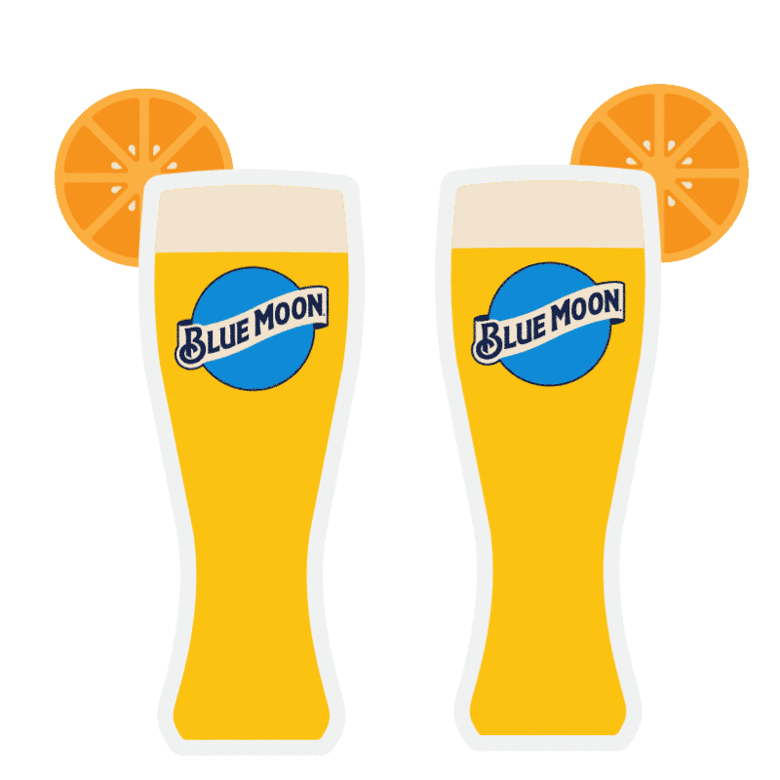
Microbrewery Production Schedule
Angela Zhang - amz2132
Lydia Jiang - lyj2001
Nicha Sophonpanich - ns2854
Yuyang Zhou - yz3421

Slide 2
Background
Overall beer sales in the US have gone down 1%
Craft beer sales have been rising at 5% per year
  steady demand because regulations prevent vertical integration
  smaller batches, high quality
  fuller flavor, greater variety
  supports local businesses
  higher average price
Time intensive production processes
  precedence constraints

Slide 3
Project Objective
Create a schedule that allows our microbrewery to increase production without the need to invest in more machines and employees
If more machines are needed, find out which machines should be bought and how will it affect the production

Slide 4

New Belgium Brewing Co.
Award winning brewery in Colorado
4th largest craft brewery in the US
365 employees
Annual sales of 583,160 barrels
13 different types of beers

Slide 5
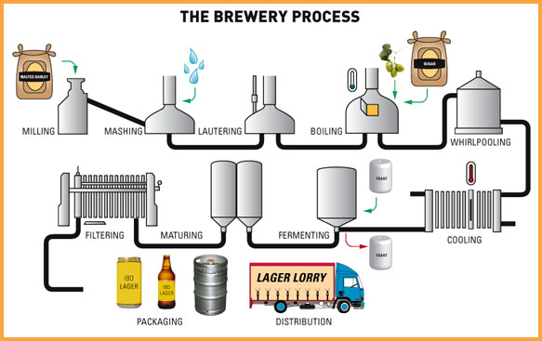
Brewing
Notes:
Milling: different types of malt are crushed together to break up the grain kernels in order to extract fermentable sugars to produce a milled product called grist
Mashing: grist is mixed with heated water in a process called mash conversion. The conversion process uses natural enzymes in the malt to break the malt’s starch down into sugars.
Lautering: mash is then pumped into the lauter tun, where a sweet liquid (known as wort) is separated from the grain husks.
Boiling: wort is then collected in a vessel called a kettle, where it is brought to a controlled boil before the hops are added
Wort separation and cooling: wort is transferred into a whirlpool for the wort separation stage. Any malt or hop particles are removed to leave a liquid that is ready to be cooled and fermented
Fermentation: yeast is added to convert the wort into beer by producing alcohol, a wide range of flavors, and carbon dioxide
Maturation: young “green” beer needs to be matured in order to allow both a full development of flavors and a smooth finish
Filtration, carbonation, and cellaring: beer is filtered, carbonated, and transferred to the bright beer tank, where it goes through a cellaring process that takes 3-4 weeks to complete.

Slide 6
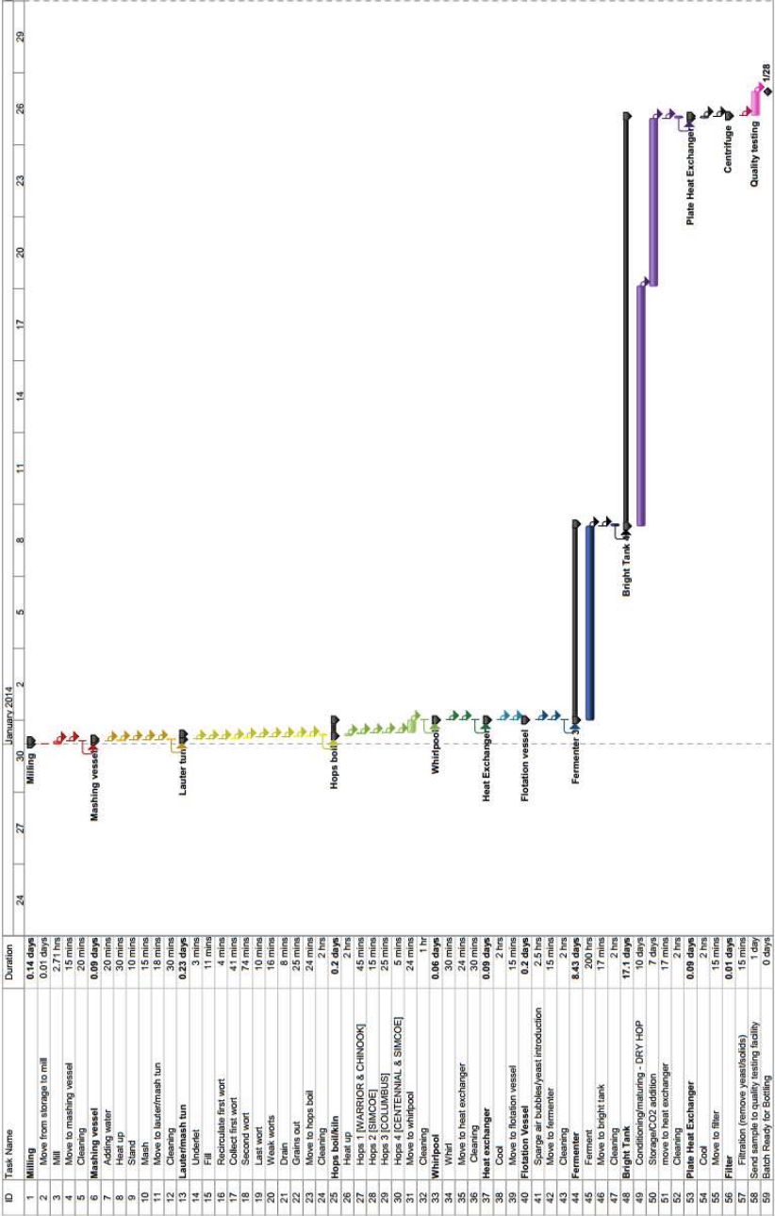
Production Process - Pale Ale
April 2019
Source: https://repository.upenn.edu/cgi/viewcontent.cgi?article=1049&context=cbe_sdr
Notes:
Pale ale is made from pale malt. It is hop-forward with a malty flavor and a golden to amber color. This is the style that inspired the American craft beer scene
makespan 26 days
17 days bright tank, 8 days fermentation
a bright tank is the vessel in which beer is placed after primary fermentation and filtering, so it can further mature, clarify and carbonate, and be stored before bottling

Slide 7
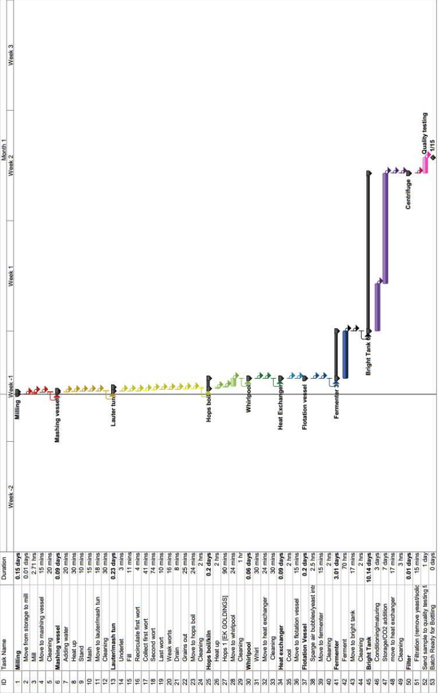
Production Process - Stout
Source: https://repository.upenn.edu/cgi/viewcontent.cgi?article=1049&context=cbe_sdr
Notes:
3 days, 10 days
15 days

Slide 8
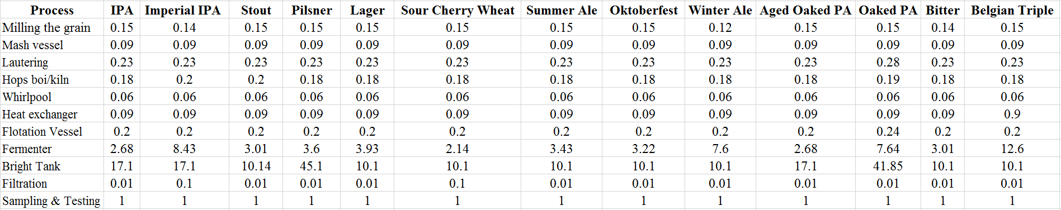
Processing Time Data
Here are the processing time data for producing one batch of beer on one machine.
(days)

Slide 9
Our Model
Assumptions:
For each process, all the machines can only work for one type of beer at the same time, which means that we could simplify multiple machines to one machine with the same output as a number of machines.
The optimal schedule should be a permutation schedule.
Based on these assumptions, we would be able to build a problem of F|perm|C_{max} to solve for the optimal schedule.

Slide 10
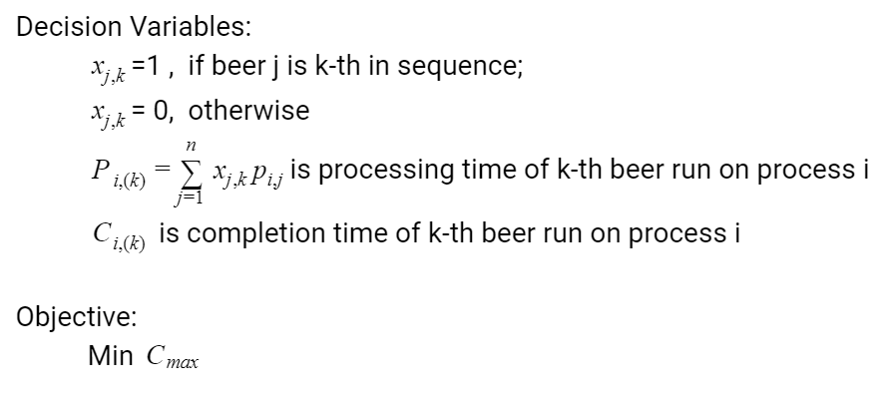
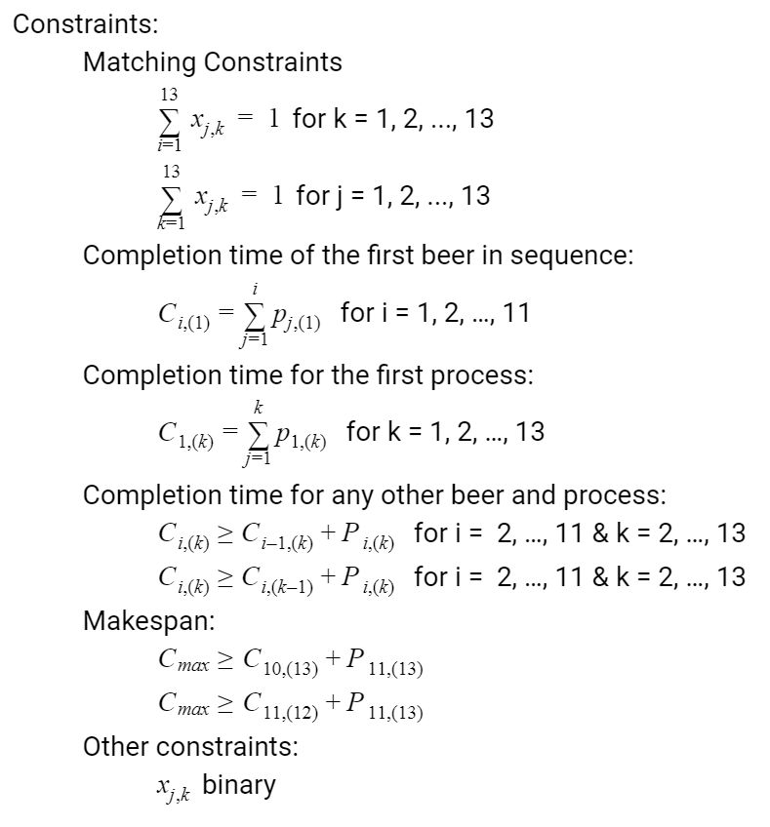
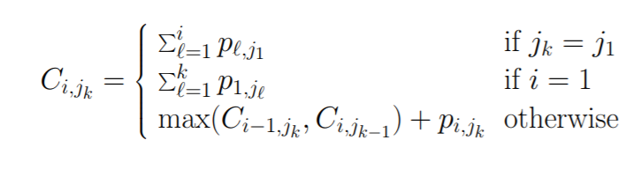
Our Model

Slide 11
Recommendation
Optimal Sequence:
Aged Oaked Imperial India Pale Ale
India Pale Ale
Summer Ale
Winter Ale
Stout
Belgian Triple
7. Pilsner
8. Oaked Imperial Pale Ale
9. Oktoberfest
10. Extra Special Bitter
11. Imperial India Pale Ale
12. Sour Cherry Wheat
13. Lager
Current makespan for one batch of beer: 3.94 days
Improved makespan for one batch of beer: 3.66 days (~7% decrease)
Notes:
if 1 more bright tank, 8.96 days

Slide 12
Results
Current production
24 machines
583,160 barrels sold annually
Current profits projected at $694M
  Assumptions:
  $5 revenue per glass of beer
  $108 cost to produce a barrel
  36 gallons per barrel of beer
Future production using our schedule
24 machines
628,155 barrels
  An 8% production increase of 144,955 barrels
  Profit increased by $17M (~3%)
Notes:
(5*(3968/16)-108)*23280

Slide 13
Options
Improved profit without new machines: $17 million
Assumptions:
261 working days per year, 3968 ounces per barrel, 16 ounces per pint, revenue per pint $5, cost per barrel $108, revenue per barrel $1240, profit per barrel $1132, 677 barrels per batch, $660,333 profit per batch
Costs of hiring additional worker, storing goods and maintaining additional machines are negligible compared to the costs of buying new machines
Fermenter cost: $1,410,000 Bright tank cost: $300,000
Options | Base case | Optimal schedule | Additional bright tank | 40 new bright tanks
avg # of days per batch | 3.94 | 3.66 | 3.53 | 1.46
# of beers in production | 13 | 13 | 13 | 13
# batches per year | 338 | 364 | 377 | 910
# barrels per year | 583,160 | 628,115 | 650,547 | 1,569,685
Profit per year for all barrels | $693,960,400 | $711,025,851 | $736,419,632 | $1,776,883,830

Slide 14
Final Recommendation
By running our optimal schedule, New Belgium would be able to increase its profit by $17M from $694M to $711M (~2.5% increase) without having to purchase any additional machine. This increase in production would allow New Belgium to meet the annual 5% increase in demand.
For future expansion, we recommend New Belgium to invest in more bright tanks, We see that in order to totally eliminate the bottleneck the bright tanks create, they would need to buy 40 new bright tank machines at a cost of $300,000 per machine or $12M in total.
Although the total cost increases by $12,000,000, New Belgium is able to increase the number of barrels produced per year by 986,525 barrels. This would ultimately increase New Belgium’s profit from $694M to $1.78B. So, assuming the profit from investing in bright tanks is linear, the company can always stand to improve their profits by investing in up to 40 more bright tanks.

Slide 15
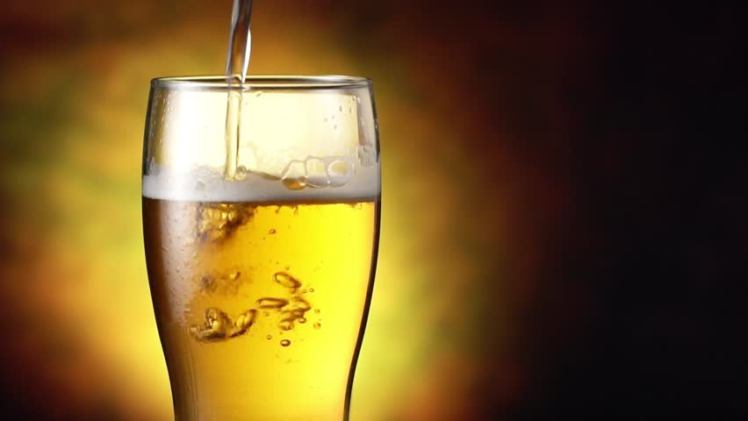
Questions?

