Slide 1
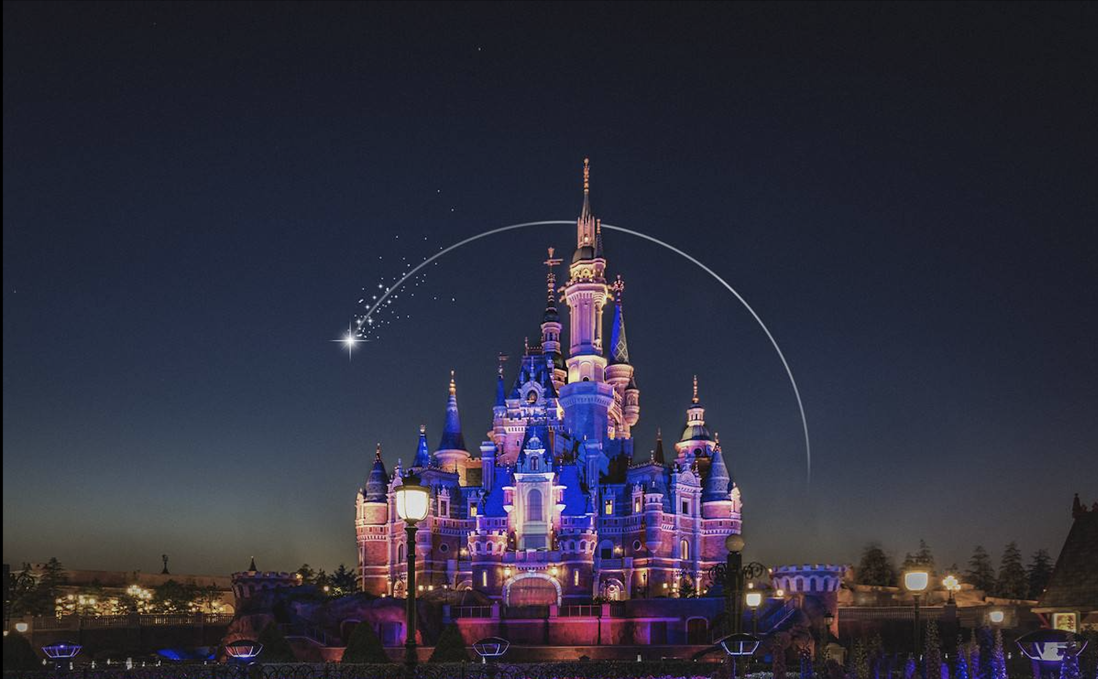
Walt Disney World
Ye Yuan
Yifan Shen
Tianjiao Wei
Linyun Wei

Slide 2
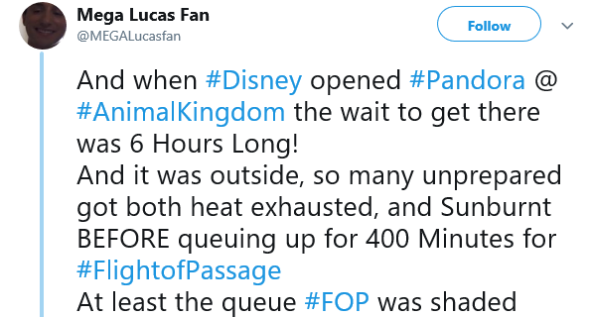
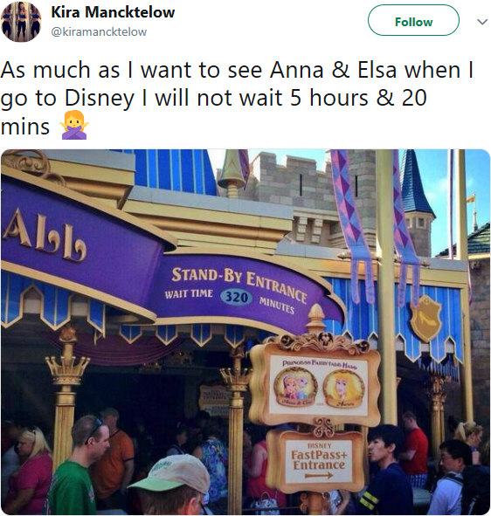
Complaints About Queueing Situation
放等候时长data（柱状图、折线图、加趋势）

Slide 3
Disney’s Queueing Situation
Most Disney’s must-rides has a queue with more than 2000 people everyday.
Queue Length of Selected 15 Rides
People
150 mins

Slide 4
Disney Queueing Situation
Visitors to Disneyland are experiencing more sore feet and sunburn while waiting to ride some of the parks’ increasingly popular attractions

Slide 5
Why Choosing Open Shop Model
01
03
05
Each machine take one person at a time
Jobs
Differences
02
04
06
A person playing some attraction
Different from job shop, open shop deals with multi-operation while the routes of the jobs open
Distribution
Processing Time
Potentially, we want to model each job as randomly generated by some distribution according to the popularity of that attraction
Generic algorithm
Time spent for that the person sitting on that attraction
Generic algorithm will be used to minimize total tardiness.

Slide 6
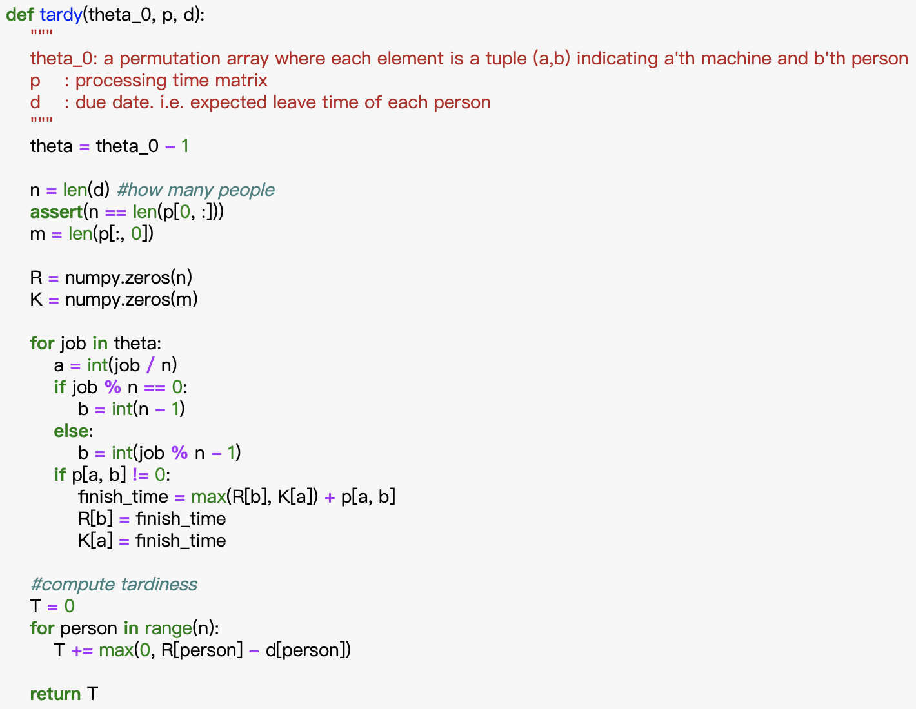
Genetic Algorithm
Compute the total tardiness of given permutation

Slide 7
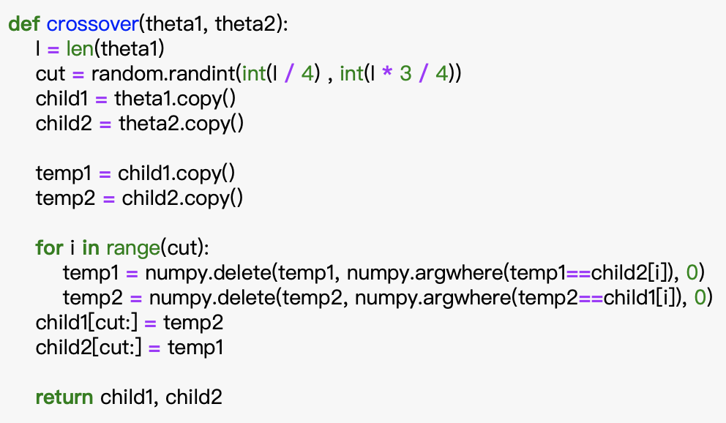
Genetic Algorithm
Crossover
  combine the sequence of operations on a single machine in one parent schedule with a sequence of operations on another machine in another different parent
  Preserves the absolute positions of the jobs taken from P1
  Preserves the relative positions of jobs taken from P2
Method: Crossover

Slide 8
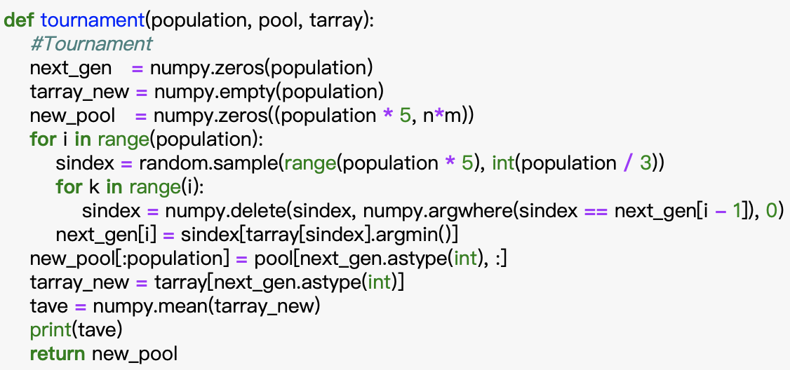
Genetic Algorithm
Tournament selection
  Randomly choose a group of T individuals from the population
  Select the best one.
Method: Tournament selection
T

Slide 9
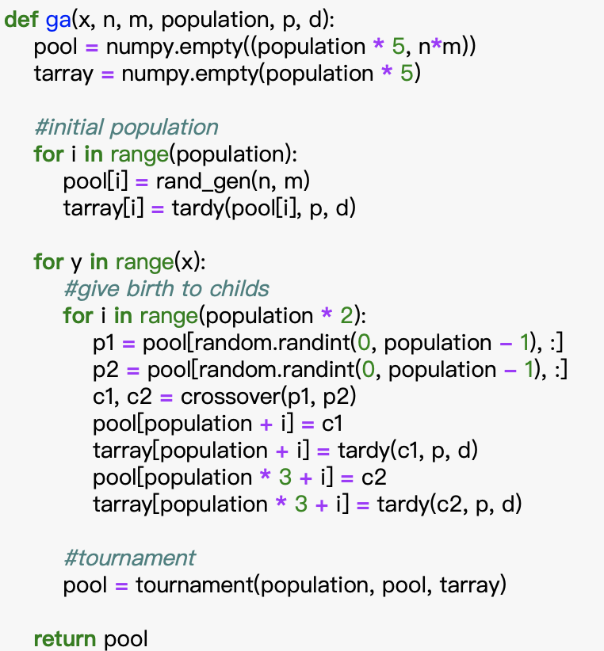
Genetic Algorithm
Method: Genetic Algorithm
00
Step 0
k=1
Select N schedules S1,1 ,... , S1,N randomly
Step 1
Select N schedules Sk+1,1 ,... , Sk+1,N using tournament
Evaluate each individual of the population
Step 2
Create new individuals by mating individuals in the current population using crossover and mutation
Evaluate the new members and insert them into the population Sk+1,N+1 ,... , Sk+1,5N
Step 3
k = k+1
If stopping condition = true
then return the best individual as the solution and STOP
else go to Step 1
01
02
03

Slide 10
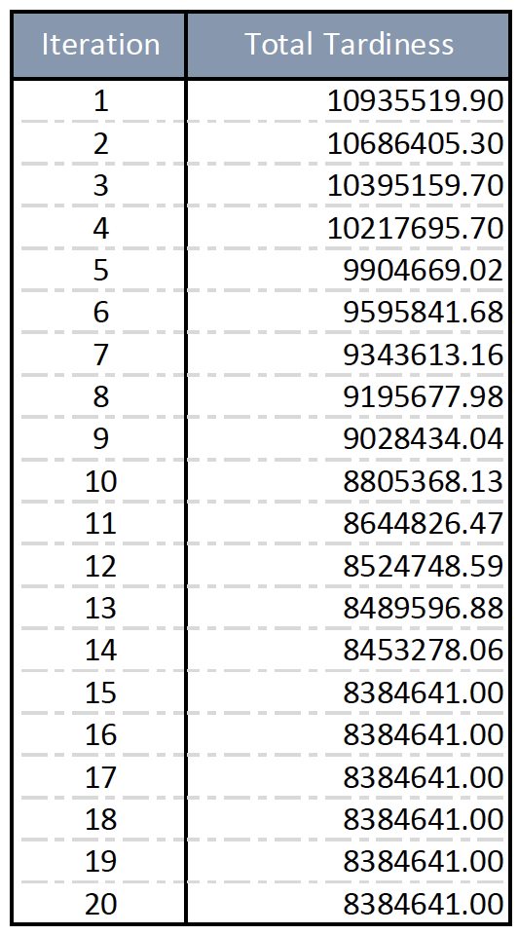
Total Tardiness Outcome
Outcome

