Slide 1
MTA Bus Scheduling
Zen Bakshi, Thomas Mecattaf,
Dessi Javier Gando Narvaez, Natalie Schmidt

Slide 2
Problem
“The Other Transit Crisis”: 2017 report by NYC Comptroller Scott M. Stringer
Jobs shifting outside of Manhattan
  Hub-and-spoke subway system designed to bring workers into Manhattan
  Employment growth 2006-2016: Brooklyn, 49%; Bronx, 35%; Queens, 34%, Staten Island, 27%; versus Manhattan, 5%
NYC lags behind nearly every other major metropolitan area
  Average bus speed is 7.4 mph, slowest of the 17 largest bus systems in the country
Disproportionately affects lower-income New Yorkers, immigrants, and people of color
  Avg bus commuter salary = $28,455 (Avg subway = $40,000; avg NYC = $38,840)
  55% bus commuters foreign-born, 75% people of color
Notes:
The other transit crisis: everyone complains about the subway (see: the closing of the L and the ruckus that caused), but the bus system is just as bad (if not worse)
Inflexibility of subway system (can’t just move tracks and stations) can’t keep up
Source: https://comptroller.nyc.gov/wp-content/uploads/documents/The-Other-Transit-Challenge.pdf

Slide 3
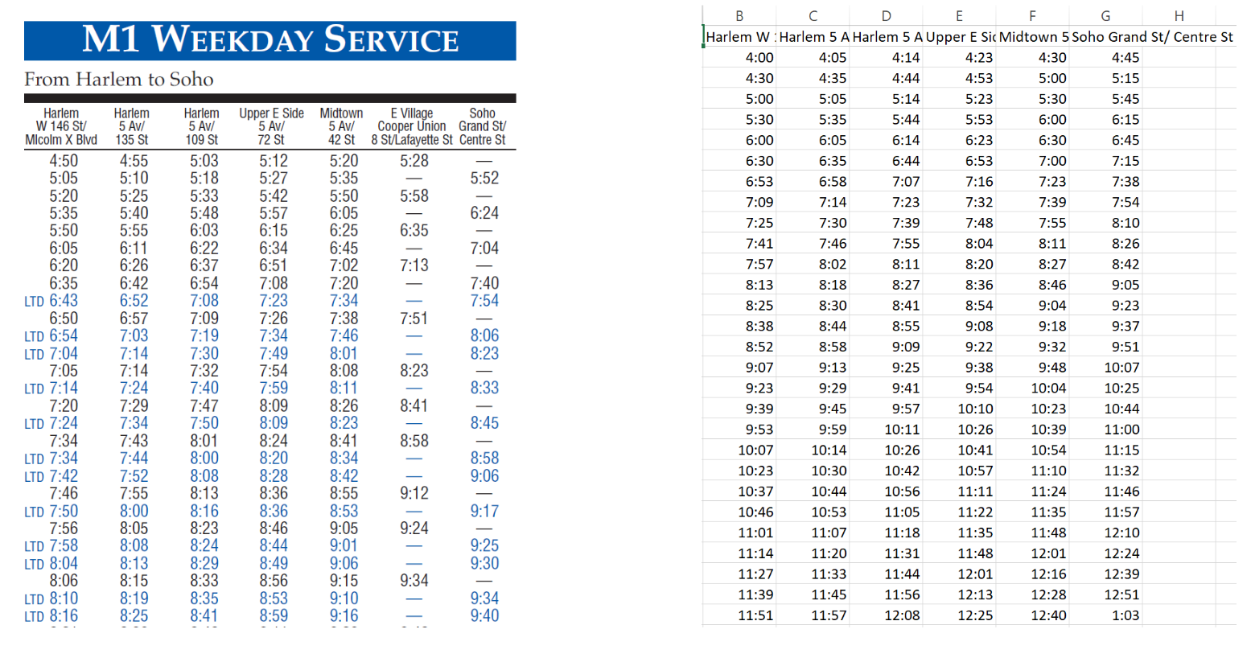
Data
Includes time at each stop, varying on weekdays/weekends/special circumstances
From this, time between each stop can be calculated
Scraping done with python script:

Slide 4
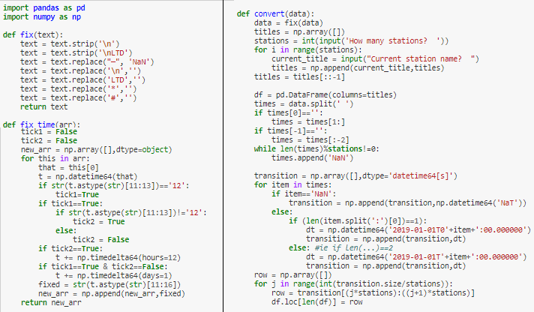

Slide 5
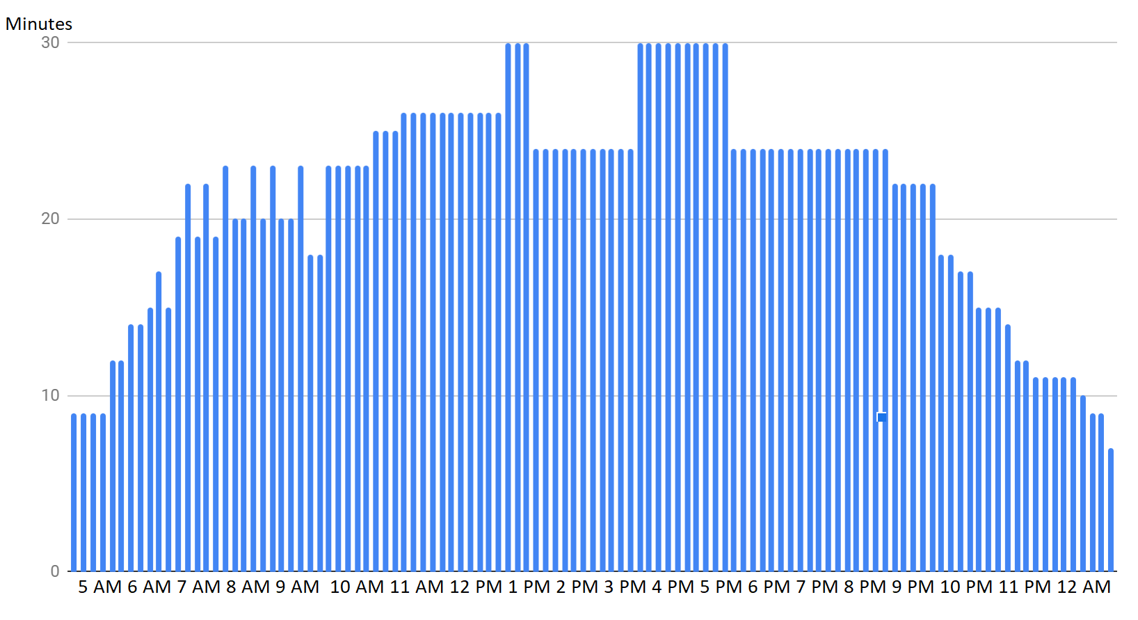
Average inter-station waiting time throughout the day

Slide 6
Papers
Model 1: Re-making the entire transit system
Model 2a: Linear program to minimize waiting time
Model 2b: Genetic algorithm to optimize bus timetables

Slide 7
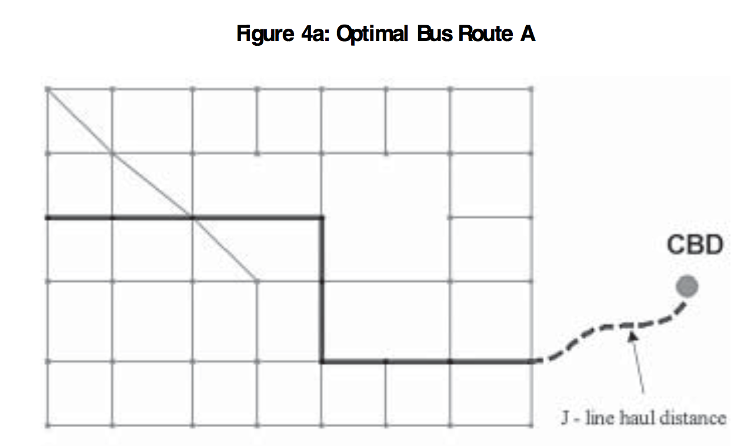
Model 1: Optimizing bus itineraries
Studying the routes themselves: “Optimization of Bus Route Planning in Urban Commuter Networks” GIS database
Grid system, adapts to changing demand
40+ metrics (passenger demand, arc lengths, fleet size, passenger walking speed, etc.)
Optimization model:
  Decision variables: arcs (i.e. streets) to travel on
  Objective function: minimize cost (operating cost + value of users’ time walking/waiting/riding)
  Outputs optimal route
  Also can solve for optimal fleet size on route
Solved using exhaustive search + GIS database
Notes:
Creating grid system requires a lot of preprocessing of diagonal arcs
Earlier models usually simplified changing demand away
So many metrics

Slide 8
Model 1: Optimizing bus itineraries
Actually applicable?
  Needs extensive GIS mapping data
  Still have 40+ metrics
  MTA data nowhere near complete enough
  Exhaustive search is exhausting!
Still key takeaways:
Many-to-one vs. many-to-few: can similarly limit number of routes to consider by limiting destinations to a few key central locations in outer boroughs (downtown Brooklyn, Long Island City, etc.)
Optimal buses per route: can’t find good, let alone optimal, way to schedule jobs unless the right number of jobs are being scheduled

Slide 9
Model 2 a: Linear program to minimize waiting time
Optimize schedule → min total wait time
We combine the waiting time of each passenger to get total waiting time
Assumptions:
  Bus capacity non-limiting (everyone waiting can board the bus when it arrives)
  Wait times of all passengers are equally important
  Total waiting time for buses are equal
Decision Variables:
  Ni : the number of buses running during time interval i
  Bi : the inter-bus arrival time during time interval i
First model: passenger arrival is deterministic
  Easily determine wait time as difference between arrival time and scheduled bus arrival time
  Multiply the wait time of one bus by the number of buses that arrive during interval i

Slide 10
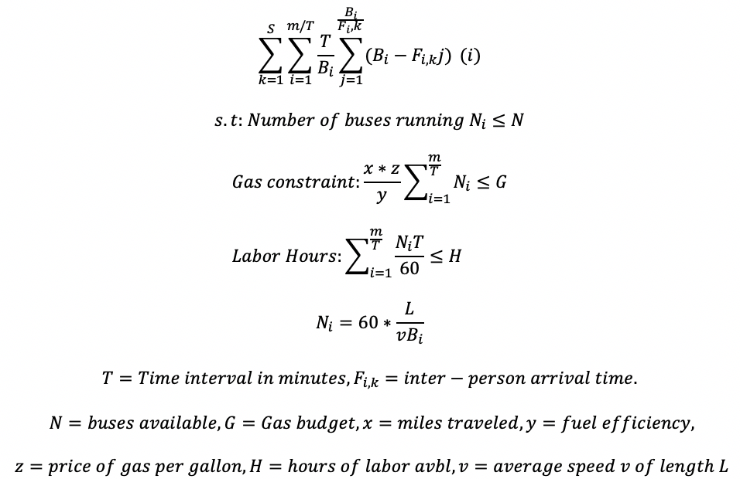
Model 2 a: Linear program to minimize waiting time

Slide 11
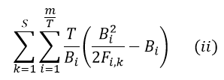
Model 2 a: Linear program to minimize waiting time
Second model: Poisson process arrivals, exponential interarrival time
  Same constraints as before
  Using data, you can estimate the arrival rate
  Objective function:
MTA data only includes bus arrival times
However, these models can be useful in understanding the nature of how passengers arrive and can give us an optimal schedule for specific time intervals
Analysis can be done to see which time intervals need the most/least amount of buses operating

Slide 12
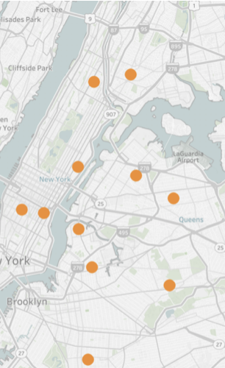
Model 2 b: Genetic algo to optimize bus timetables
-A numerical optimization method developed by John Holland in 1970 based on Natural Selection and Genetics
- Five step process:
Initialize population > Compute Fitness >
REPEAT Reproduction > Crossover > Mutation > Compute Fitness
TILL Fitness[generation] ~ Max(Fitness[generation])
Application: optimizing delivery routes, bus scheduling, etc.

Slide 13
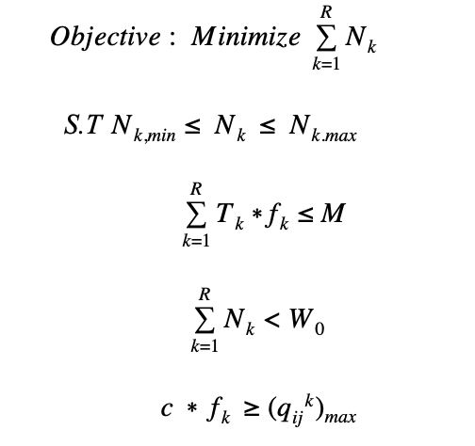

Genetic Algorithm LP and Procedure
Size of string = k * 3 - eg. 110010101 for 3 routes
If N_{k,min} is 6,9,8 what is N_{k}?
Assign low fitness value if:
Fleet size less than base fleet size OR
Number of passengers exceed capacity
Maximize fitness value

Slide 14
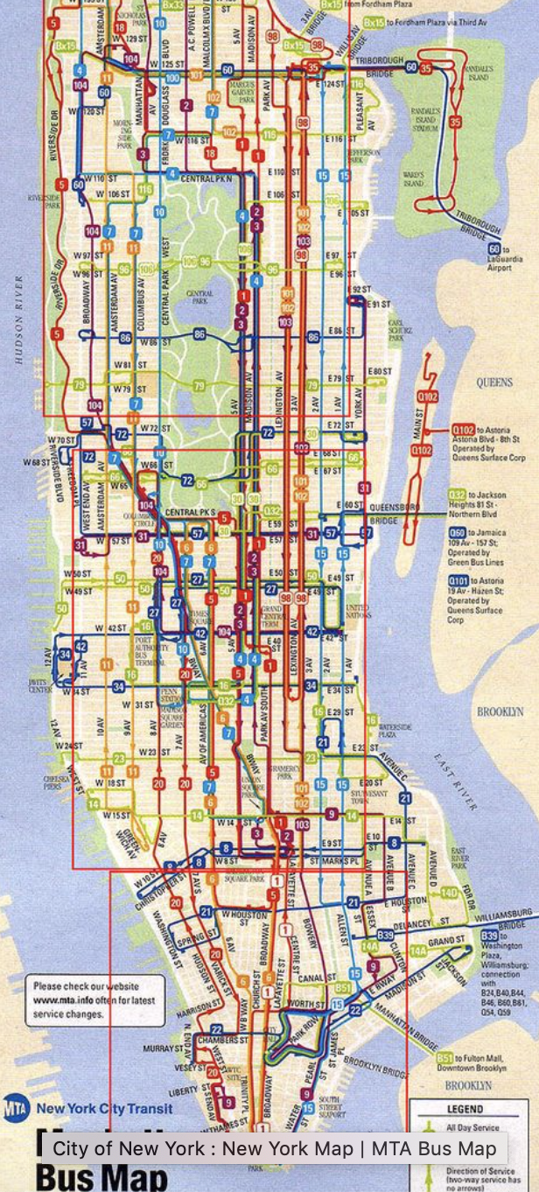
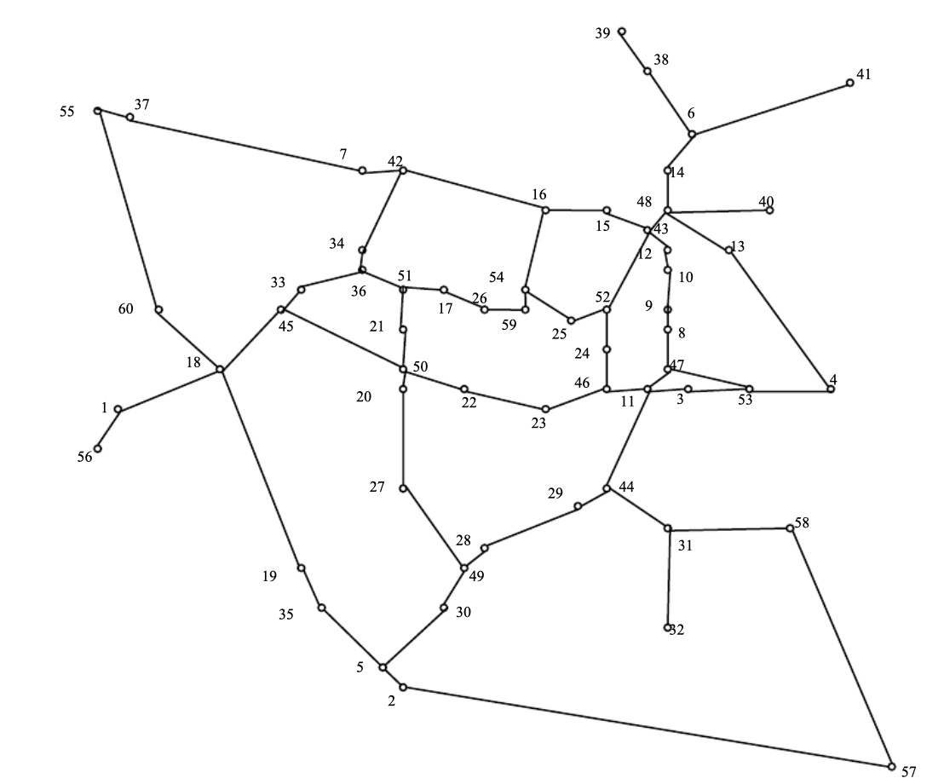
Results

