Slide 1

NBA Scheduling
May 2, 2019
Mitch Gaiser, Alex Carvalho,
Luqman Ebrahim, Norman Paasivaara
https://freebiesupply.com/logos/nba-logo/
Notes:
Luqman

Slide 2
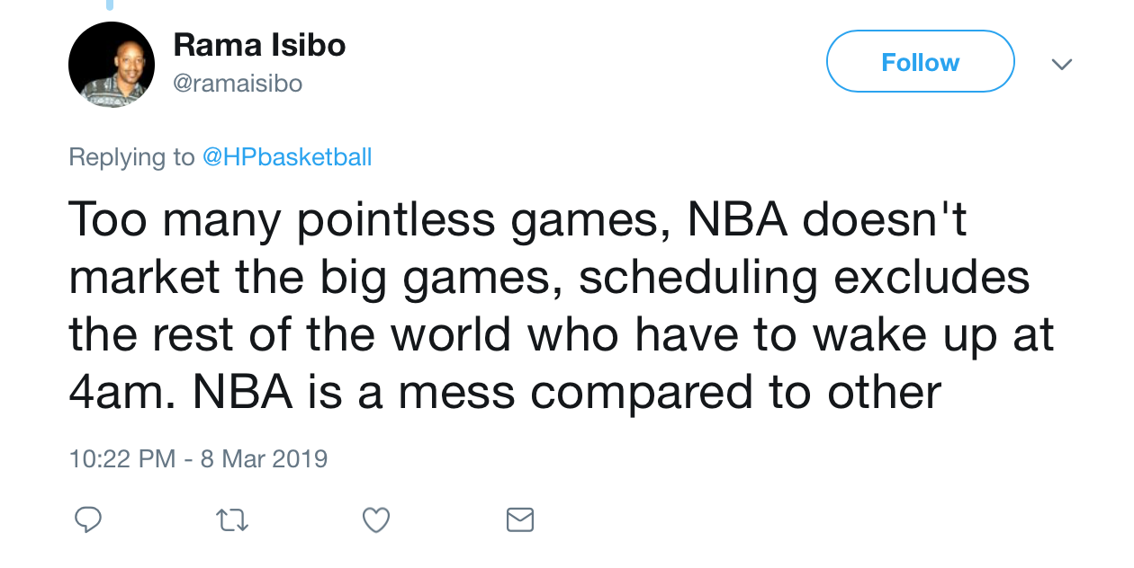
Introduction
NBA schedules 1230 games in 176 days
Revenues total $2.6 bn
Inefficiencies create
  Lost Revenue Opportunities
  Player dissatisfaction
  Fan dissatisfaction
Notes:
Luqman

Slide 3
Initial Ideas
Create an LP with team fatigue and fan penalty
  Maximize Revenue for NBA
  Minimize Fatigue (back-to-back games)
  Minimize travel distance
162,000 Variable matrix
  Very hard to optimize
  Massive computing power
Notes:
Alex

Slide 4


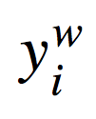
The Model
Definitions
= 1 if team i plays team j on day d; 0 otherwise.
→ i = 1,...,30; j = 1,...,30; d = 1,...,180.
= objective coefficient value if team i plays team j on day d.
→ comes from team-viewership data and importance of day.
represents the number of games team i plays in week w
Each team i is in Conference Set S_{C} ; where C = 1 or 2
Each team i is in Division Set S_{D} ; where D = 1, 2, 3, 4, 5, or 6
Notes:
MITCH
Define variables, weights, etc
IP Formulation
Assumptions: home and away teams can be chosen in post, time of games can be chosen in post
Missing variables: broadcasting availability, court availability

Slide 5
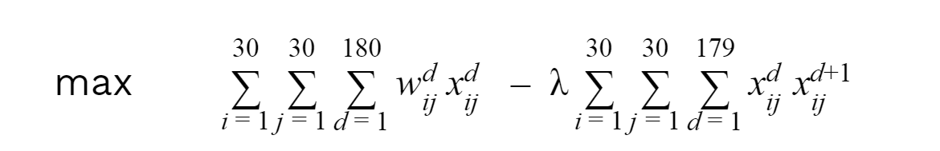
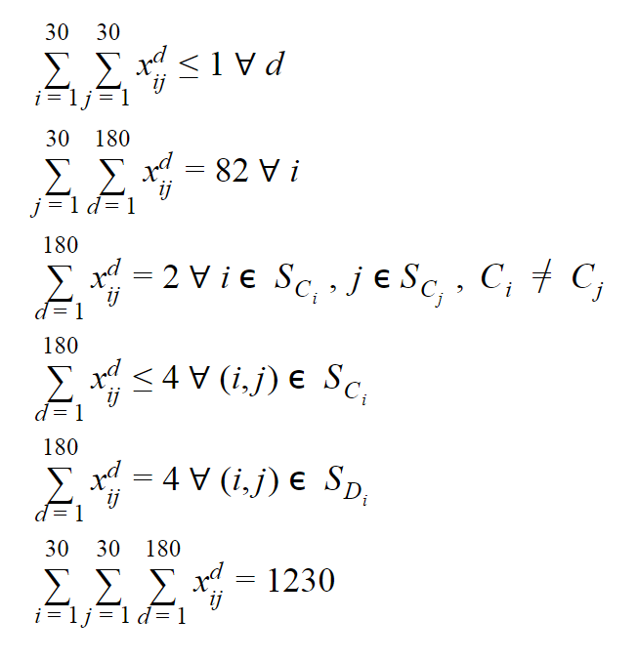
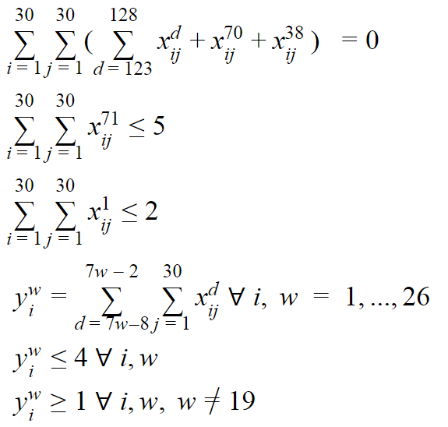
The Model
subject to:
Teams can only play once per day
No games during all-star break, Christmas Eve and Thanksgiving
Each team plays 82 total games
At most five games on Christmas Day
Teams in opposing conferences play twice
At most 2 games on Opening Day
Teams in the same conference play at most 4 times
Weekly variable definition
Teams in the same division play exactly 4 times
At most 4 games per week for all teams
Total number of scheduled games is 1,230
At least 1 games per week for all teams
Notes:
MITCH
Define variables, weights, etc
IP Formulation
Assumptions: home and away teams can be chosen in post, time of games can be chosen in post
Missing variables: broadcasting availability, court availability

Slide 6
The Greedy Algorithm
while (all teams haven’t played 82 games) {
for (weight-sorted days in the schedule) {
choose the objective maximizing game on that day
if (the game is schedulable) {
schedule it
decrease objective coefficients for d-1 and d+1
} else {
set objective coefficient for team-team-day combination = 0
}
}
}
Notes:
MITCH

Slide 7
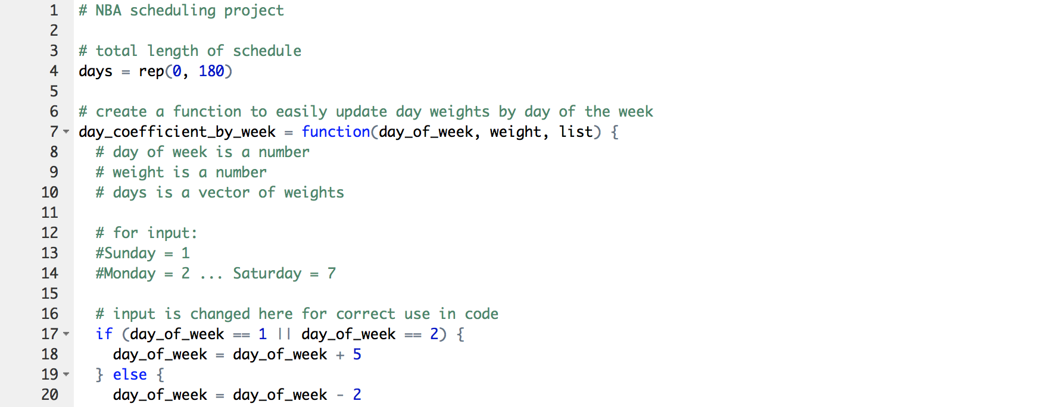
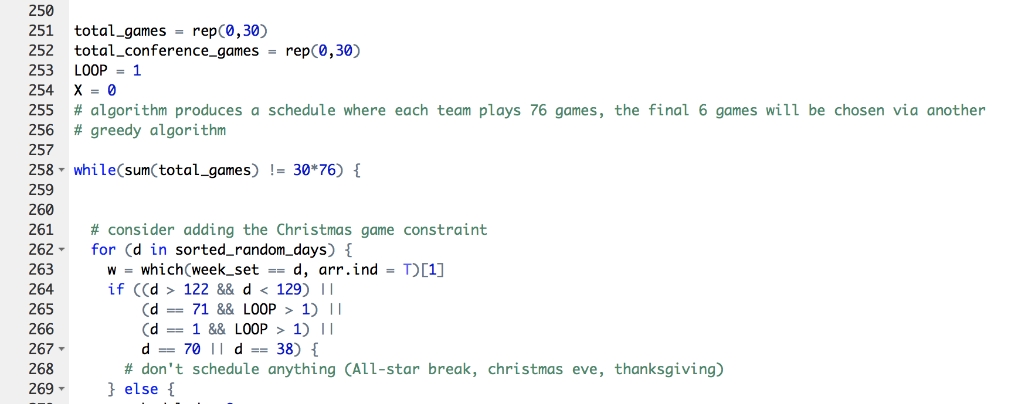
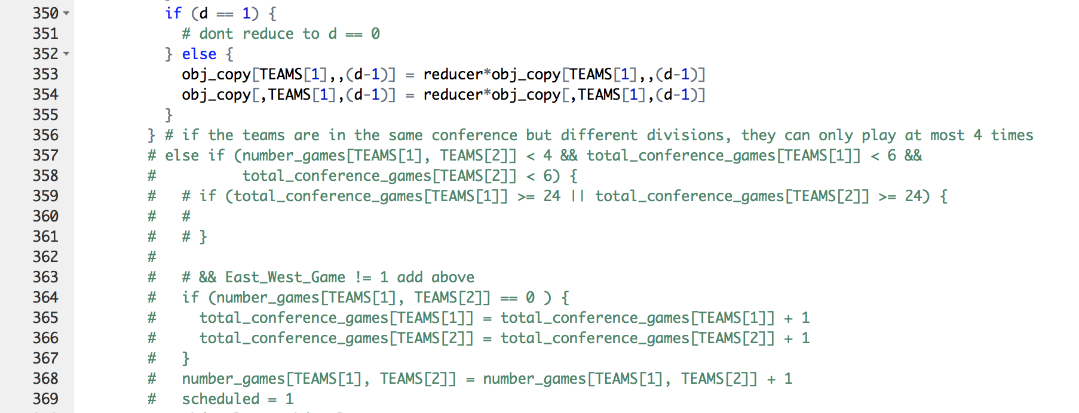
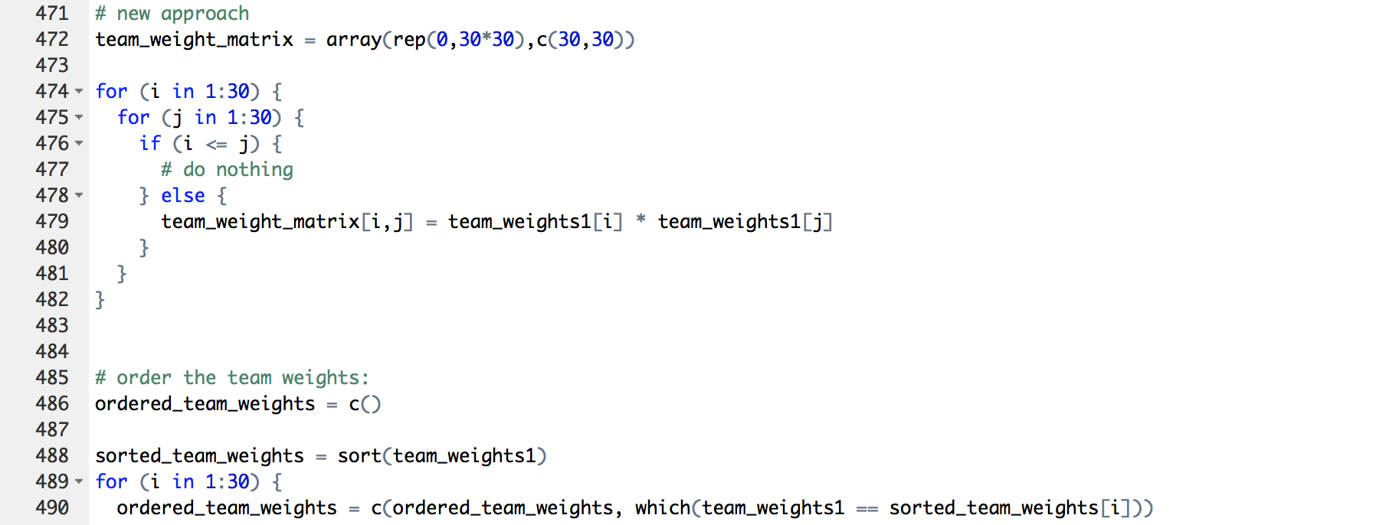
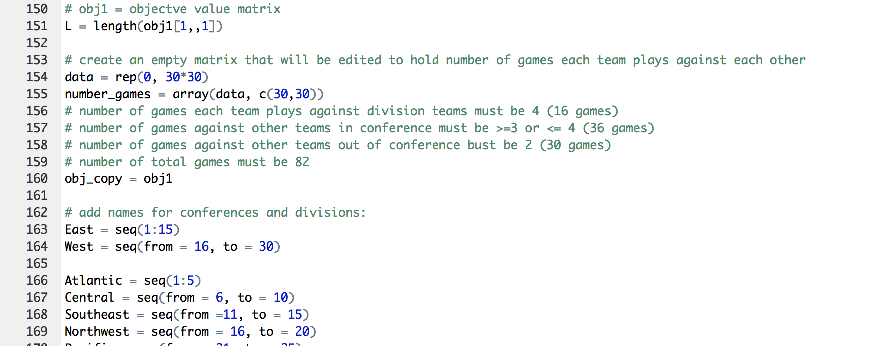
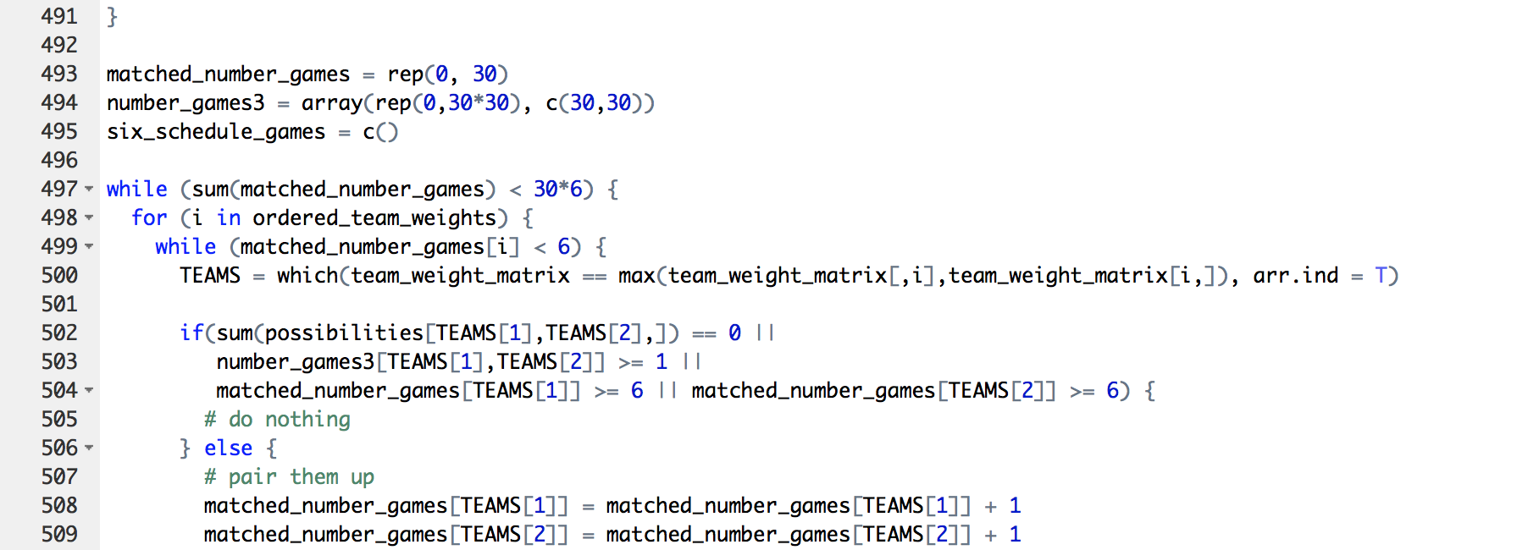
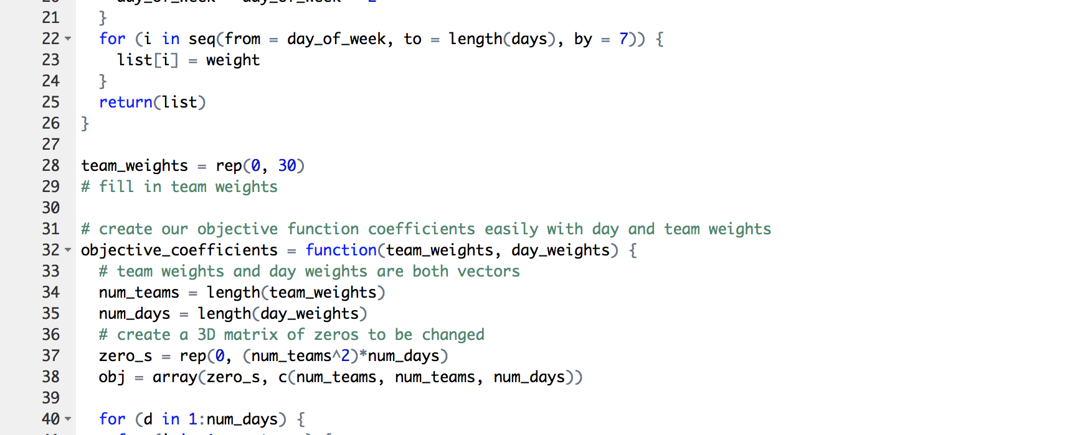
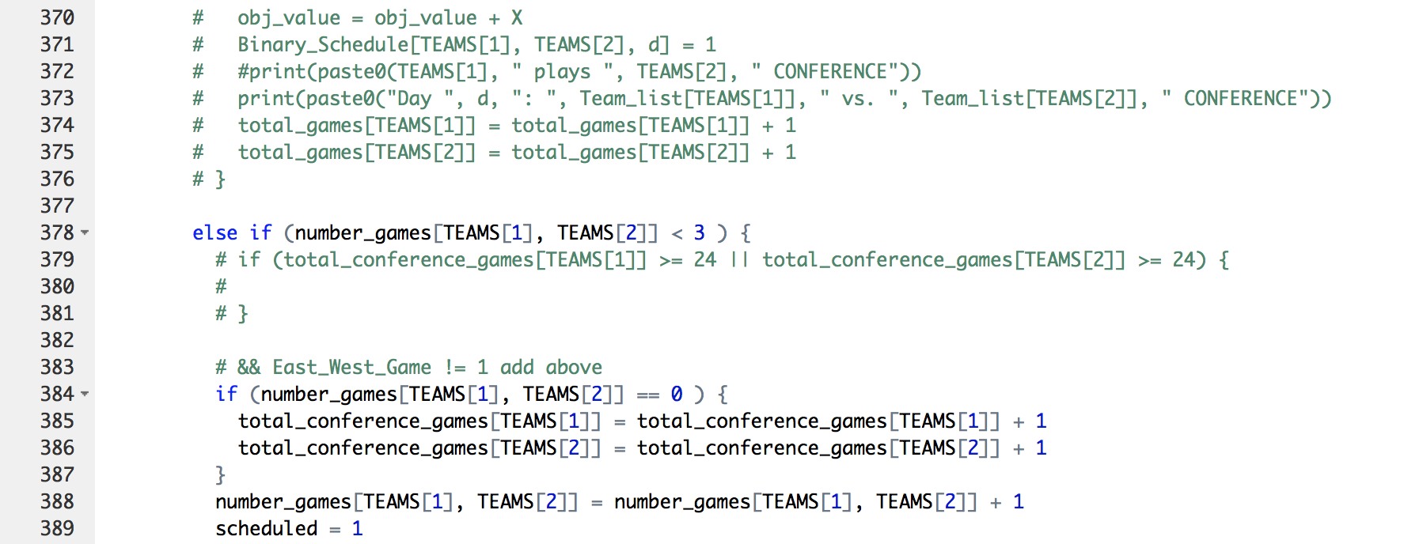
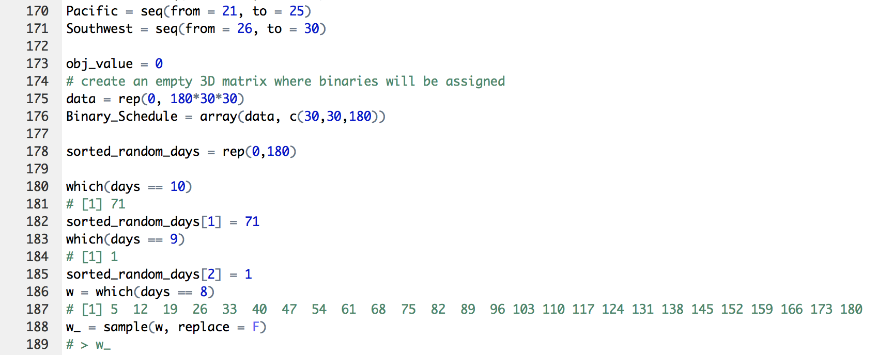
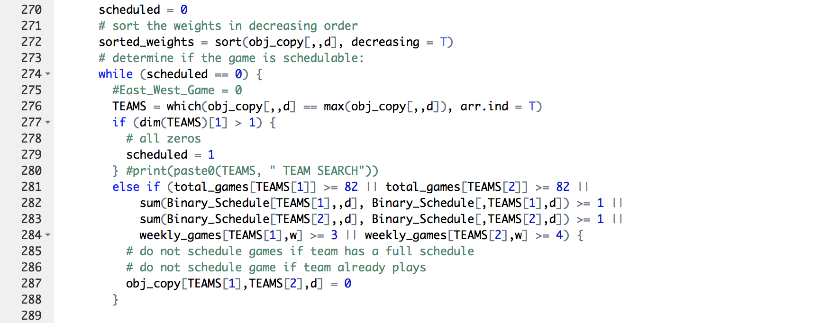
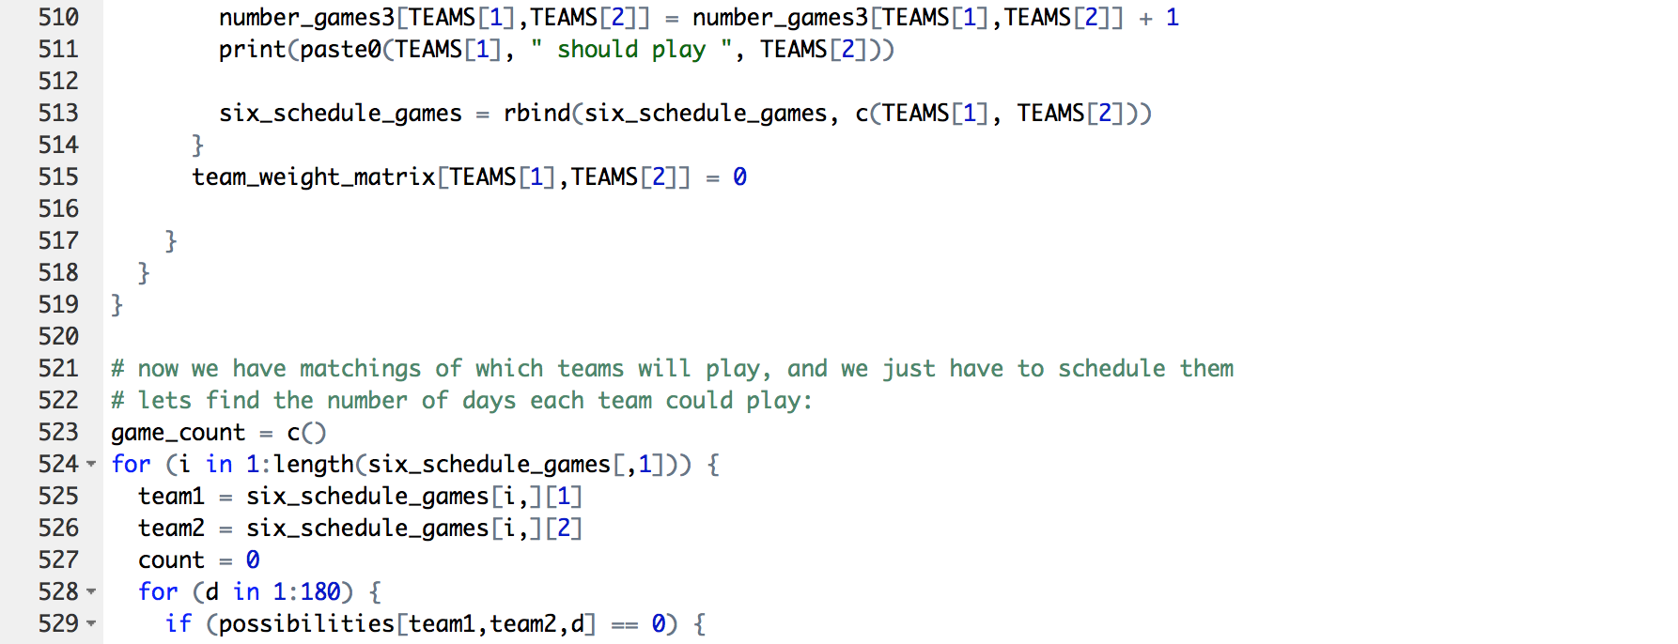
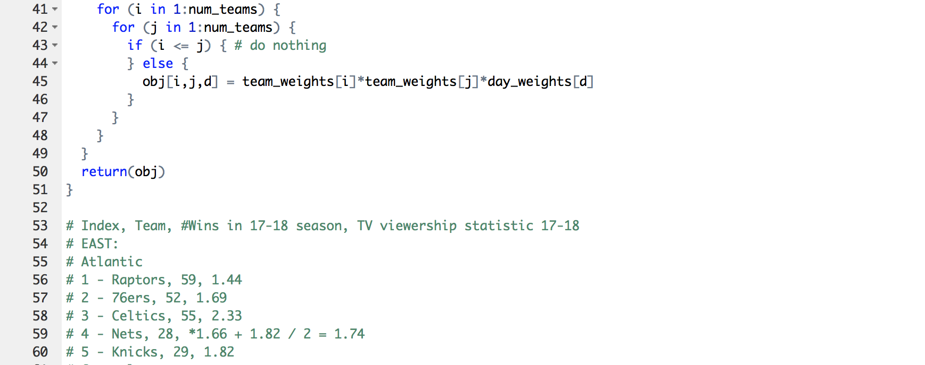
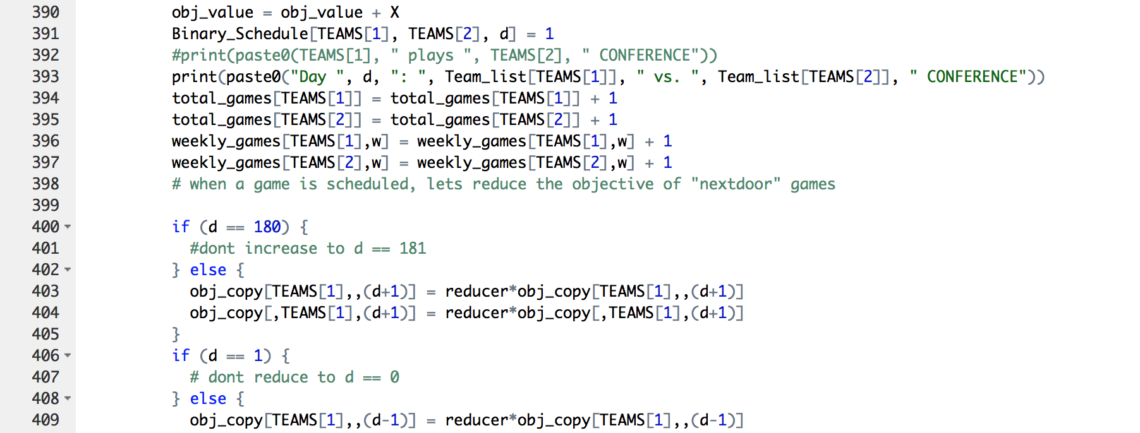
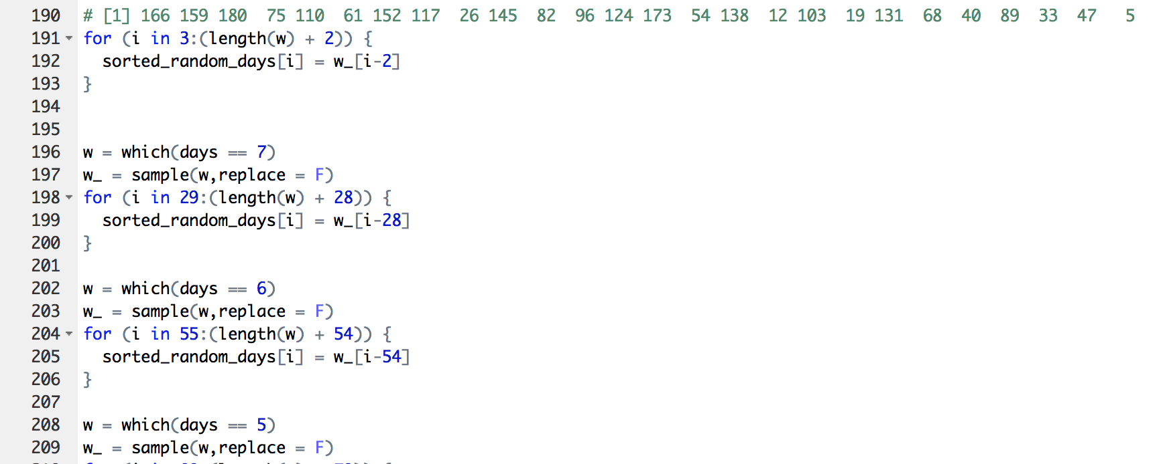
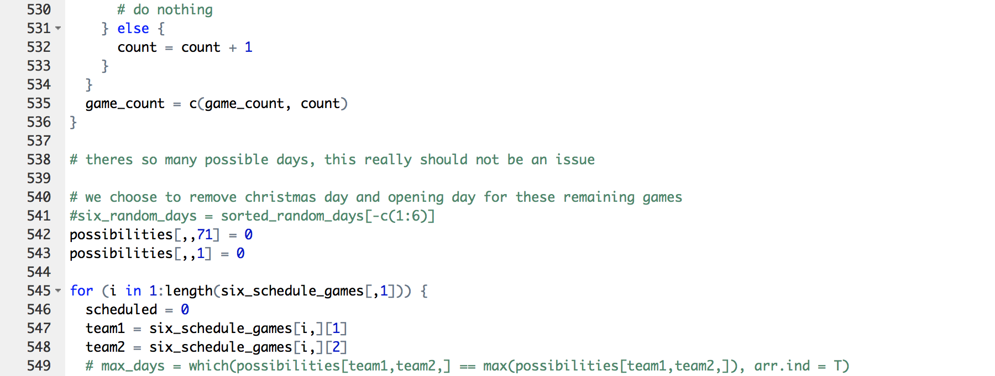
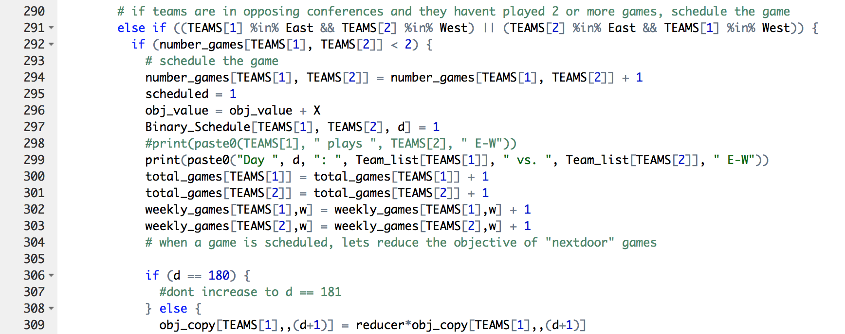
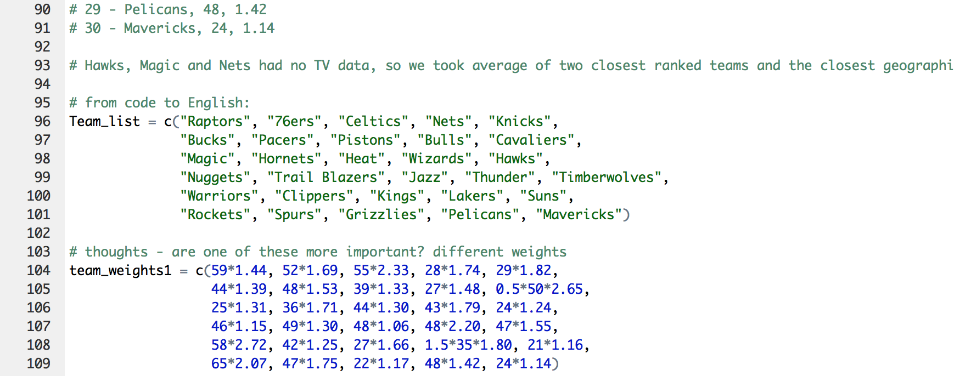
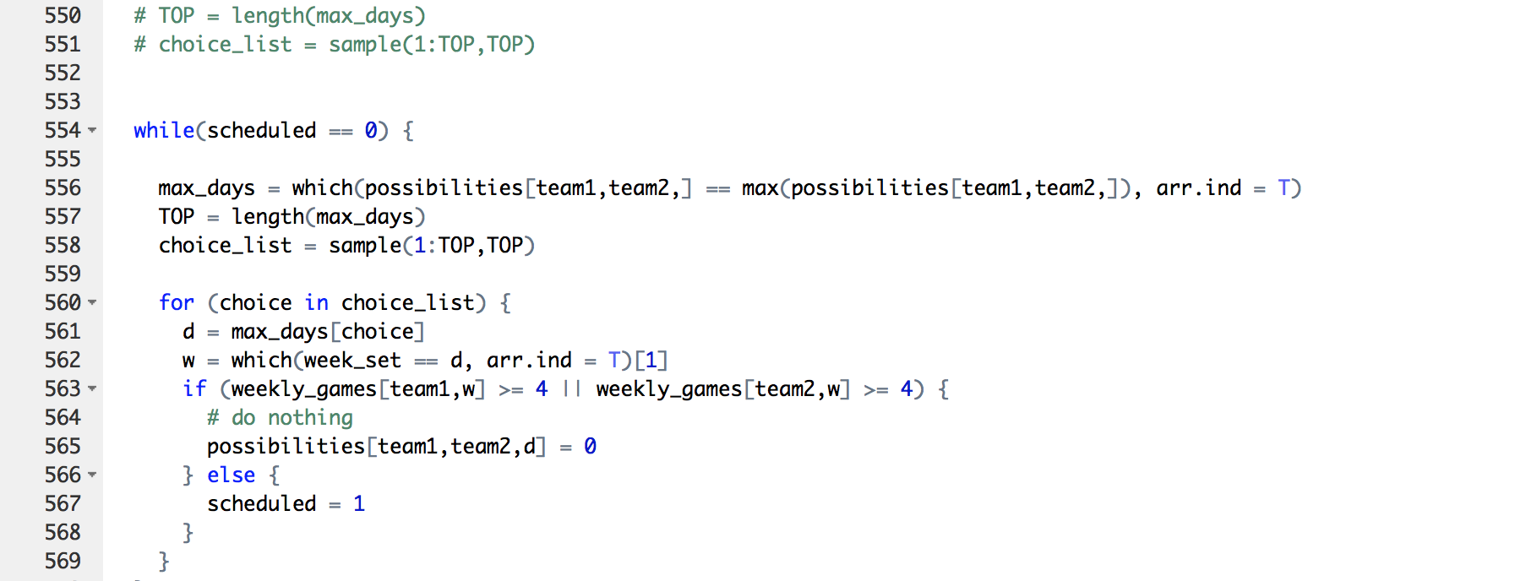
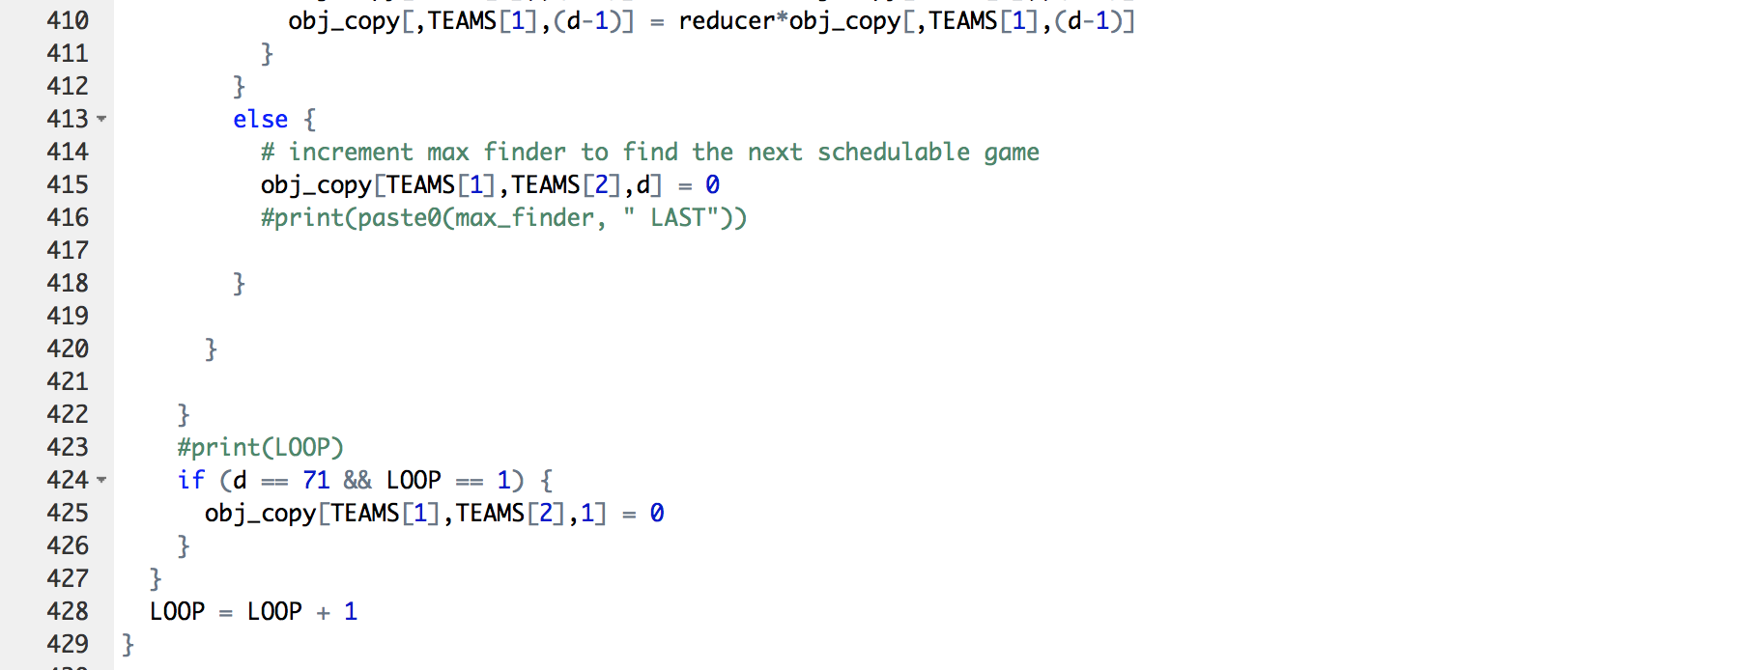
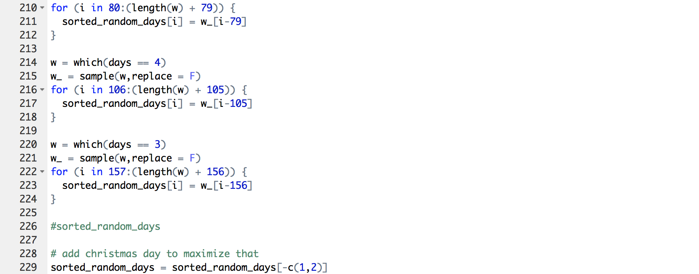
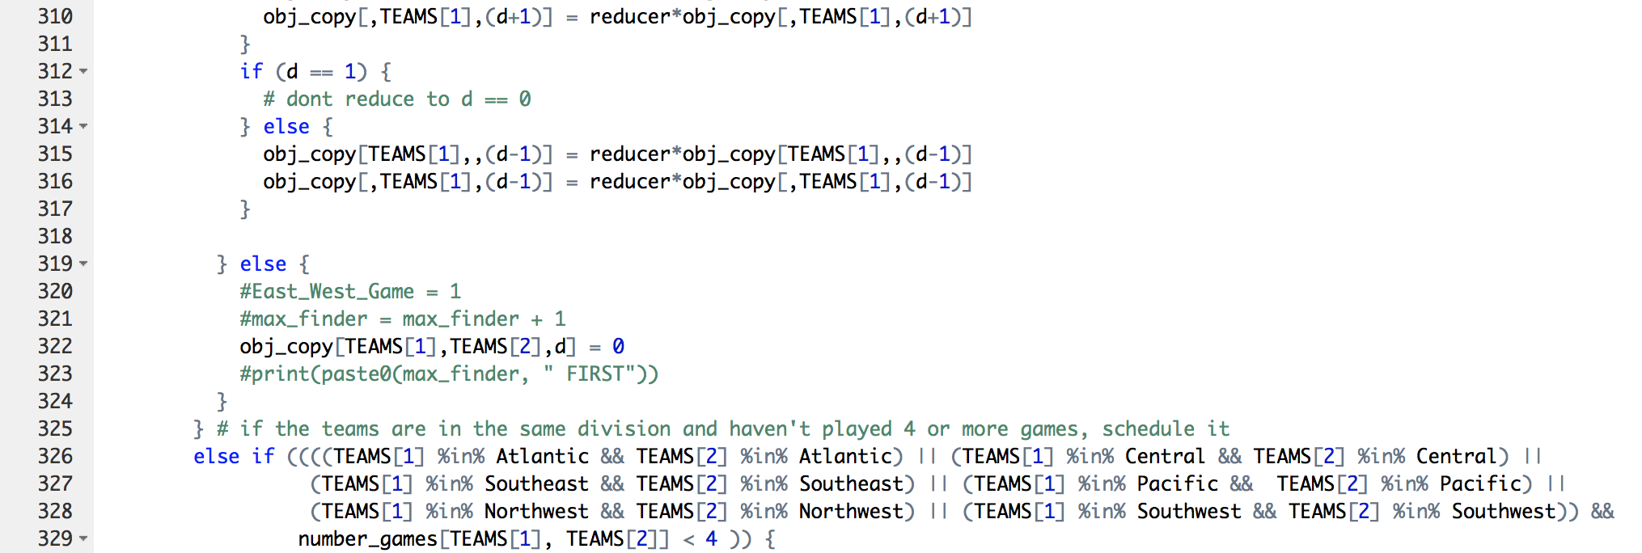
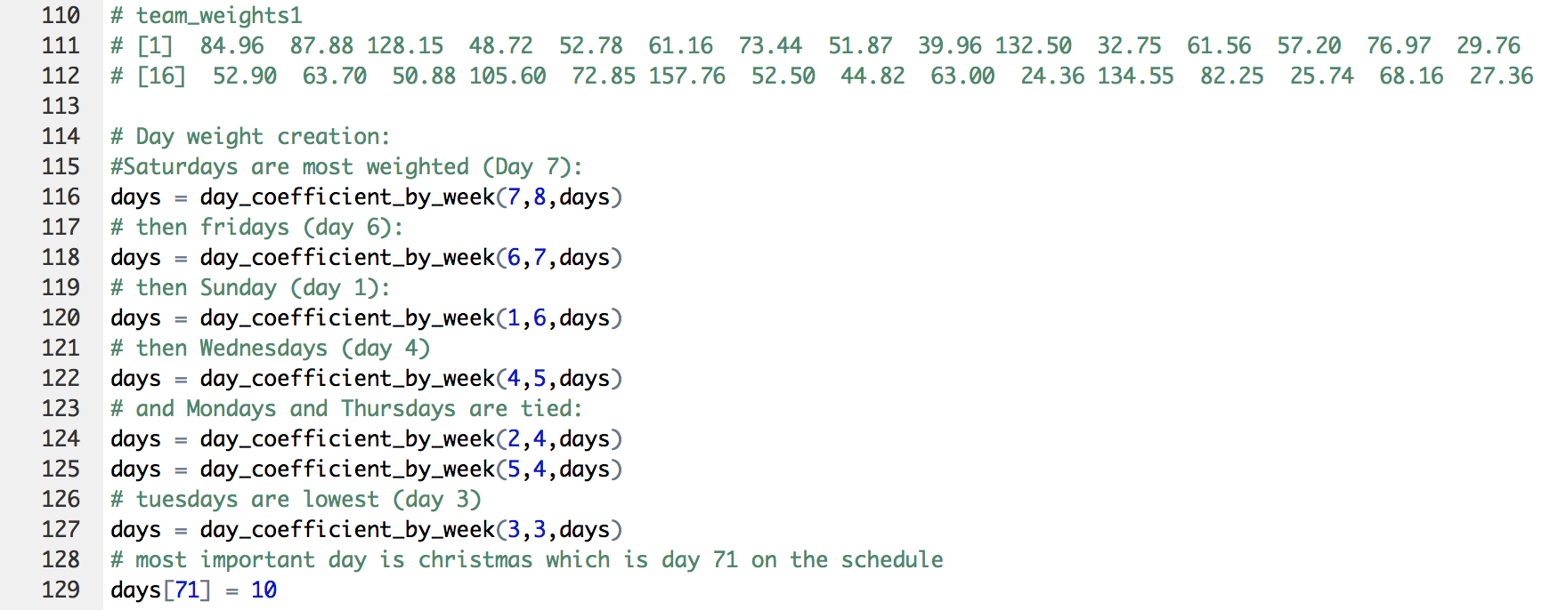
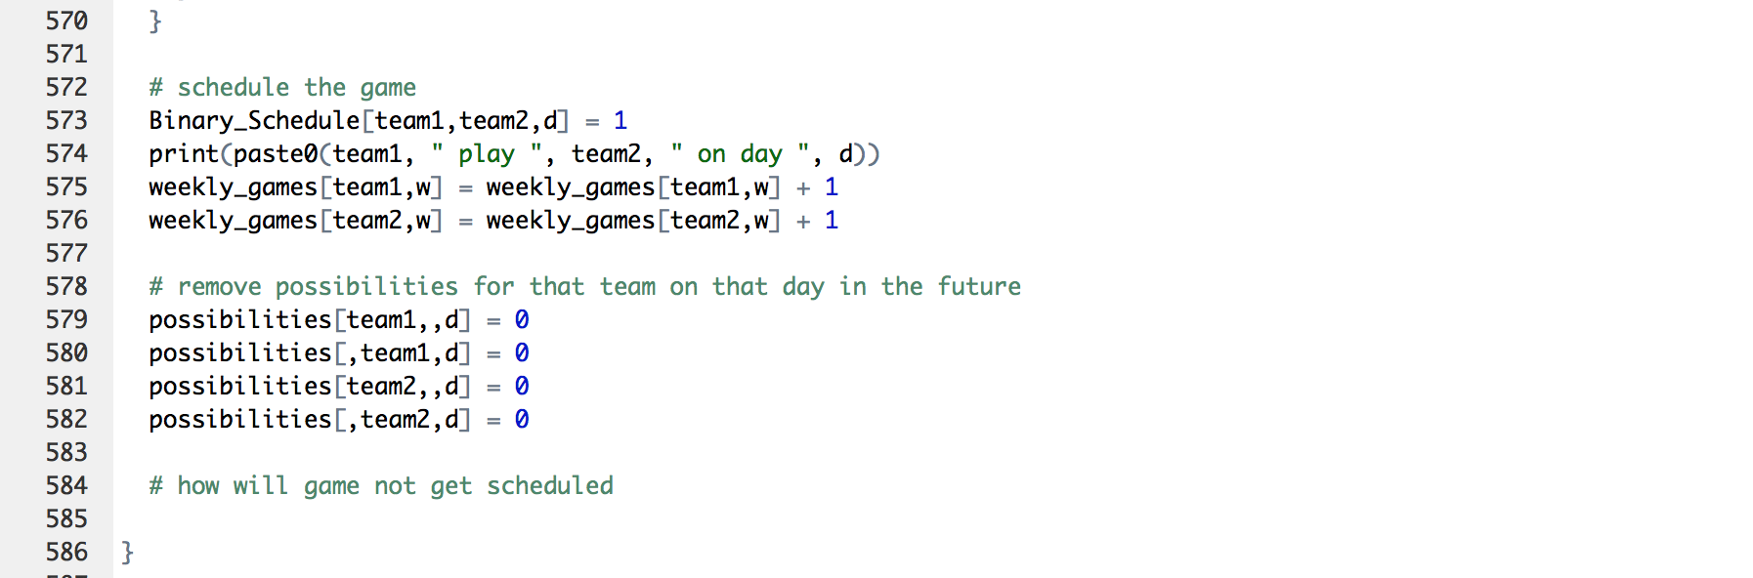
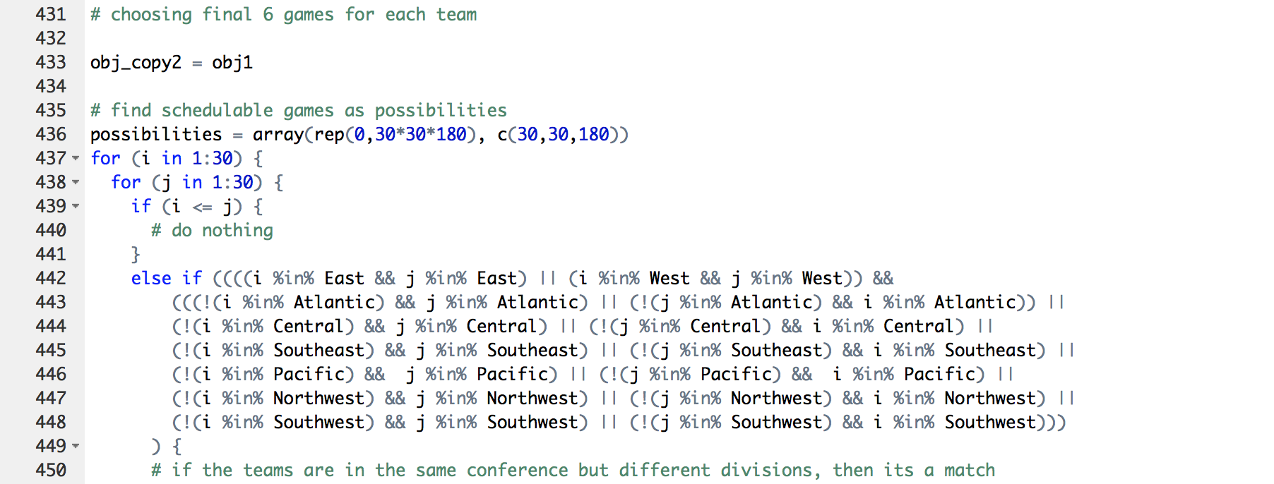
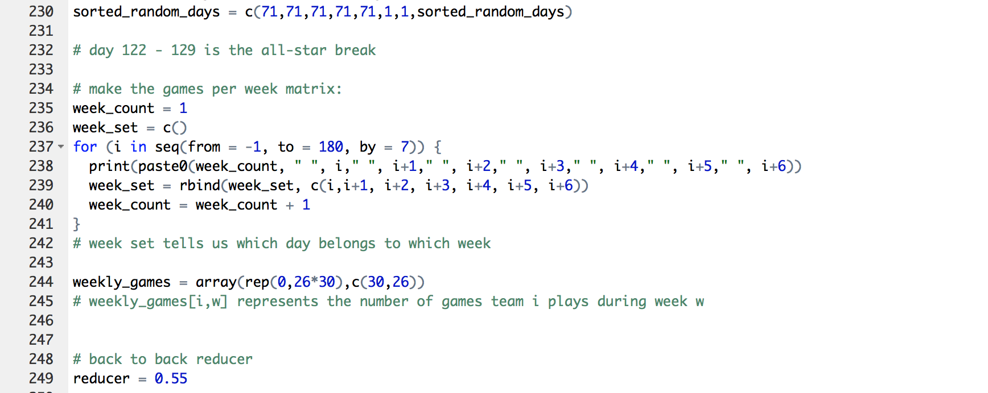
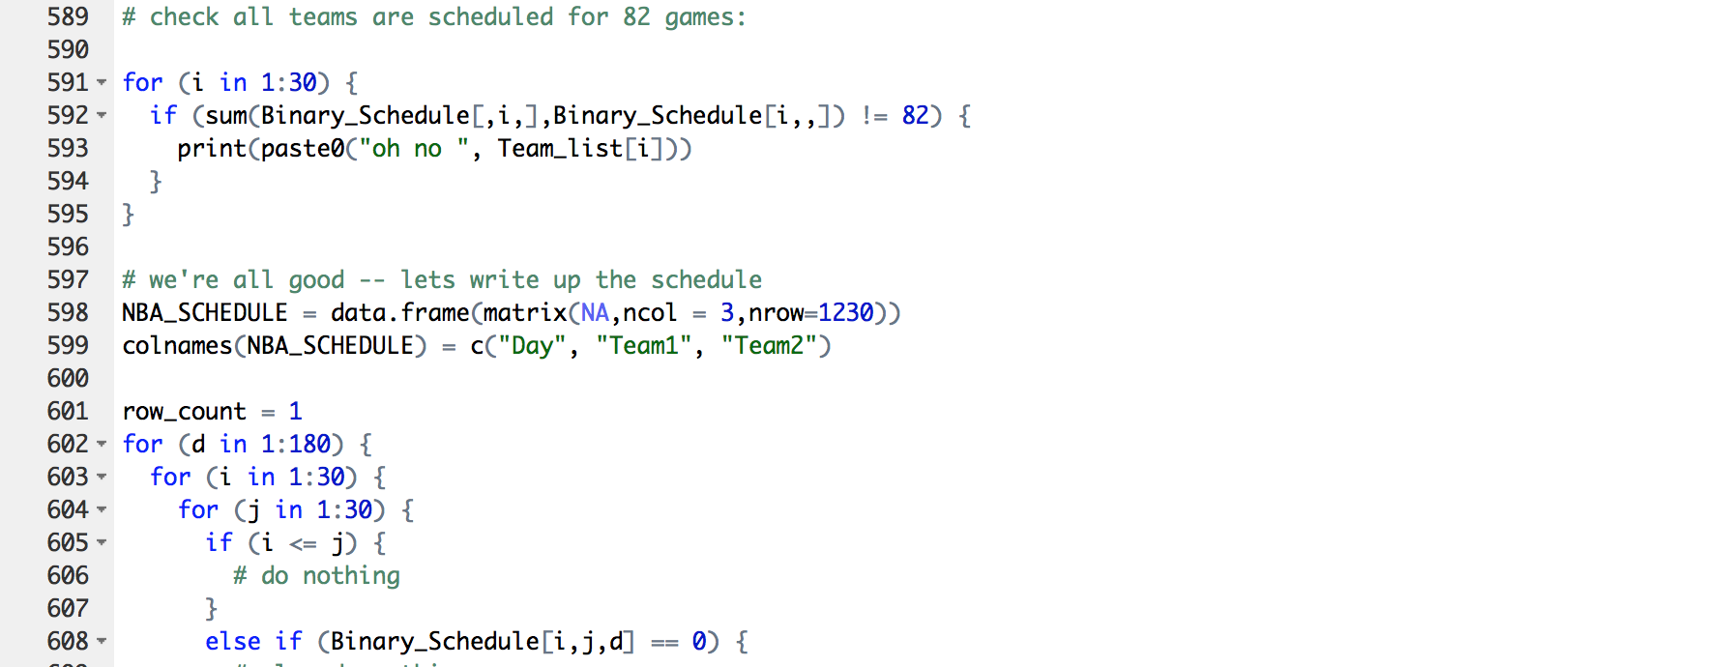
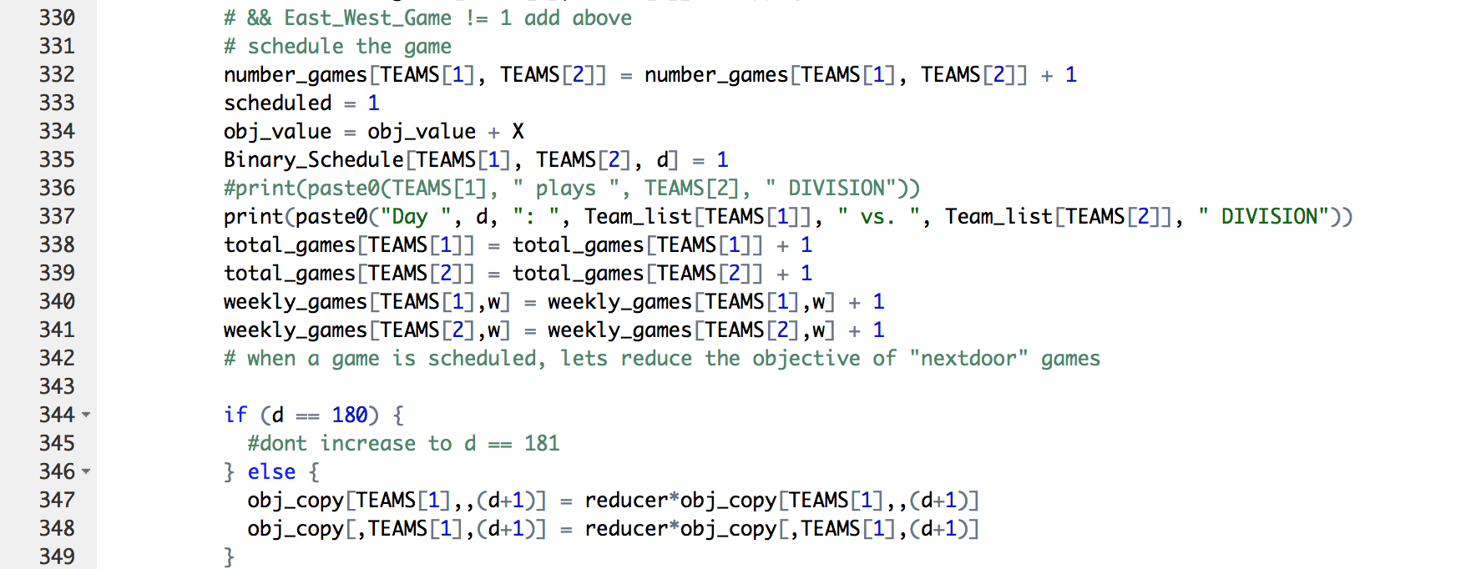
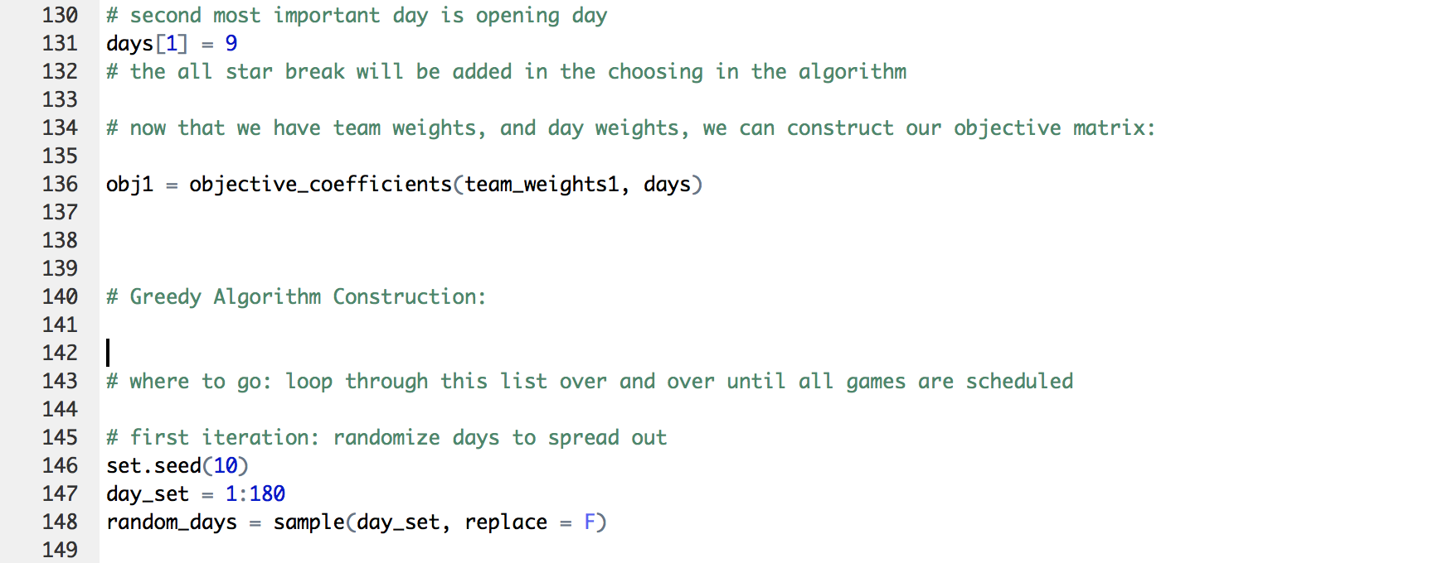
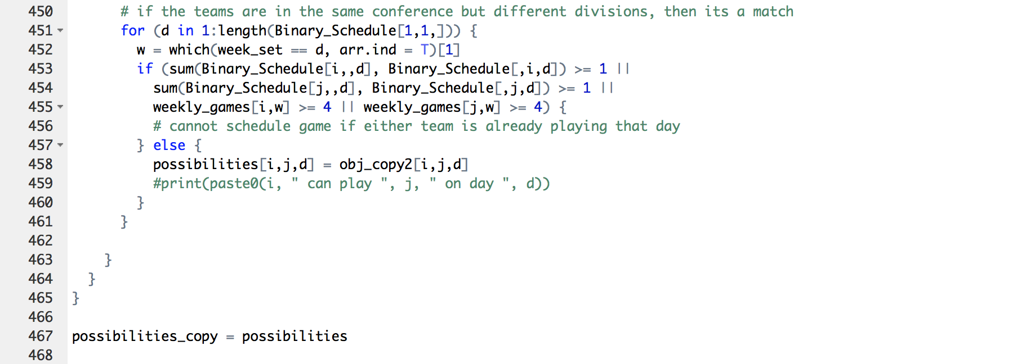
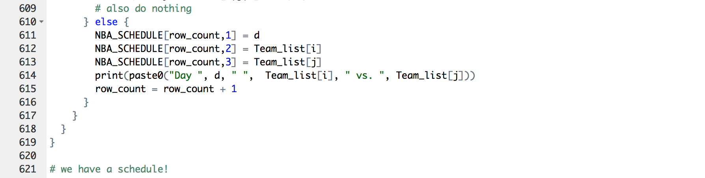
Notes:
MITCH

Slide 8





Interesting Finds:
Opening Day
Actual 2018-19 NBA Schedule vs. vs. | Our 2018-19 NBA Schedule vs. vs.
Notes:
MITCH

Slide 9

Interesting Finds:
Christmas Day
Actual 2018-19 NBA Schedule vs. vs. vs. | Our 2018-19 NBA Schedule vs. vs. vs.
Notes:
MITCH

Slide 10
Interesting Finds:
25
Exactly matched games

Slide 11
Evaluation
First Iteration Schedule
7% increased TV revenue over NBA
$180M “improvement”
However, on average 35 back-to-back games
Slightly less total travel distance as real schedule
New Schedule (B2B penalty)
5% increased TV revenue over NBA
$130M “improvement”
Reduction to average of 25 back-to-back games
Slightly less total travel distance as real schedule

Slide 12
Conclusion
Tradeoff between revenue and player comfortability
Difficulty balancing different objectives
NBA likely not optimizing for revenue
Optimizing for additional constraints such as rest, travel time or cost
Notes:
norm

Slide 13
Further exploration
Additional Inputs
Better Revenue Model
Broadcasting availability and constraints
Home and Away optimization
Methodology
Different or added objective (travel time, rest etc.)
Improved Heuristic
Notes:
norm

Slide 14
Q&A

