Slide 1
Craft Brewery Scheduling:
Minimizing Bottlenecks in Production Process
Donny Donnelly
Meghana Gudur
Luke Guo
Helen Lu

Slide 2
Executive Summary
Production scheduling for a microbrewery
Background
Craft breweries often lack sufficient human capital and resources to optimally plan production processes
Integer Program
Modeling bottlenecks as a mathematical problem, we aim to minimize production time when producing:
Three product types
Key Takeaways
Major bottleneck procedures that considerably slow down production include cleaning and changeover times
Heuristic Algorithms
On three sets of machines
Genetic Algorithms
Simulated Annealing
Simulated Annealing provides the best solution
Integer Program cannot be used for large scale production
Notes:
Meghana

Slide 3


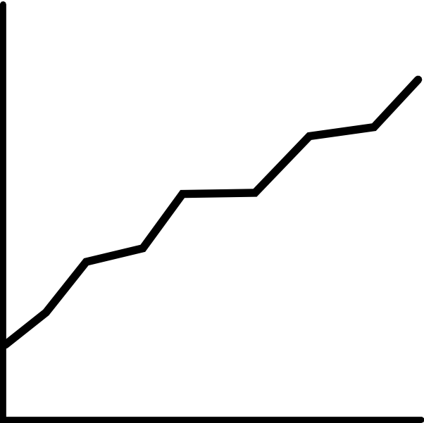

Problem Statement
Creating business impact from enhanced mathematical analysis
Problem: Microbreweries lack planning divisions and face many bottlenecks in production
Opportunity: Reduce time spent on transitioning between machines
Approach:
Overview:
Client: Small Microbrewery
Objective: Optimally use machines to minimize production time
Solution: Build sequence of production applying analytical and heuristic methods
Long-term Outcome: Focus more on profit-driving activities like fermentation rather than cleaning
Simplify Production Using Assumptions
Formulate into Integer Program
Apply Heuristic Algorithms
Implement Findings
Notes:
Meghana

Slide 4
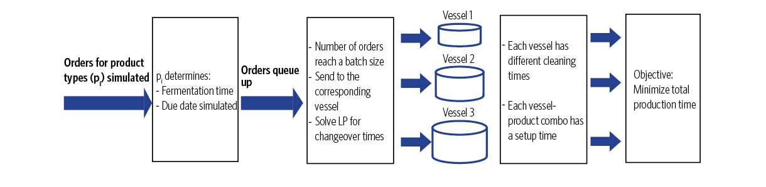
Beer-making Process
Breaking down the problem
Brewing production depends on:
Visualizing decision making points
Fermentation time | A product-specific time needed for yeast to act on brew
Setting up time | A vessel- and product-specific time to get ingredients and transport product on vessels required before every batch
Cleaning time | A vessel-specific time for cleaning required before every batch
Changeover time | A non-variable time that only occurs on a vessel if it is switching to produce a brew different than its last batch
Notes:
Helen
Beer production follows job shop scheduling
Orders arrive for three beer products
Orders accumulate to reach a batch size
Limited capacity of fermentation vessels
Vessels cleaned after each batch

Slide 5
IP Formulation
Formulating the beer production process as an integer program
Variable | Description
T_{p} | Fermentation time of each product
T_{setup} | Setting up time
T_{clean} | Cleaning time
T_{change} | Changeover time
T_{due} | Due date for each product
i | Number of products
j | Number of vessels
x_{ij} | Number of occurrences of operation
c_{ij} | Binary: 1, if i is working on vessel j; 0, otherwise
v_{j} | Capacity of vessel j
n₁ | Number of processing times for product to be produced as same as previously finished batch
n₂ | Number of processing times for product to be produced as different as previously finished batch
m₁ | Number of times product to be produced as same as previously finished batch
m₂ | Number of times of product to be produced as different as previously finished batch
N_{i} | Demand for each product
Notes:
Helen

Slide 6
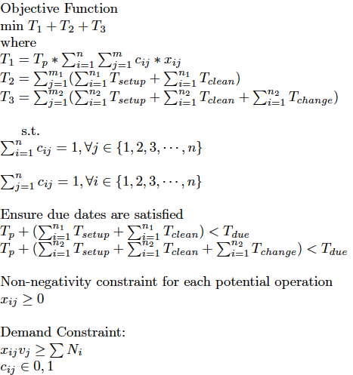
IP Formulation
Formulating the beer production process as an integer program
Fermentation times
Setting up and cleaning times
Setting up and cleaning and change over times
Each vessel produces one batch of one product at a time
Non-changeover scenarios
Particular for changeover scenarios
Notes:
Helen

Slide 7
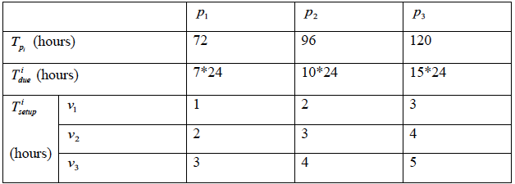
IP Formulation Assumptions
Forming assumptions to simplify data
Fermentation times
Due dates assumed from demand
Notes:
Donny
In this case, it is assumed that fermentation time will take 72, 90, and
120 hours respectively; the setting up time is determined by different product types
having different setting up time; the cleaning time of 1v , 2 v , and 3v will take 2, 3 and 5
hours respectively; the changeover time may occur when the next batch production is
changed to the differing vessels for production, it will be 5 hours delay. In addition, the
due date of products is 7, 10, and 15 days, respectively, based on customer demand.

Slide 8
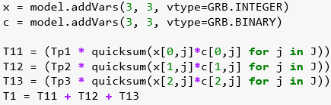
IP Findings
Contextualizing our outputted solutions to draw intermediate conclusions
Production times for each product
Whether or not the next batch production will be changed to another vessel is dependent on not only demand and capacity but also time
  Time subscripts will have to be implemented in order to see when changeover is needed
Subscripting x and c with time k would make the IP NP-Hard
Notes:
Donny
I think decision variables are cij, m1, m2, n1, and n2
Get numbers for Ni from appendix and vj from assumptions

Slide 9
Heuristics
Understanding genetic algorithm and simulated annealing
Model Assumptions
Product orders form batches
Batches are produced when size reaches the capacity of its assigned vessel and when that vessel is idle
Surplus of a batch is added to the next batch of orders
Producing a product on a different vessel leads to changeover time
Formulation of Schedule
The schedule for a product is a sequence of 100 numbers, one vessel assignment for each day such that no product shares the same vessel on the same day
Genetic Algorithm
Generate an initial population
Select parents from the population
Use crossovers and mutations to generate new individuals
Repeat
Simulated Annealing
Create a random schedule from current one
If better, accept. If not, accept with a probability dependent on temperature
Decrease temperature and repeat

Slide 10
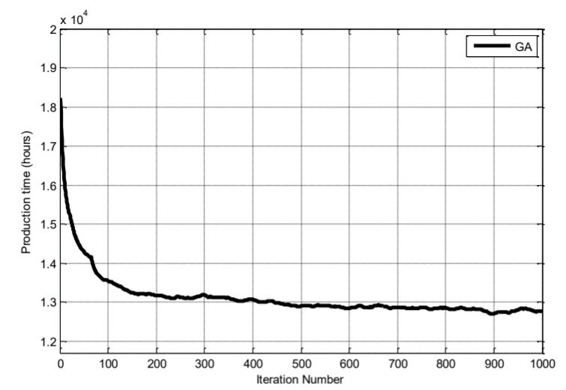
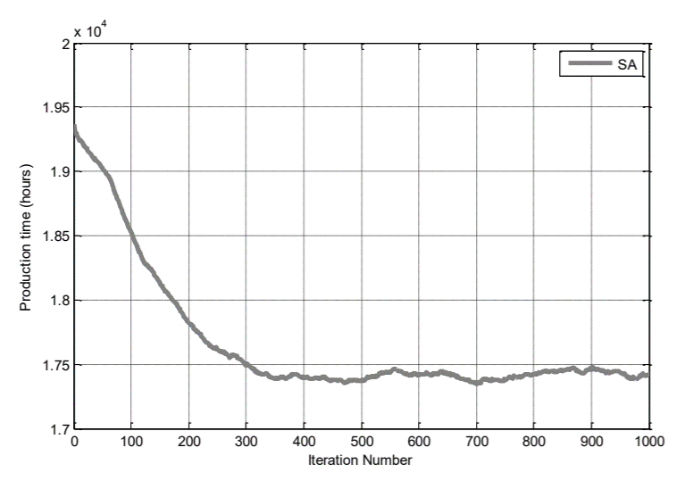
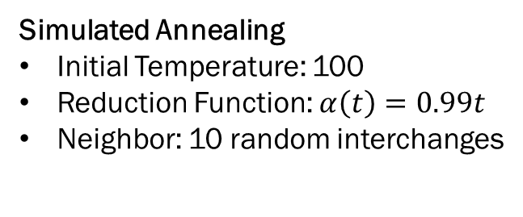
Heuristics
Understanding genetic algorithm and simulated annealing
Genetic Algorithm
Crossover Probability: 0.8
Mutation Probability: 0.2
Generation Gap: 0.9
Population Size: 20
Simulated Annealing
Initial Temperature: 100
Reduction Function: $α\left(t\right)=0.99t$
Neighbor: 10 random interchanges
Results
Compared to a non optimized schedule, ~35% decrease in total production time for genetic algorithms and ~16% for simulated annealing

Slide 11
Key Takeaways
Moving forward with next steps for discovery
Integer Program
Provides us with a concise analytical model of constraints
However, it does not provide us with a realistic sequence of batch production for larger scale problems
Heuristic Algorithms
Genetic Algorithm provides us with the shortest processing time
Simulated Annealing improves upon non-optimized times
Future Steps
Implement a hybrid of the Genetic Algorithm and Simulated Annealing
Scale up our optimal heuristic for larger production processes
Compared to a non optimized schedule, ~35% decrease in total production time for genetic algorithms and ~16% for simulated annealing
Notes:
Luke

