Slide 1

GATORADE
MX Production
Ana, Chloe, Shivani, Izzet

Slide 2

BACKGROUND
Notes:
First we will go into some background information about the Gatorade Mexico plant and assembly process.

Slide 3
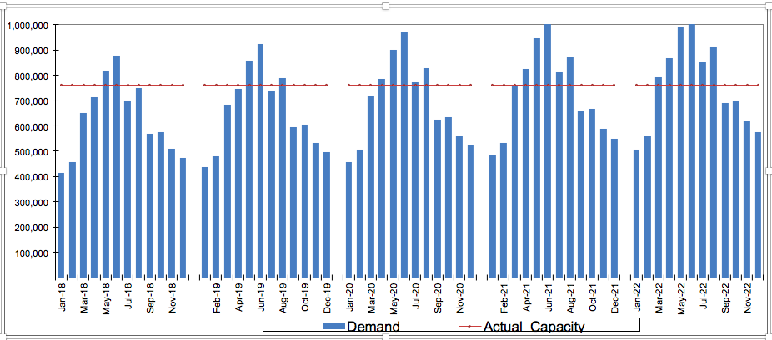
DEMAND & CAPACITY
- The demand for gatorade has a cyclical pattern with Overall YoY growth of 5%
- In 2019, demand starts to exceed capacity by May
- By 2022, the capacity issue becomes more pronounced
Notes:
In this project, we will analyze the production for Gatorade in Mexico. The overarching goal is to improve the efficiency of current operations in order to meet periods of peak demand, specifically May. As is represented in the figure below, the demand for Gatorade has a cyclical pattern with an overall YoY growth of 5%. The red lines represent the capacity of the warehouse. In 2019, we see that demand starts to exceed capacity starting in May and that by 2022, the capacity issue becomes more pronounced.
We hence will explore 4 potential solutions and report our recommendations based on economic trade-offs associated with each.

Slide 4
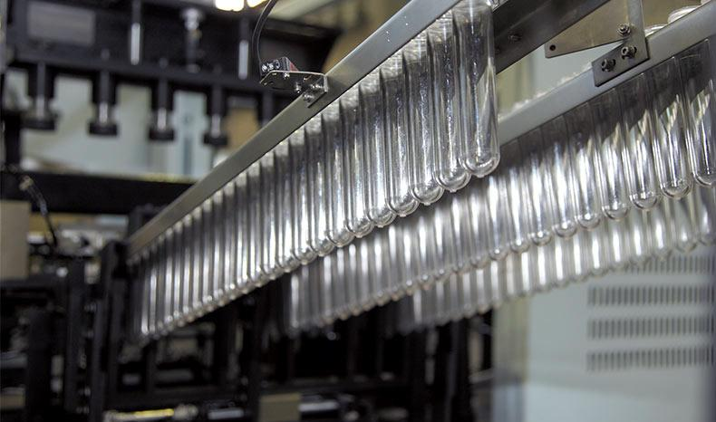
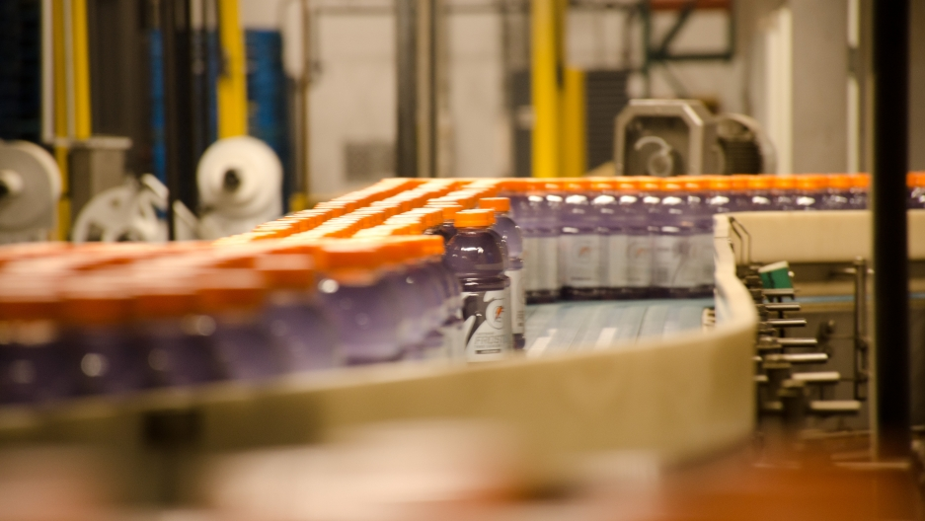
MANUFACTURING PROCESS
Two Stage process that uses an assembly line with 2 machines.
  Machine 1: takes care of building the bottle
  Machine 2: fills different flavors
For our analysis, we consider the entire assembly line to be 1 machine
  Production Times are calculated based on the bottleneck
Notes:
Gatorade’s production process is a two stage process that comprises an assembly line of two machines.The first, is the blowing machine, which takes care of building the PET bottle and the later one is the filling machine, where the different flavors get filled. We consider the assembly line as a whole to be a machine for the purposes of this project.

Slide 5
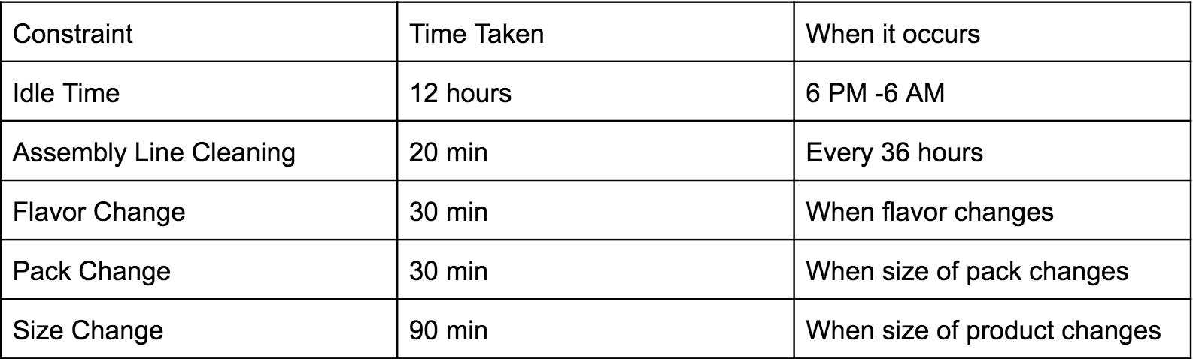
PRODUCTION CONSTRAINTS
Notes:
The production constraints are summarized in the table on this slide.For all products, the size of the pack produced is configured at the start of the process which has a time cost. Thus, we must take this time into account when switching jobs. There is also a time cost associated with producing different flavors. If there is a switching of jobs that changes flavors and sizes, the time cost is the maximum of these costs as these configurations can happen simultaneously.
There is also a production time constraint. For each day, production can only happen between the hours of 6 AM and 6 PM. In essence production can occur for maximum 12 hours a day. However, cleaning and product changes can occur at any time. Cleaning of the assembly line occurs every 36 hours and requires 20 minutes.

Slide 6
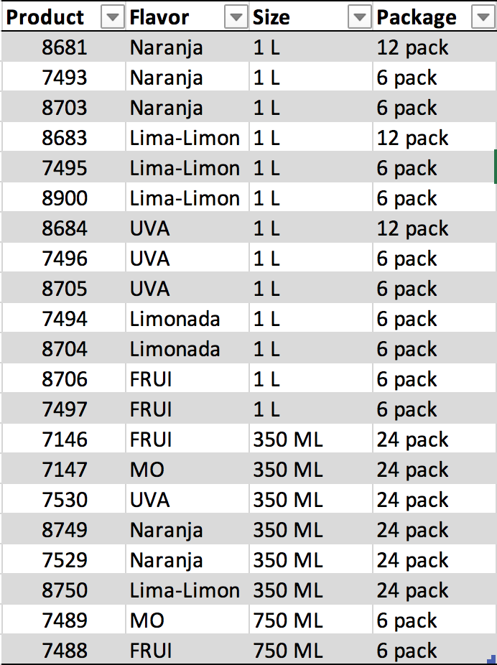
PRODUCTS
Notes:
For the type of assembly line that we are focusing on, we will be analyzing demand for the following products

Slide 7
ANALYSIS

Slide 8
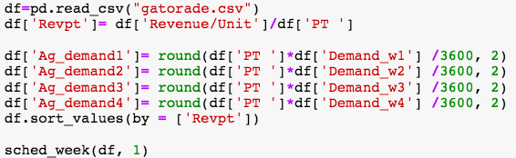
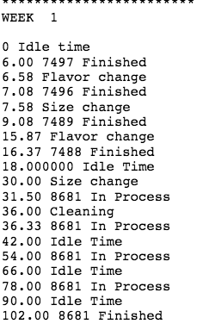
BASE CASE
Given our current production constraints, we cannot meet demand for all products in May
In order to maximize revenue, given constraints, we use a revenue per processing time heuristic
Notes:
We are given data on demand for the 4 weeks of May. We know that given our current production constraints we will not be able to meet demand for all the products. In order to maximize revenue given these constraints we used a revenue per processing time heuristic. In other words, we processed jobs on the assembly line in decreasing order of revenue/processing time. In reality, each package is its own job. However, we aggregate the demand for each product to simplify the scheduling process. This is shown on the table on the next slide:

Slide 9
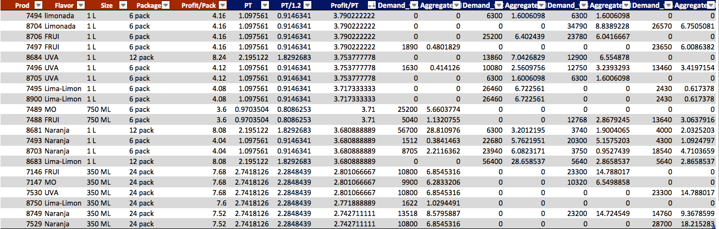
DATA
Notes:
The revenue/package is given for each product from the Mexico factory. The processing times were calculated from velocities given for each job on the assembly line. These velocities represent the velocity of the product on the slower of the 2 machines in the assembly line.

Slide 10
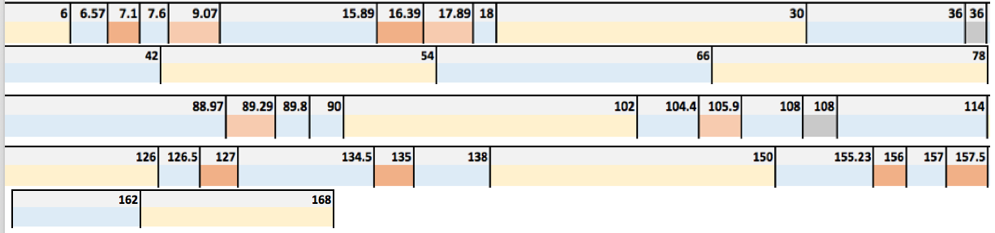
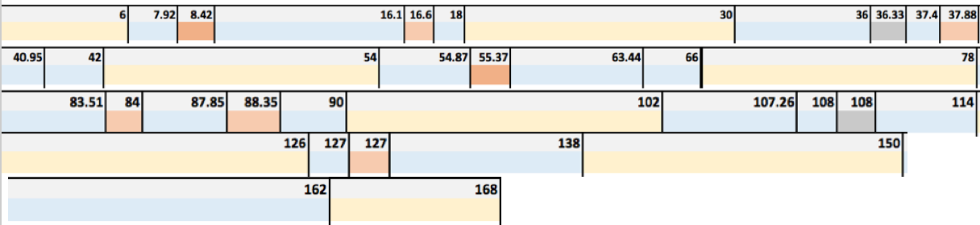
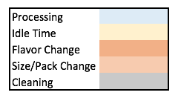
GANTT CHARTS
Week 1
Week 2
Notes:
Using this the revenue per processing time heuristic, we created a schedule for each of the four weeks of May as shown in the Gantt Charts.As can be seen on the gantt chart, every week we operate at full capacity for the week given our constraints (there are 168 total hours in a week). This results in lost revenue as the demand for all products each week in May is not met. The lost revenues for each week are summarized in the table on the next slide.

Slide 11
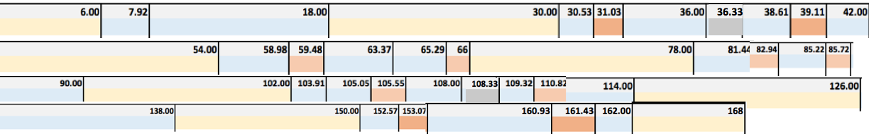
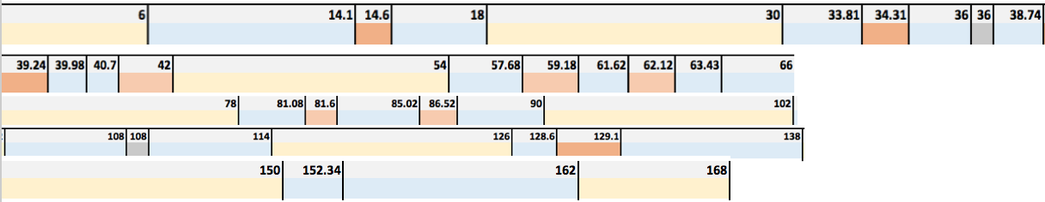
GANTT CHARTS
Week 3
Week 4

Slide 12
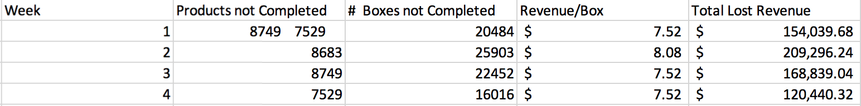
LOST REVENUE
$652,615
The total lost revenue for the month of May is:
Notes:
The total lost revenue for the month of May is $652,615 which is a substantial amount and considering the fact that demand is expected to grow in the future, we will evaluate several options to mitigate this lost revenue.

Slide 13
20% INCREASE IN VELOCITY
Assembly line consists of 2 machines where one machine is slower than the other
By upgrading this machine, the velocity of each job would be 20% higher and processing times would be 20% less
Cost of upgrade = $4 Million
Notes:
As was previously mentioned, the assembly line consists of 2 machines and one machine is significantly slower than the other. By upgrading this machine, the velocities of each job would be 20% higher and processing times would therefore be 20% less. Upgrading this machine would have a cost of $4 million. Using the same heuristic as before, we scheduled the 4 weeks of May.

Slide 14
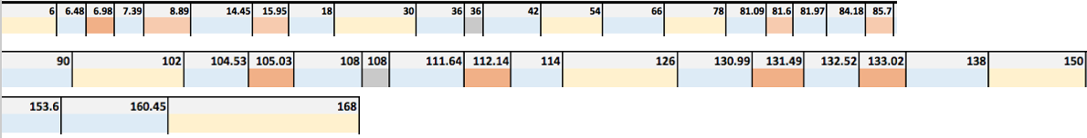
GANTT CHARTS
Week 1
Week 2

Slide 15
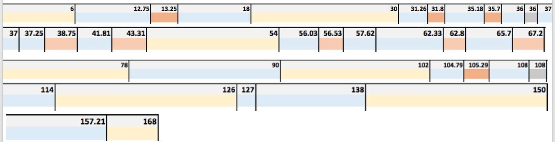
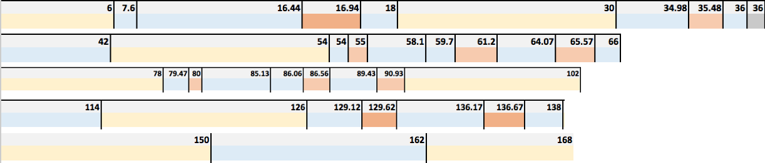
GANTT CHARTS
Week 3
Week 4

Slide 16
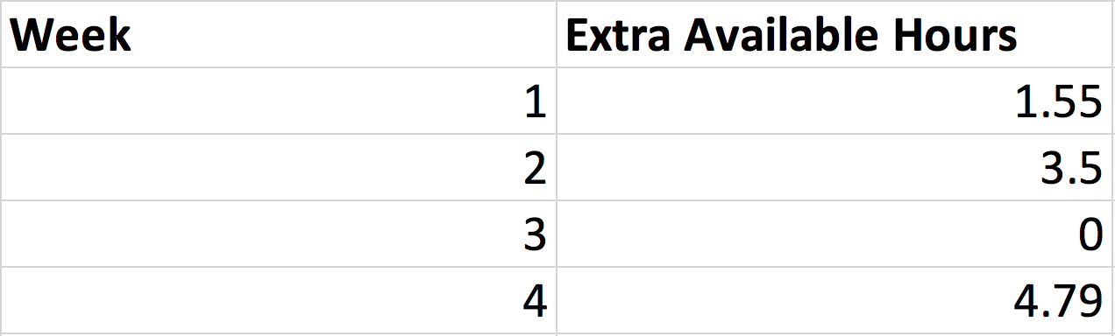
EXTRA HOURS
Notes:
As seen on the gantt charts for the four weeks of May with shorter processing times, for weeks 1,2, and 4, we finish all jobs before the last idle period (6 PM -12 PM) or hour 162 on the last day. We hence have the following extra hours available each week as seen on the slide. Week 3 is the only week in which we are still not able to meet demand and now has a lost revenue of $16,475 compared to $168,839. Hence the total net benefit for the month of May is $636,140. Since there are extra available hours, if we increase the speed of the assembly line, other products currently being produced in other locations could potentially be also produced in this factory if it makes financial sense taking into account transportation costs. This could increase the benefit by more than just the reduction of lost revenue.

Slide 17
2 ASSEMBLY LINES
We can consider the possibility of adding another assembly line
This is like adding another machine
We use a variation of the longest processing time heuristic
We do not split up production of units of a certain product between the 2 assembly lines to minimize the costs of changing jobs
Cost of Machine = $12 Million
Notes:
We next considered the possibility of adding another assembly line which in essence is like adding another machine as we consider each assembly line to be a machine. Because we know that with 2 machines we will definitely be able to meet demand for each week, we used a variation of the longest processing time heuristic that is usually considered close to optimal for the NP hard P||Cmax problem. However, for the most part we do not split up production of units of a certain product between the 2 assembly lines to minimize the costs associated with changing jobs. The cost for adding this machine is $12 million.

Slide 18
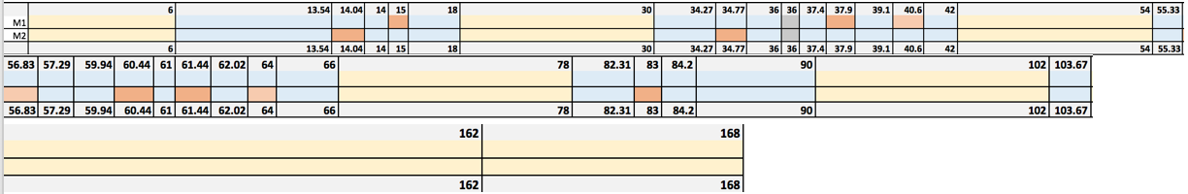
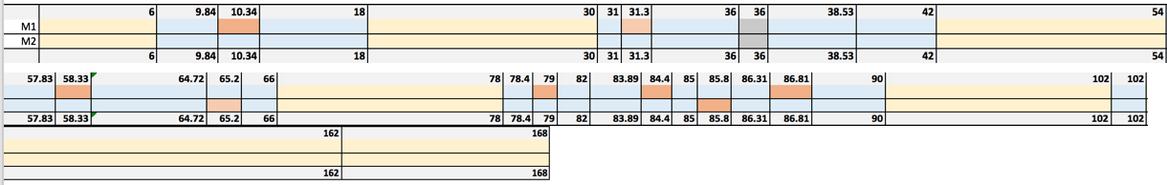
GANTT CHARTS
Week 1
Notes:
For each week it is clear that we finish production for all the demanded jobs way in advance. All the lost revenue would be recovered if we added a machine line but we would need to take into account that installation would take a year. If we had an extra machine, there would be a large amount of excess capacity so further analysis would need to be done to see how we could utilize that perhaps with production from other factory locations.

Slide 19
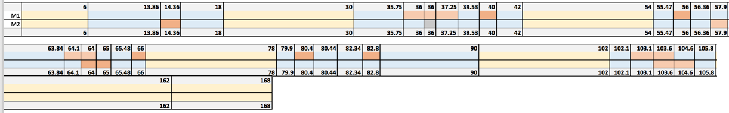
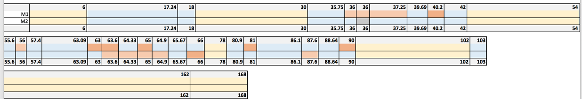
GANTT CHARTS
Week 3

Slide 20
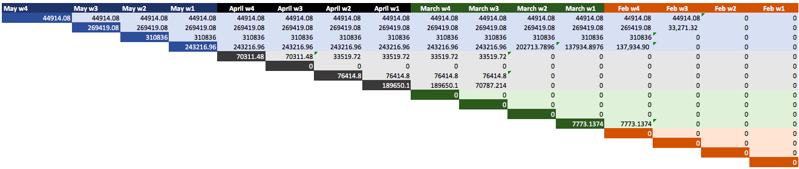
UNSATISFIED DEMAND / WEEK
Profit/Unit = 0.5871
Holding Cost/Unit = 0.1427

Slide 21
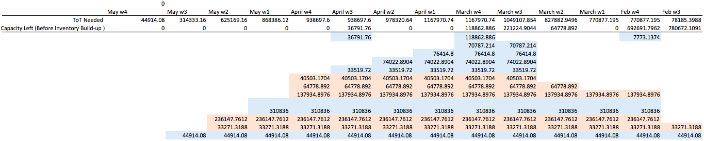
FEASIBLE SCHEDULE

Slide 22
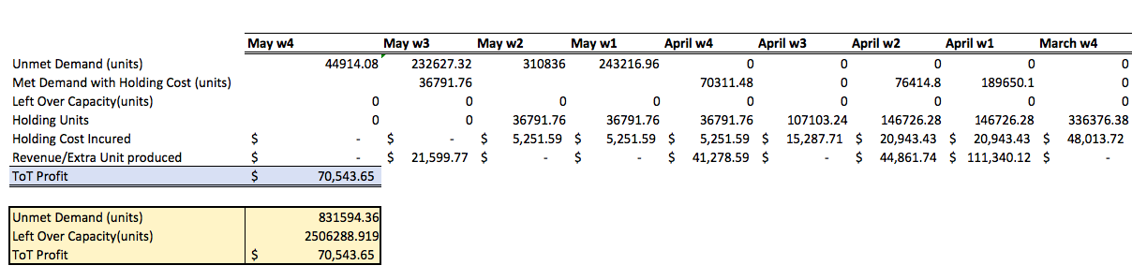
INVENTORY BUILD-UP
HOLDING COST BREAKEVEN
Weeks =Profit/Unit
Holding Cost
~ 4 weeks
$70,543.65

Slide 23
FINANCIAL ANALYSIS

Slide 24
UPGRADE MACHINE (+%20 Vel)
Results in $636,140 net revenue in month of May
Assuming that there are 2 months per year where we have a capacity issue, we gain around $1,272,280/year
At a cost of $4 million to upgrade the machine, we breakeven in ~3 years
This is a conservative estimate as demand is growing and we anticipate more months to produce above current capacity by 2020

Slide 25
+ASSEMBLY LINE
With a second assembly line we fulfill all of May’s demand so we gain $652,615 in revenue
Assuming that there are 2 months per year where we have a capacity issue, we gain around 1,300,000 per year
At a cost of $12 million to add an assembly line this would require 9.2 + 1 year of installation to break even
To bring down the break-even time, production from other factories could be completed on the new assembly line but this may have added costs

Slide 26
CONCLUSION
- In the short term, Inventory build-up is the favorable strategy
- In the long run, upgrading the machine makes sense as we gain more revenue per year
- Demand is growing so the breakeven point will likely be less than 3 years

